Slide 1
All in the Family
An Example How DNA Can Assist You in Verifying Your Ancestry

Slide 2
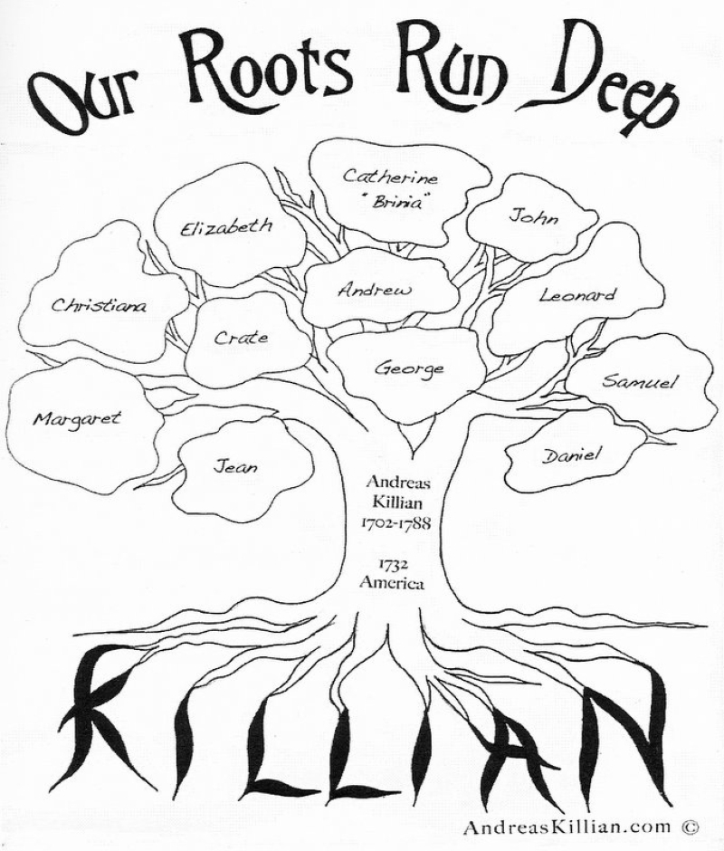
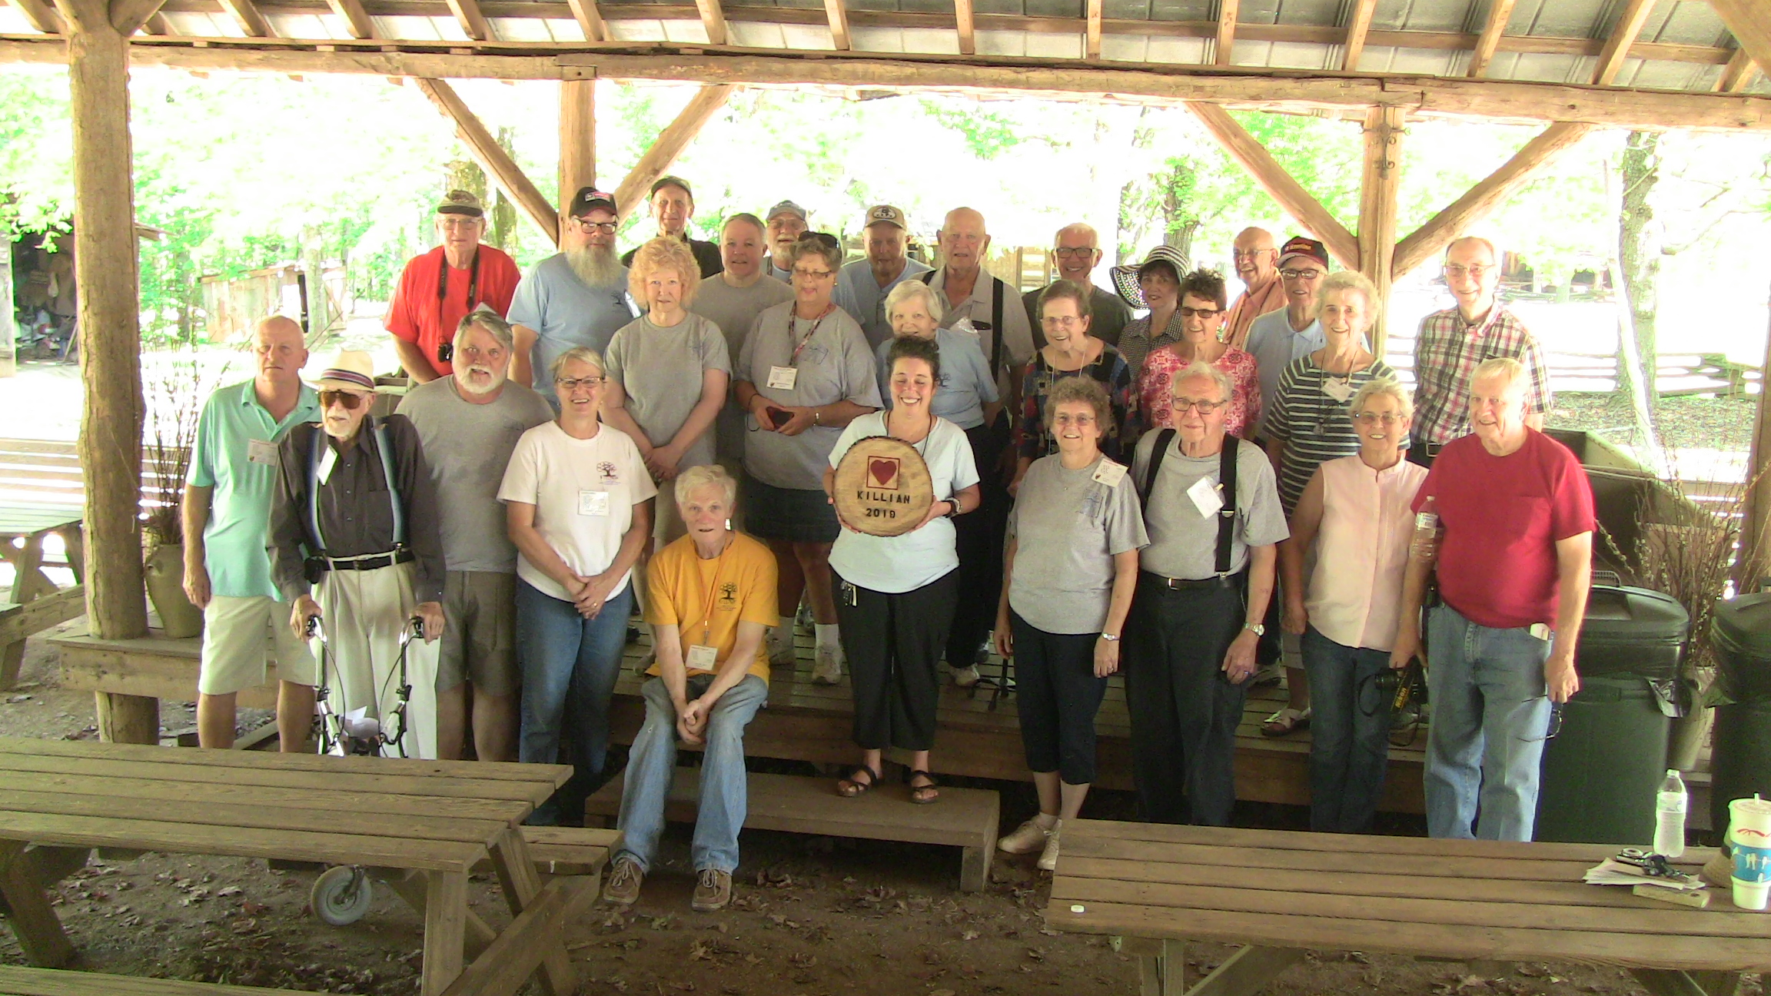
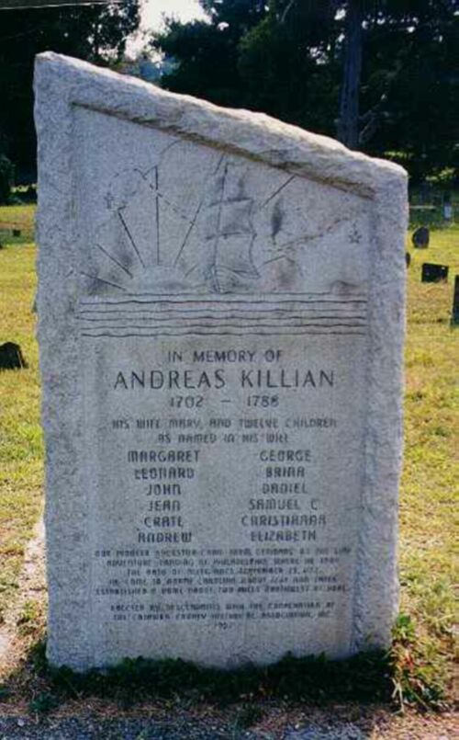
(AKDHA) Andreas Killian Descendants Historical Association

Slide 3
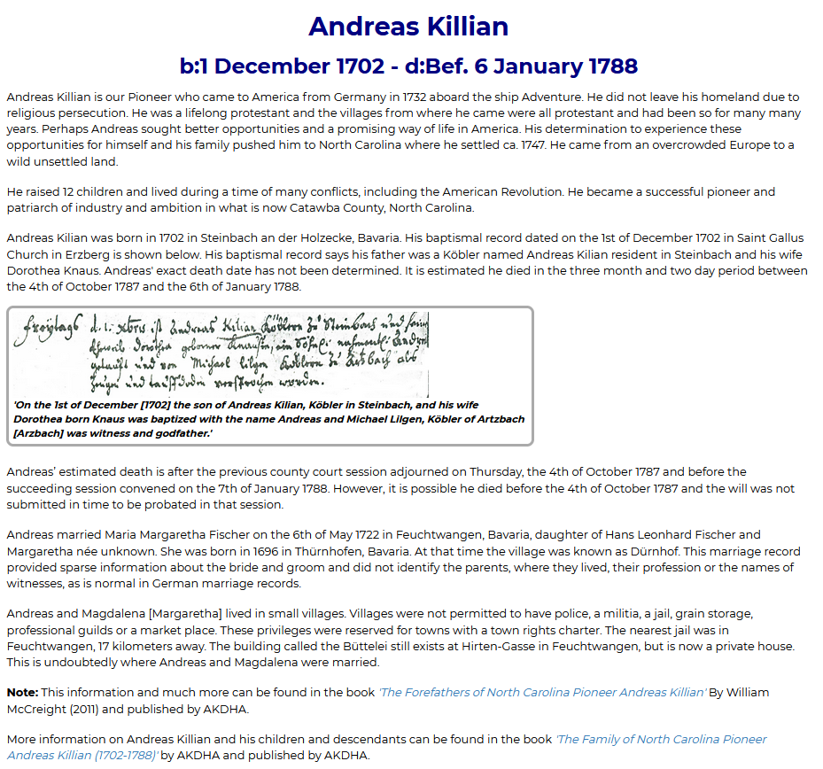
Pioneer to America
Andreas (Andrew) Killian Sr
Born About 1 December 1702
Steinbach, Germany

Slide 4
Pioneer to America
Andreas (Andrew) Killian Sr
Born About 1 December 1702
Steinbach, Germany
Married 6 May 1722
Feuchtwangen
Bavaria, Germany
Maria Margaretha Fischer
Born in Germany
Died in Germany
Before Andreas Came to America

Slide 5
Pioneer to America
Andreas (Andrew) Killian Sr
Born About 1 December 1702
Steinbach, Germany
Married 6 May 1722
Feuchtwangen
Bavaria, Germany
Maria Margaretha Fischer
Born in Germany
Died in Germany
Before Andreas Came to America
Immigrated 1732
North Hampton, PA

Slide 6
Pioneer to America
Andreas (Andrew) Killian Sr
Born About 1 December 1702
Steinbach, Germany
Married 6 May 1722
Feuchtwangen
Bavaria, Germany
Maria Margaretha Fischer
Born in Germany
Died in Germany
Before Andreas Came to America
Immigrated 1732
North Hampton, PA
Received Land Grant and Settled
Around 1747 Killian’s Creek
Today Catawba County, NC

Slide 7
Pioneer to America
Andreas (Andrew) Killian Sr
Born About 1 December 1702
Steinbach, Germany
Married 6 May 1722
Feuchtwangen
Bavaria, Germany
Maria Margaretha Fischer
Born in Germany
Died in Germany
Before Andreas Came to America
Immigrated 1732
North Hampton, PA
Received Land Grant and Settled
Around 1747 Killian’s Creek
Today Catawba County, NC
Died Before 6 January 1788
Near Newton Township
Catawba County, NC

Slide 8
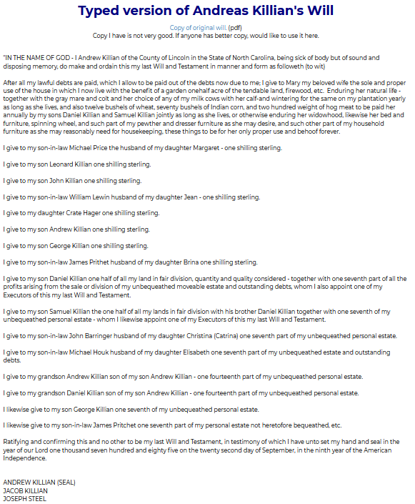
Andreas (Andrew) Killian Sr’s Will
2 September 1785
Lincoln County, NC

Slide 9
Andreas (Andrew) Killian Sr’s Will
2 September 1785
Lincoln County, NC
Our John Killian
Son of Andreas Killian

Slide 10
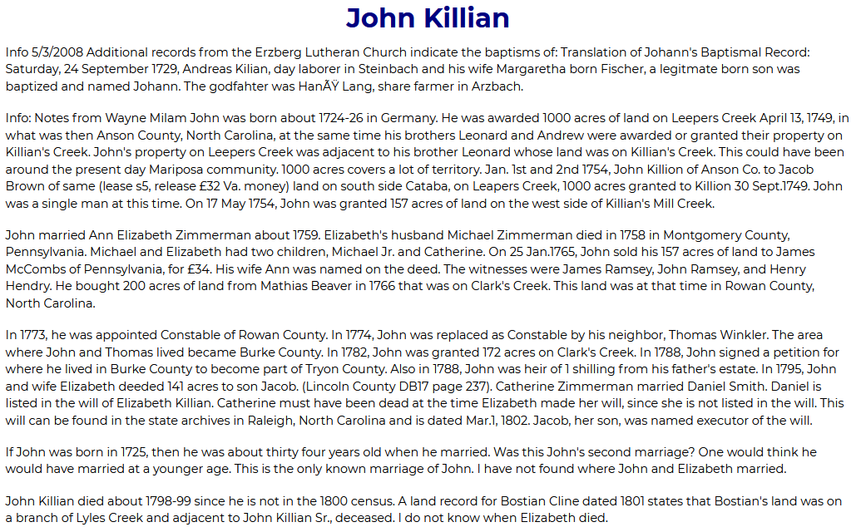
John Killian
Born Between 1724 and 1726 Germany

Slide 11
John Killian
Born Between 1724 and 1726 Germany
Married
About 1759
Montgomery County, PA
Anna Elizabeth Zimmerman (Carpenter)
Born in Pennsylvania
Both Died in North Carolina

Slide 12
Jacob Killian
Born 8 Apr 1760
Lincoln County, NC
Our Jacob Killian
Son of John Killian
Son of Andreas Killian

Slide 13
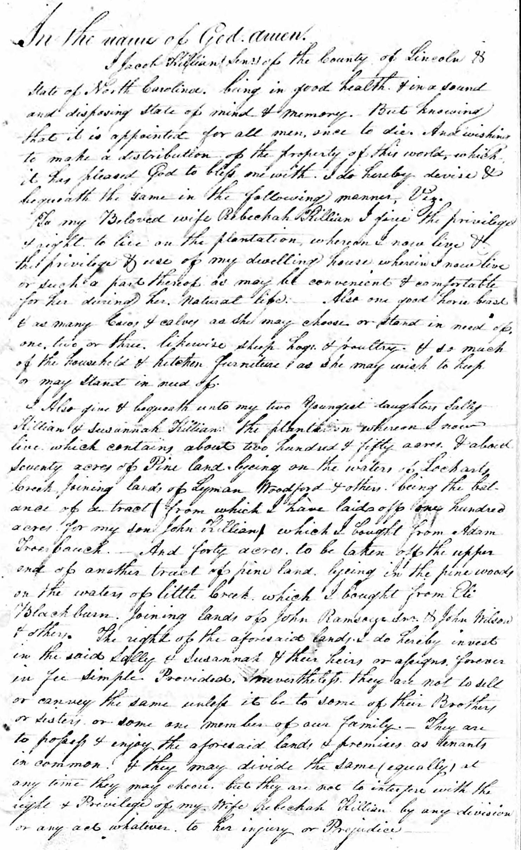
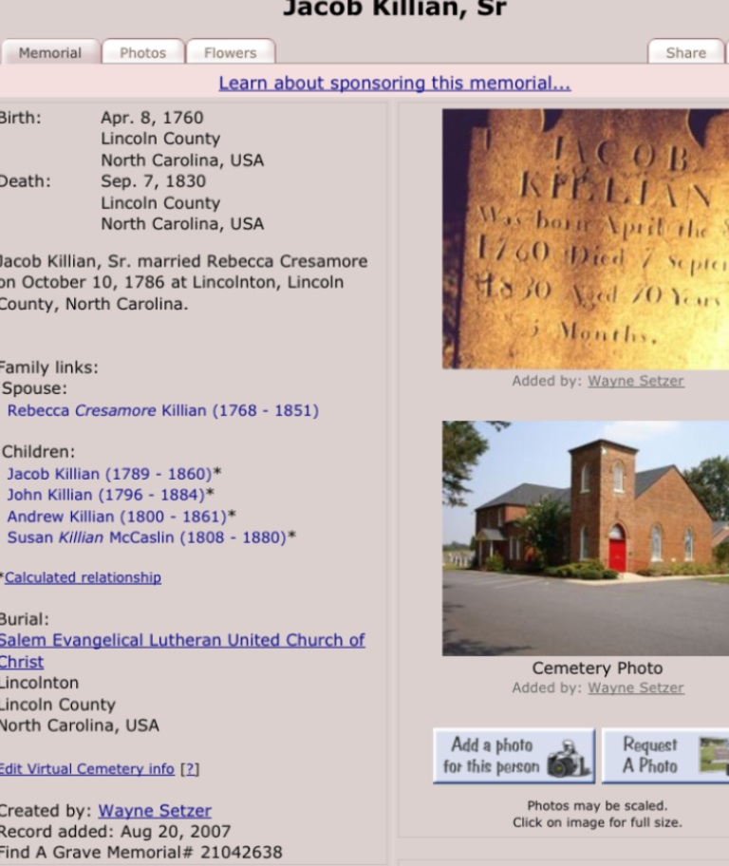
Jacob Killian
Born 8 Apr 1760
Lincoln County, NC
Our Jacob Killian
Son of John Killian
Son of Andreas Killian

Slide 14
Jacob Killian
Born 8 Apr 1760
Lincoln County, NC
Died 7 September 1830
Lincoln County, NC
Married
10 October 1786
Rebecca Cresamore
Born 10 October 1768
Died 26 July 1851
Lincoln County, NC
Buried
Salem Evangelical Lutheran United Church of Christ
Lincoln County, NC

Slide 15
John Wesley Killian
Born 23 June 1796
Salem, Forsyth County, NC
Our John
Son of Jacob Killian
Son of John Killian
Son of Andreas Killian

Slide 16
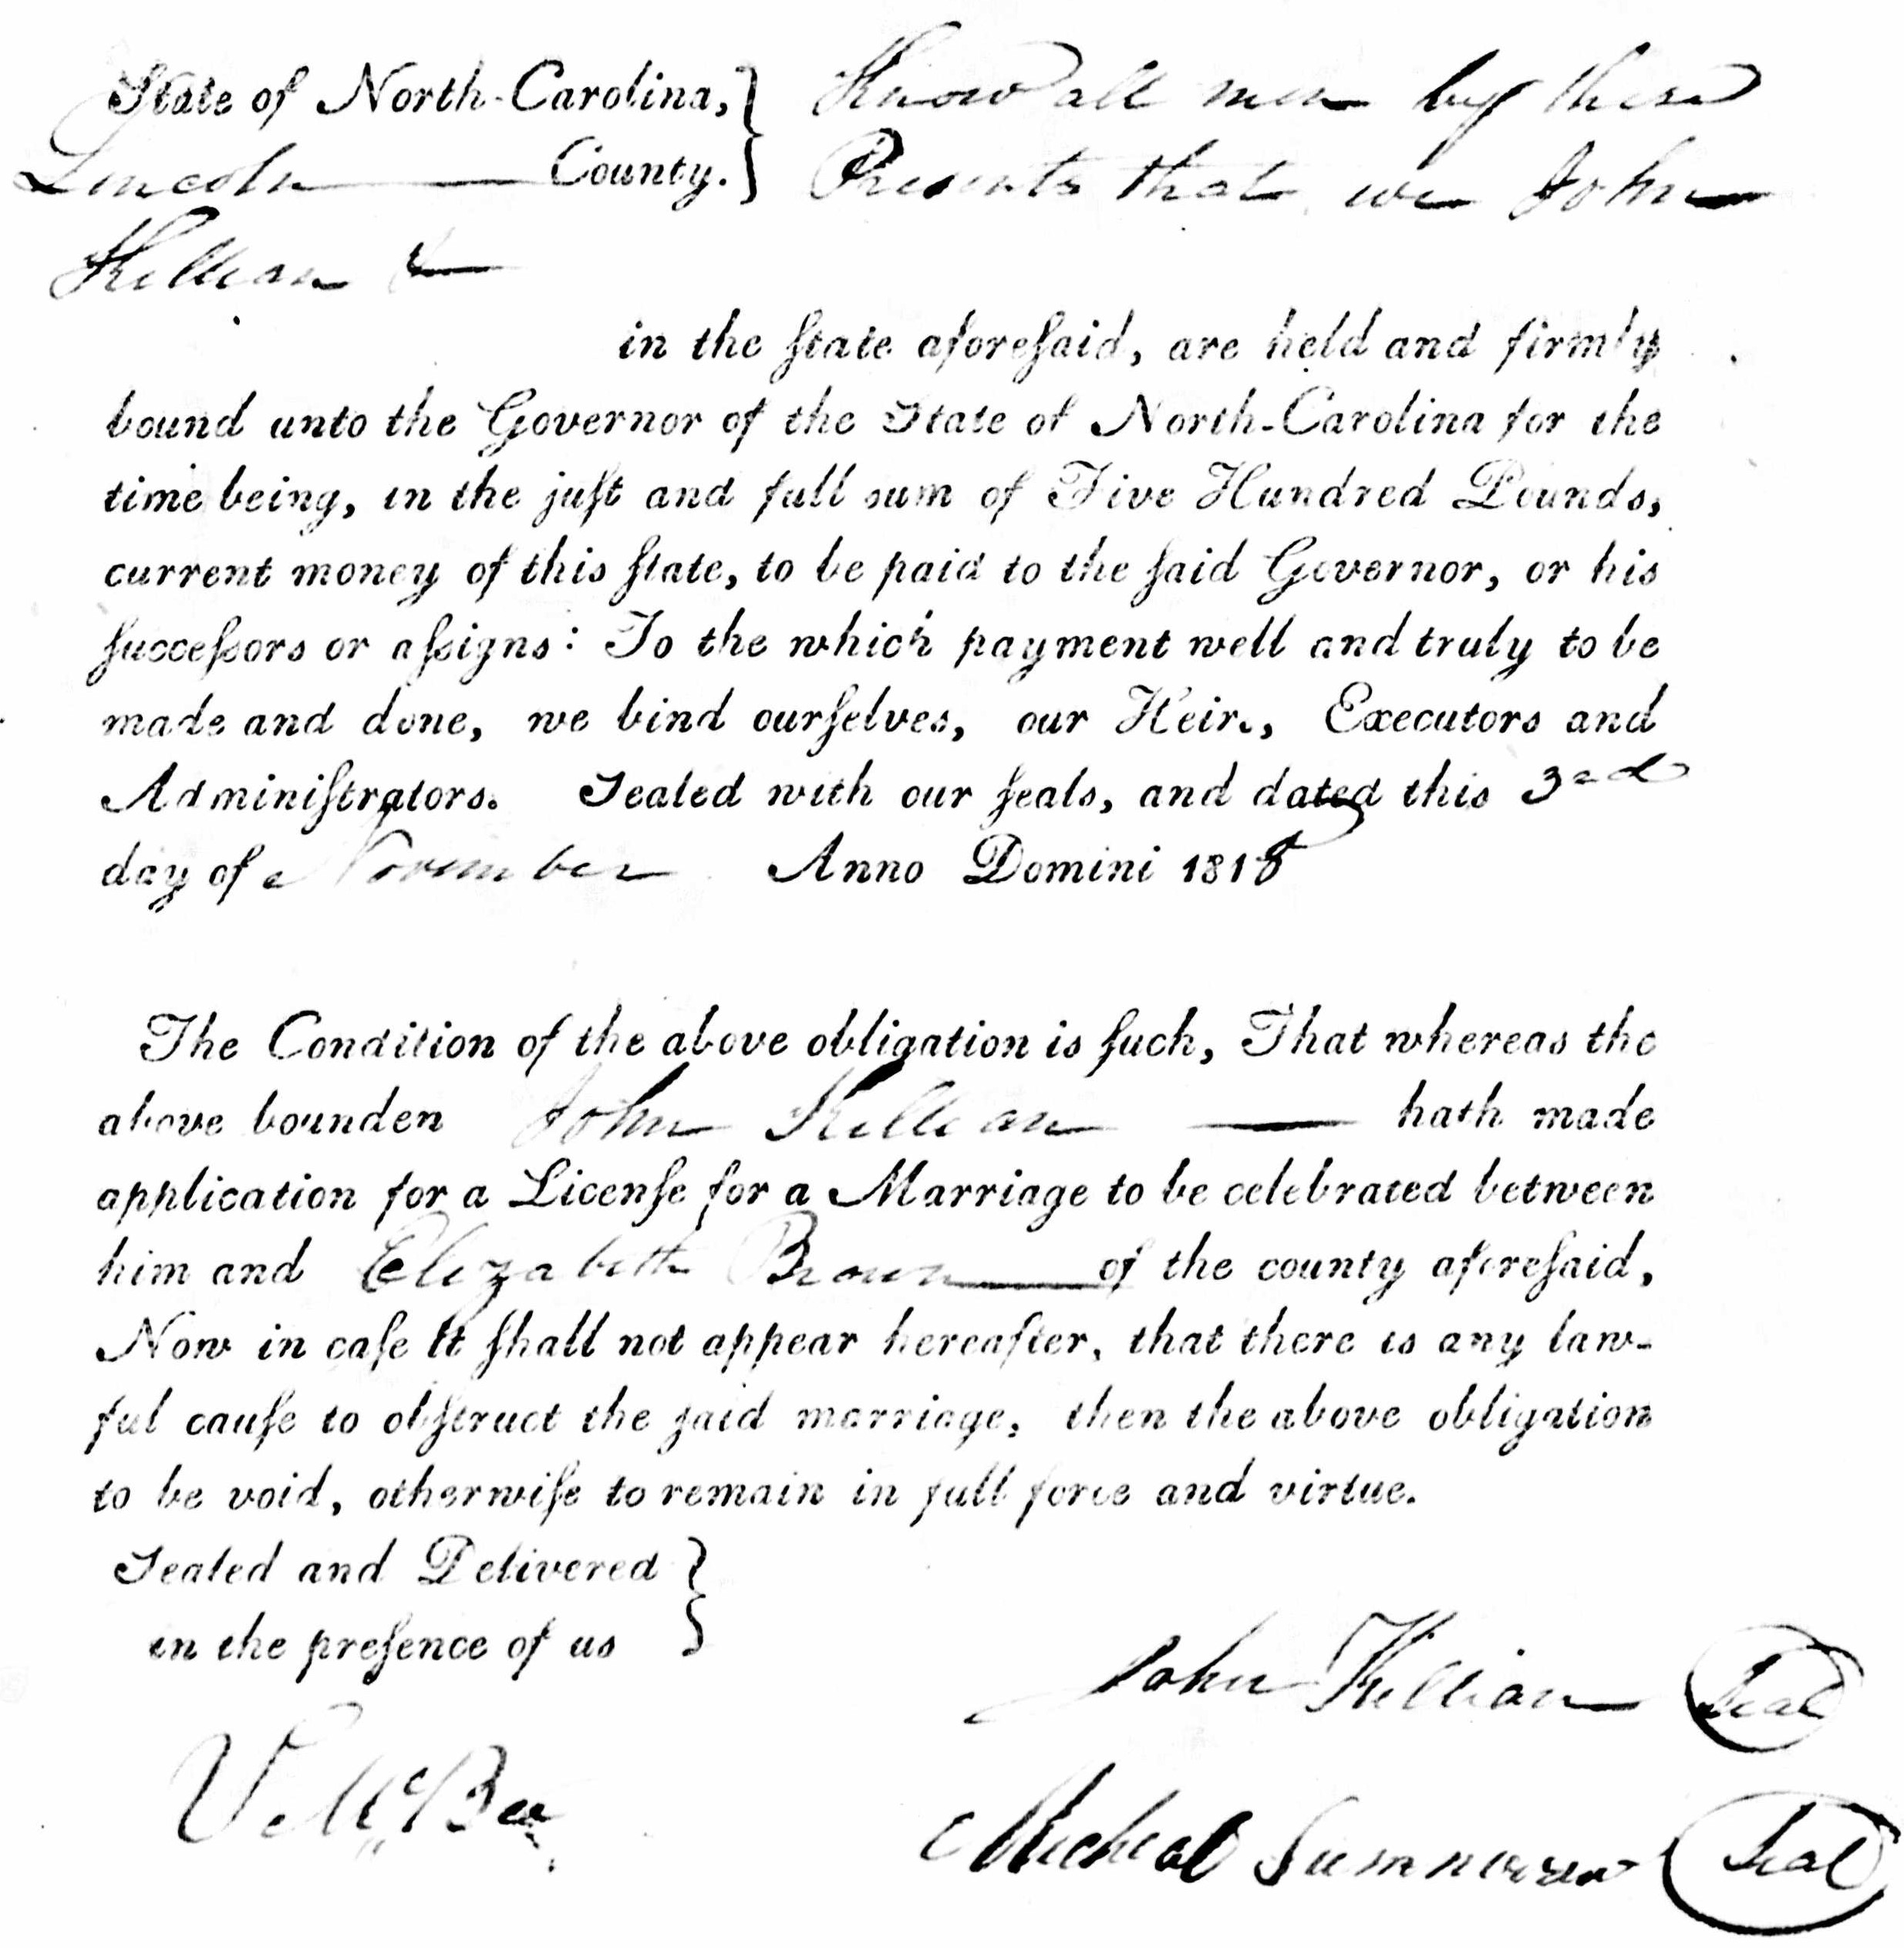
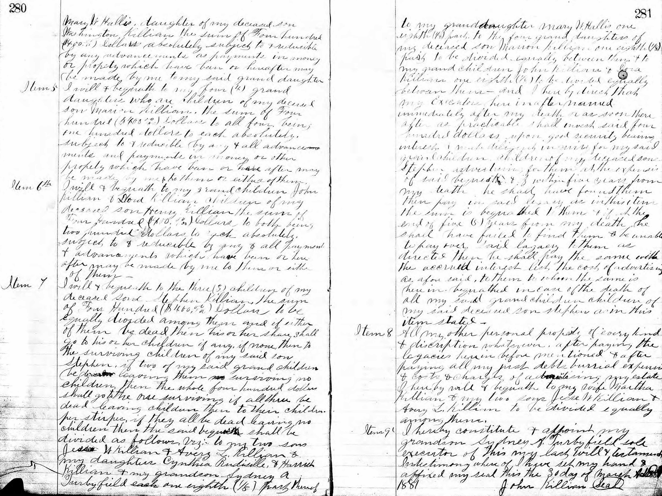
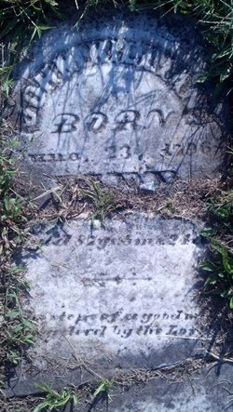
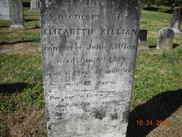
John Wesley Killian
Born 23 June 1796
Salem, Forsyth County, NC
Died 18 March 1884
Lincoln County, NC
Married 1st Wife
Elizabeth Brown
3rd November 1818
Born 16 February 1797
Catawba County, NC
Died 6 January 1854
Lincoln County, NC

Slide 17
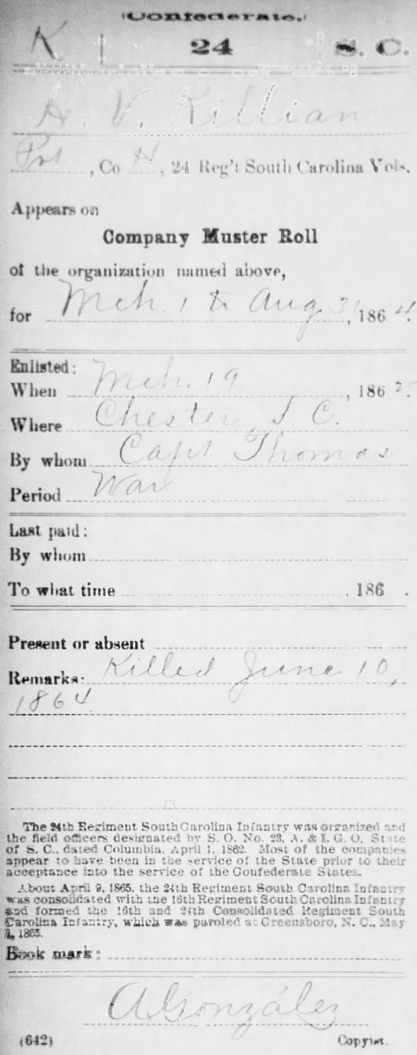
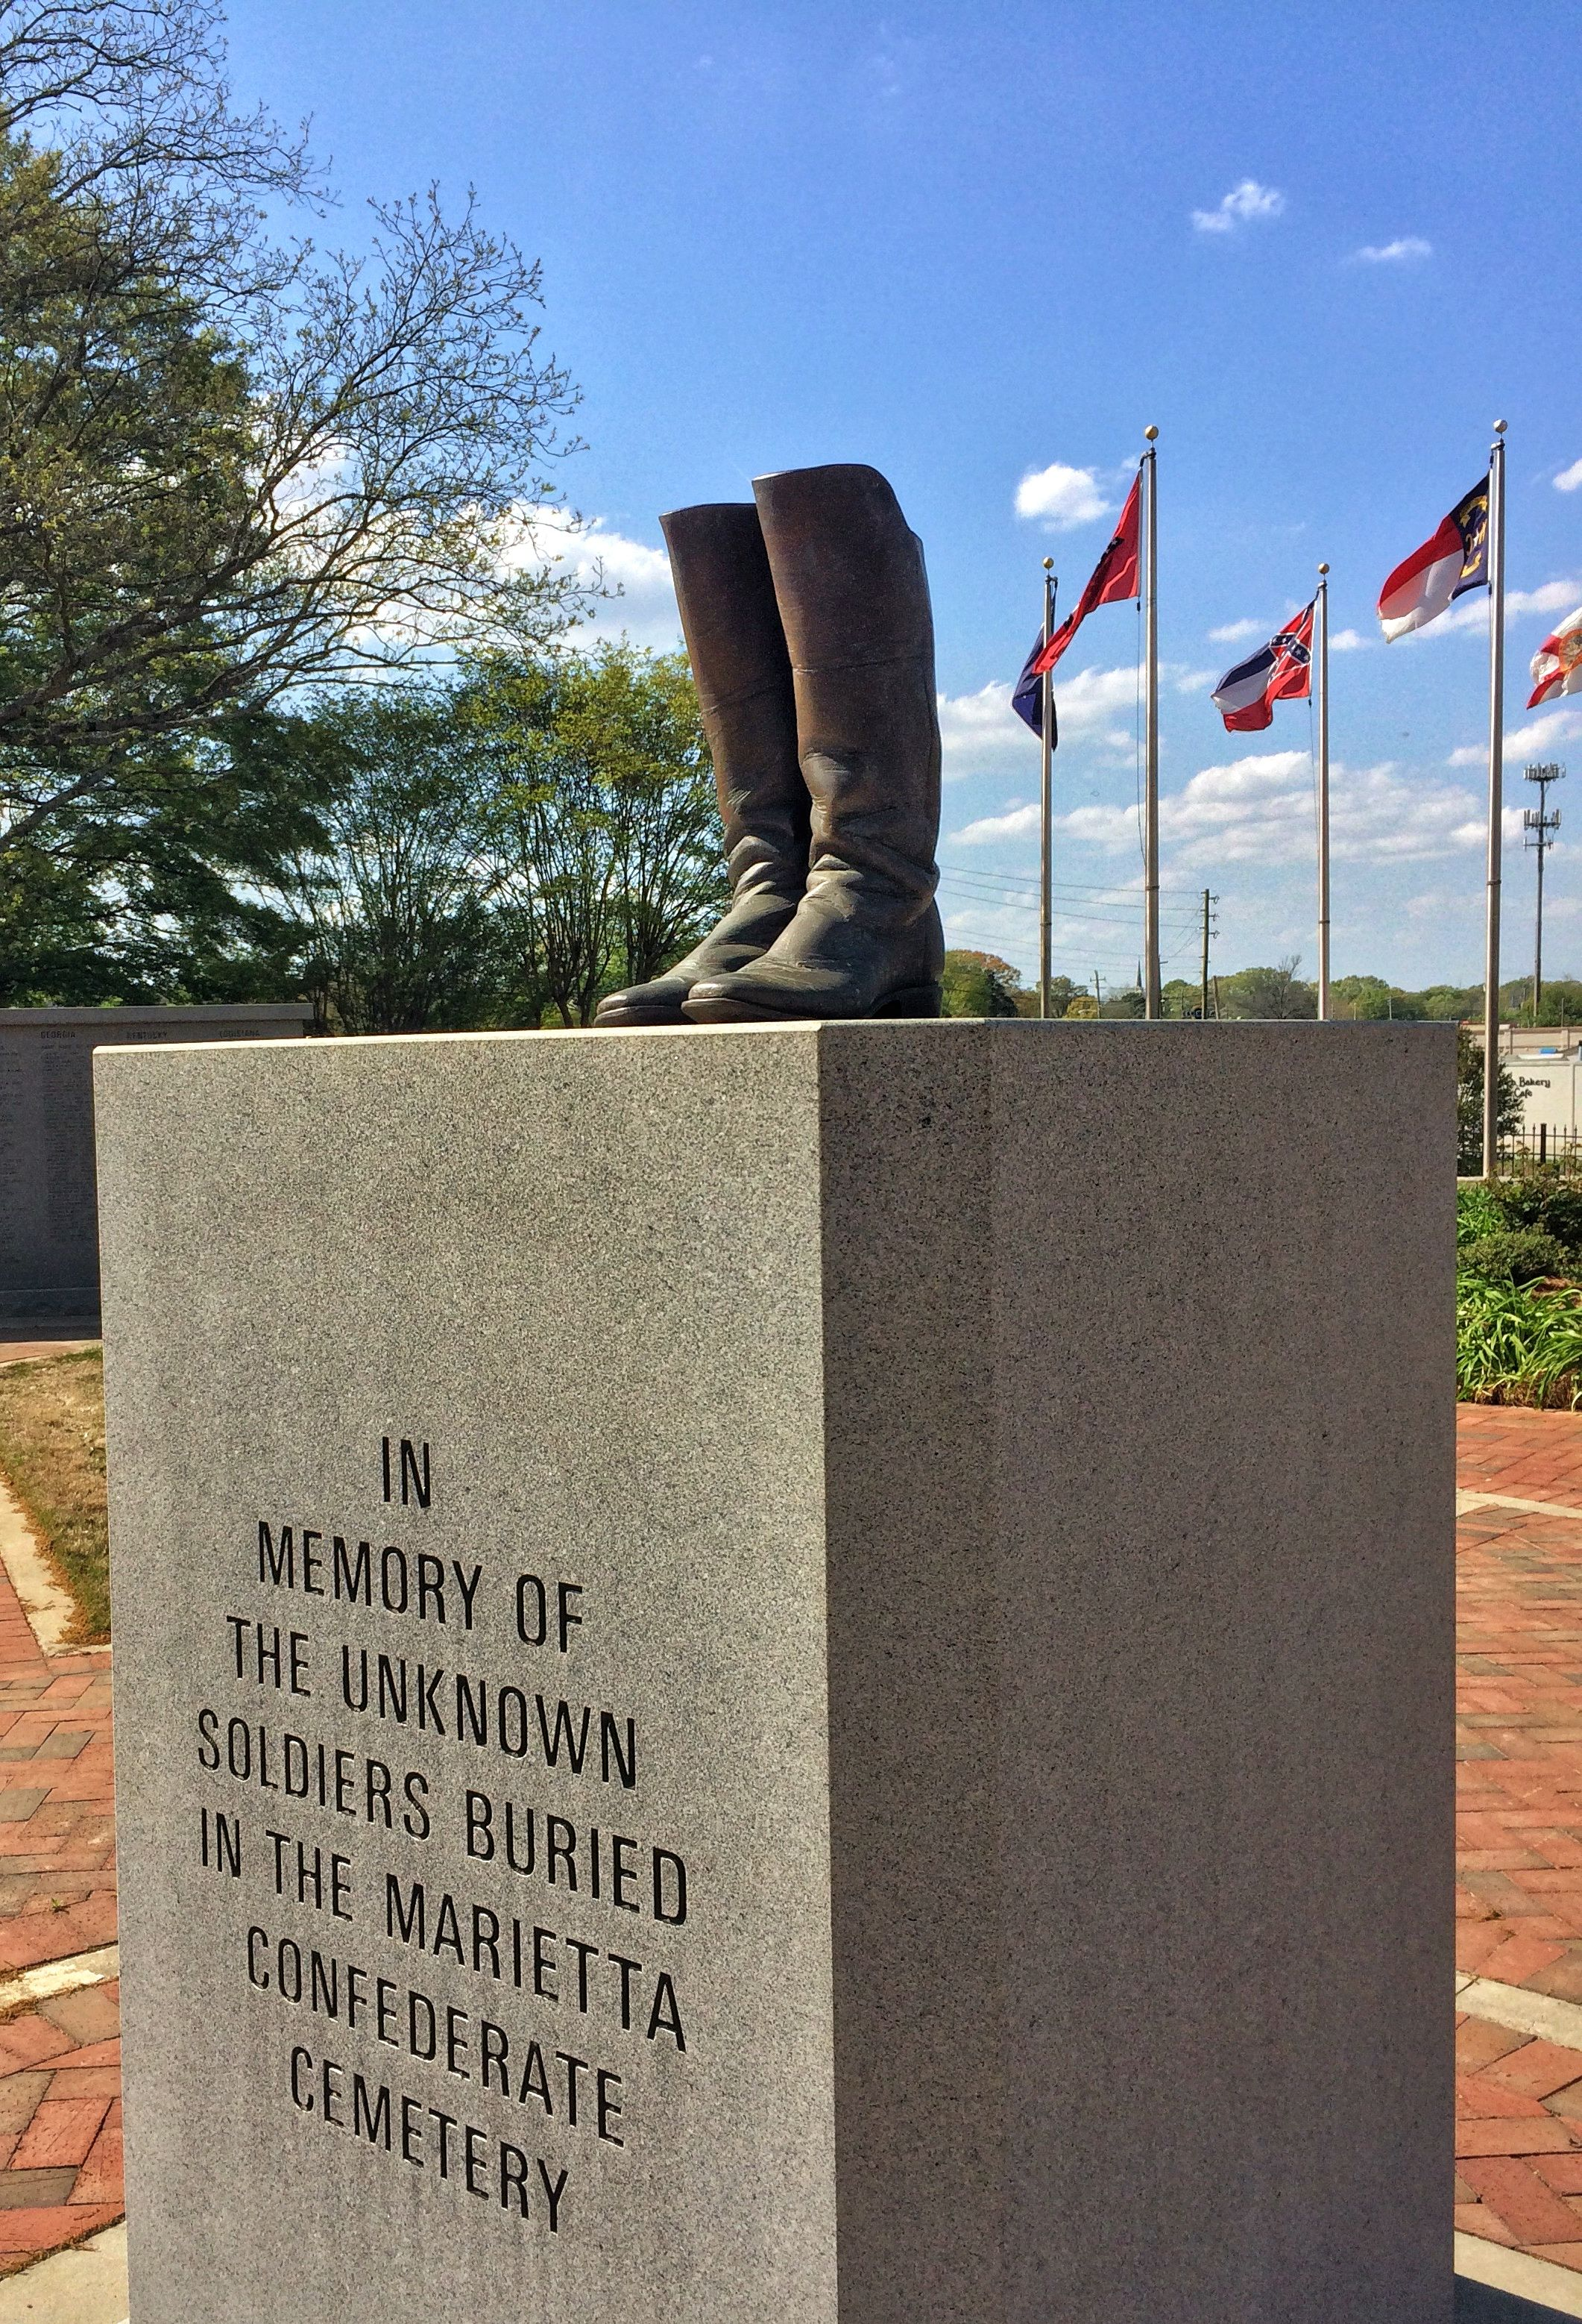
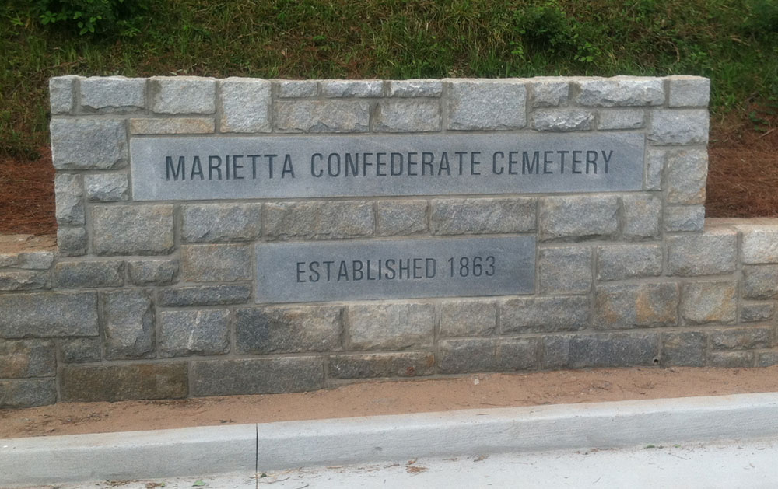
Henry Van Killian
Born 1836
Newton, Catawba County, NC
Wounded 10 June 1864
Pine Mountain Lookout
Cobb County, GA
Died 19 June 1864
Confederate Hospital
Marietta, GA
Buried 19 June 1864
Marietta Confederate Cemetery
Hospital Section
Cobb County, GA
Our Henry Van Killian
Son of John Wesley Killian
Son of Jacob Killian
Son of John Killian
Son of Andreas Killian

Slide 18
Henry Van Killian
Born 1836
Newton, Catawba County, NC
Wounded 10 June 1864
Pine Mountain Lookout
Cobb County, GA
Died 19 June 1864
Confederate Hospital
Marietta, GA
Buried 19 June 1864
Marietta Confederate Cemetery
Hospital Section
Cobb County, GA
Our Henry Van Killian
Son of John Wesley Killian
Son of Jacob Killian
Son of John Killian
Son of Andreas Killian
John Alexander
Killian
1859 SC - 1944 SC
Dora Elizabeth “Etta”
Killian
1862 SC - 1938 SC

Slide 19
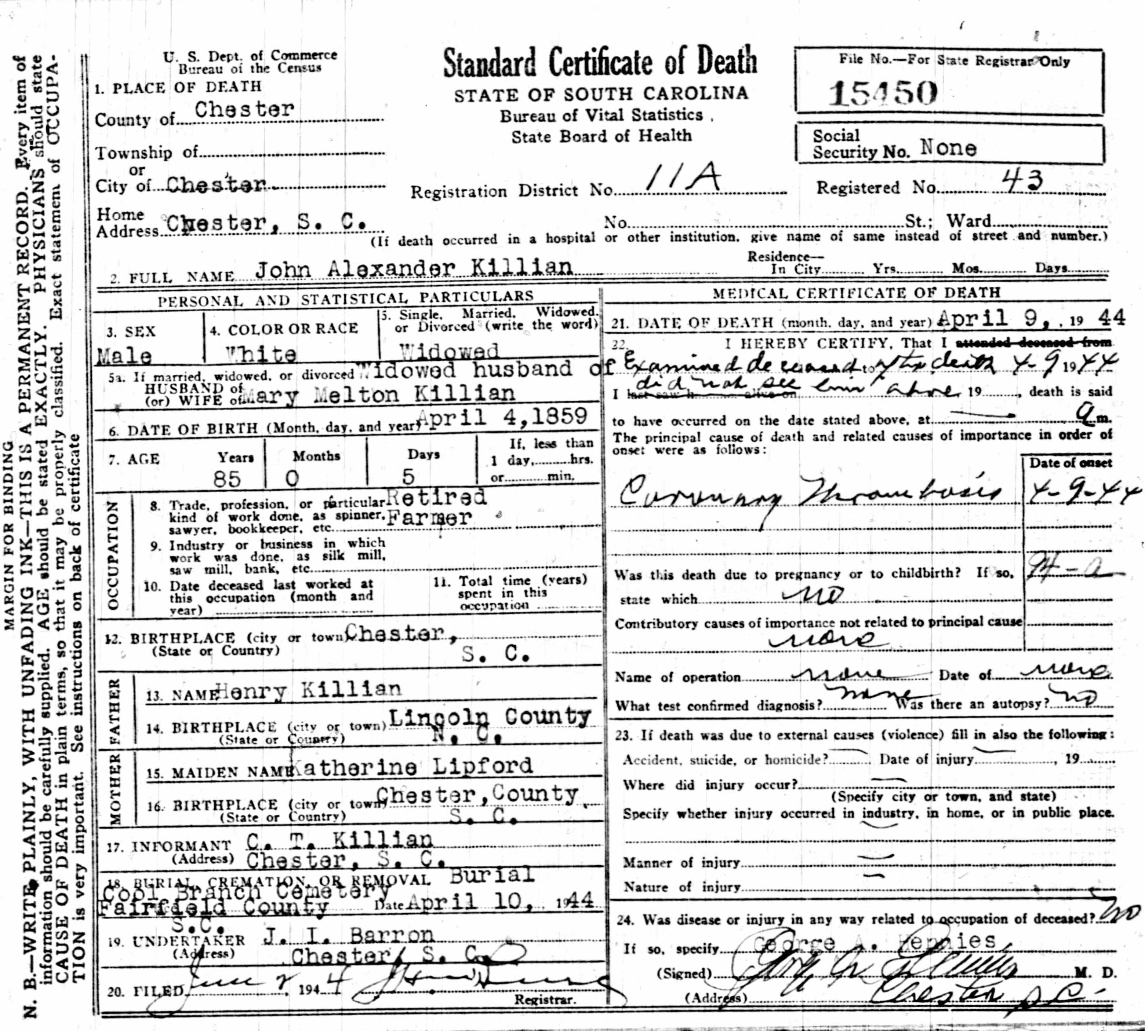
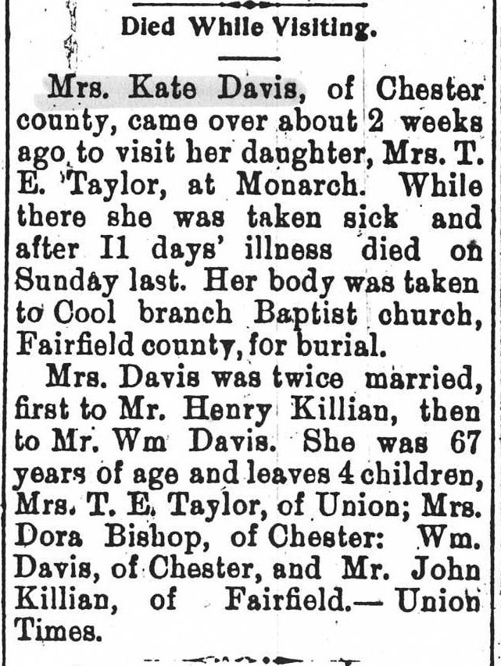
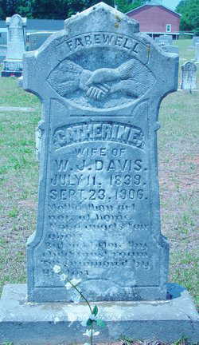
Henry Van Killian
Born 1836
Newton, Catawba County, NC
Died 19 June 1864
Married
K(C)atherine “Kate” Lipford
1st Husband
Born 11 July 1839
Chester County, SC
Died 23 September 1906
Monarch, Union County, SC
Buried Cool Branch Baptist
Township #1
Fairfield County, SC
John Alexander
Killian
1859 SC - 1944 SC
Dora Elizabeth “Etta”
Killian
1862 SC - 1938 SC

Slide 20
Henry Van Killian
Born 1836
Newton, Catawba County, NC
Died 19 June 1864
Married
K(C)atherine “Kate” Lipford
1st Husband
Born 11 July 1839
Chester County, SC
Died 23 September 1906
Monarch, Union County, SC
Buried Cool Branch Baptist
Township #1
Fairfield County, SC
John Alexander
Killian
1859 SC - 1944 SC
Dora Elizabeth “Etta”
Killian
1862 SC - 1938 SC
Married 1880
Joseph Timothy
Bass
1856 SC - 1924 SC
Catherine
Lipford
1841 SC - 1906 SC
Married 2nd Husband
Autosomal DNA NOT Match
William Jefferson Nathan
Davis
1838 SC - 1874 SC
Autosomal DNA Match
Only Son and Daughter of
Henry Van and Catherine Lipford Killian Marriage

Slide 21
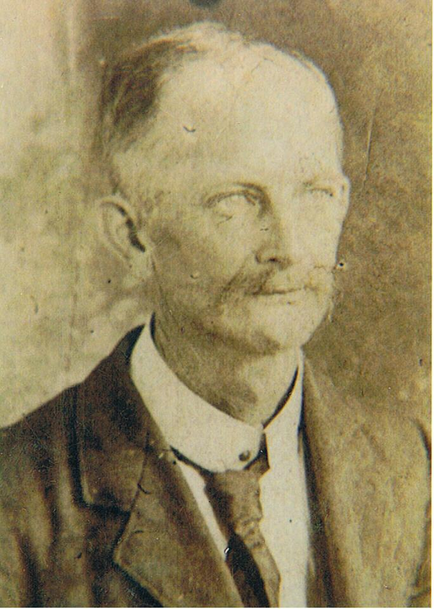
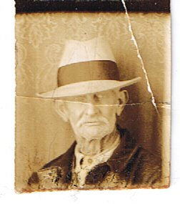
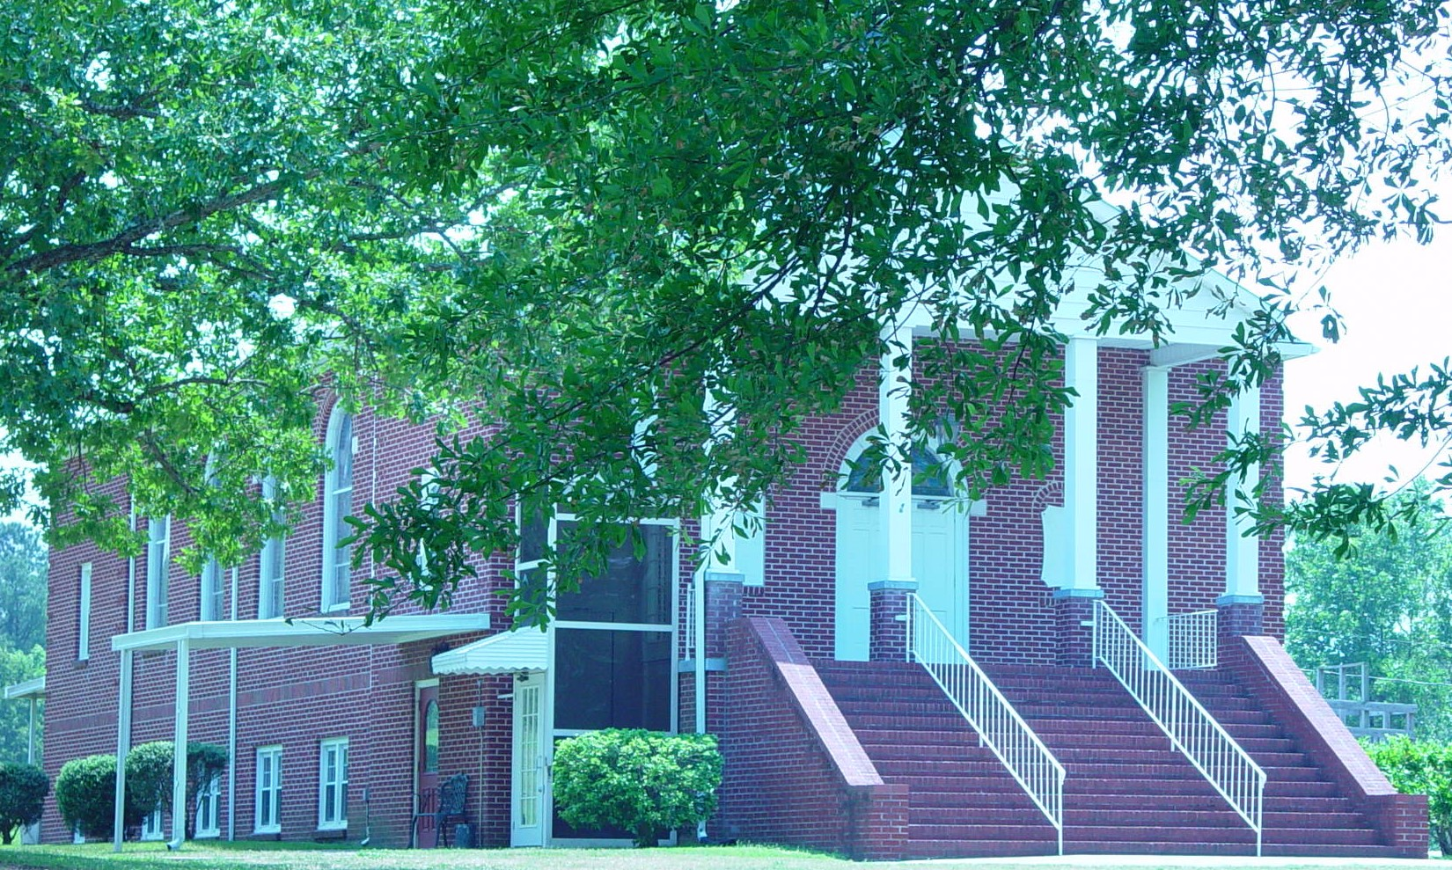
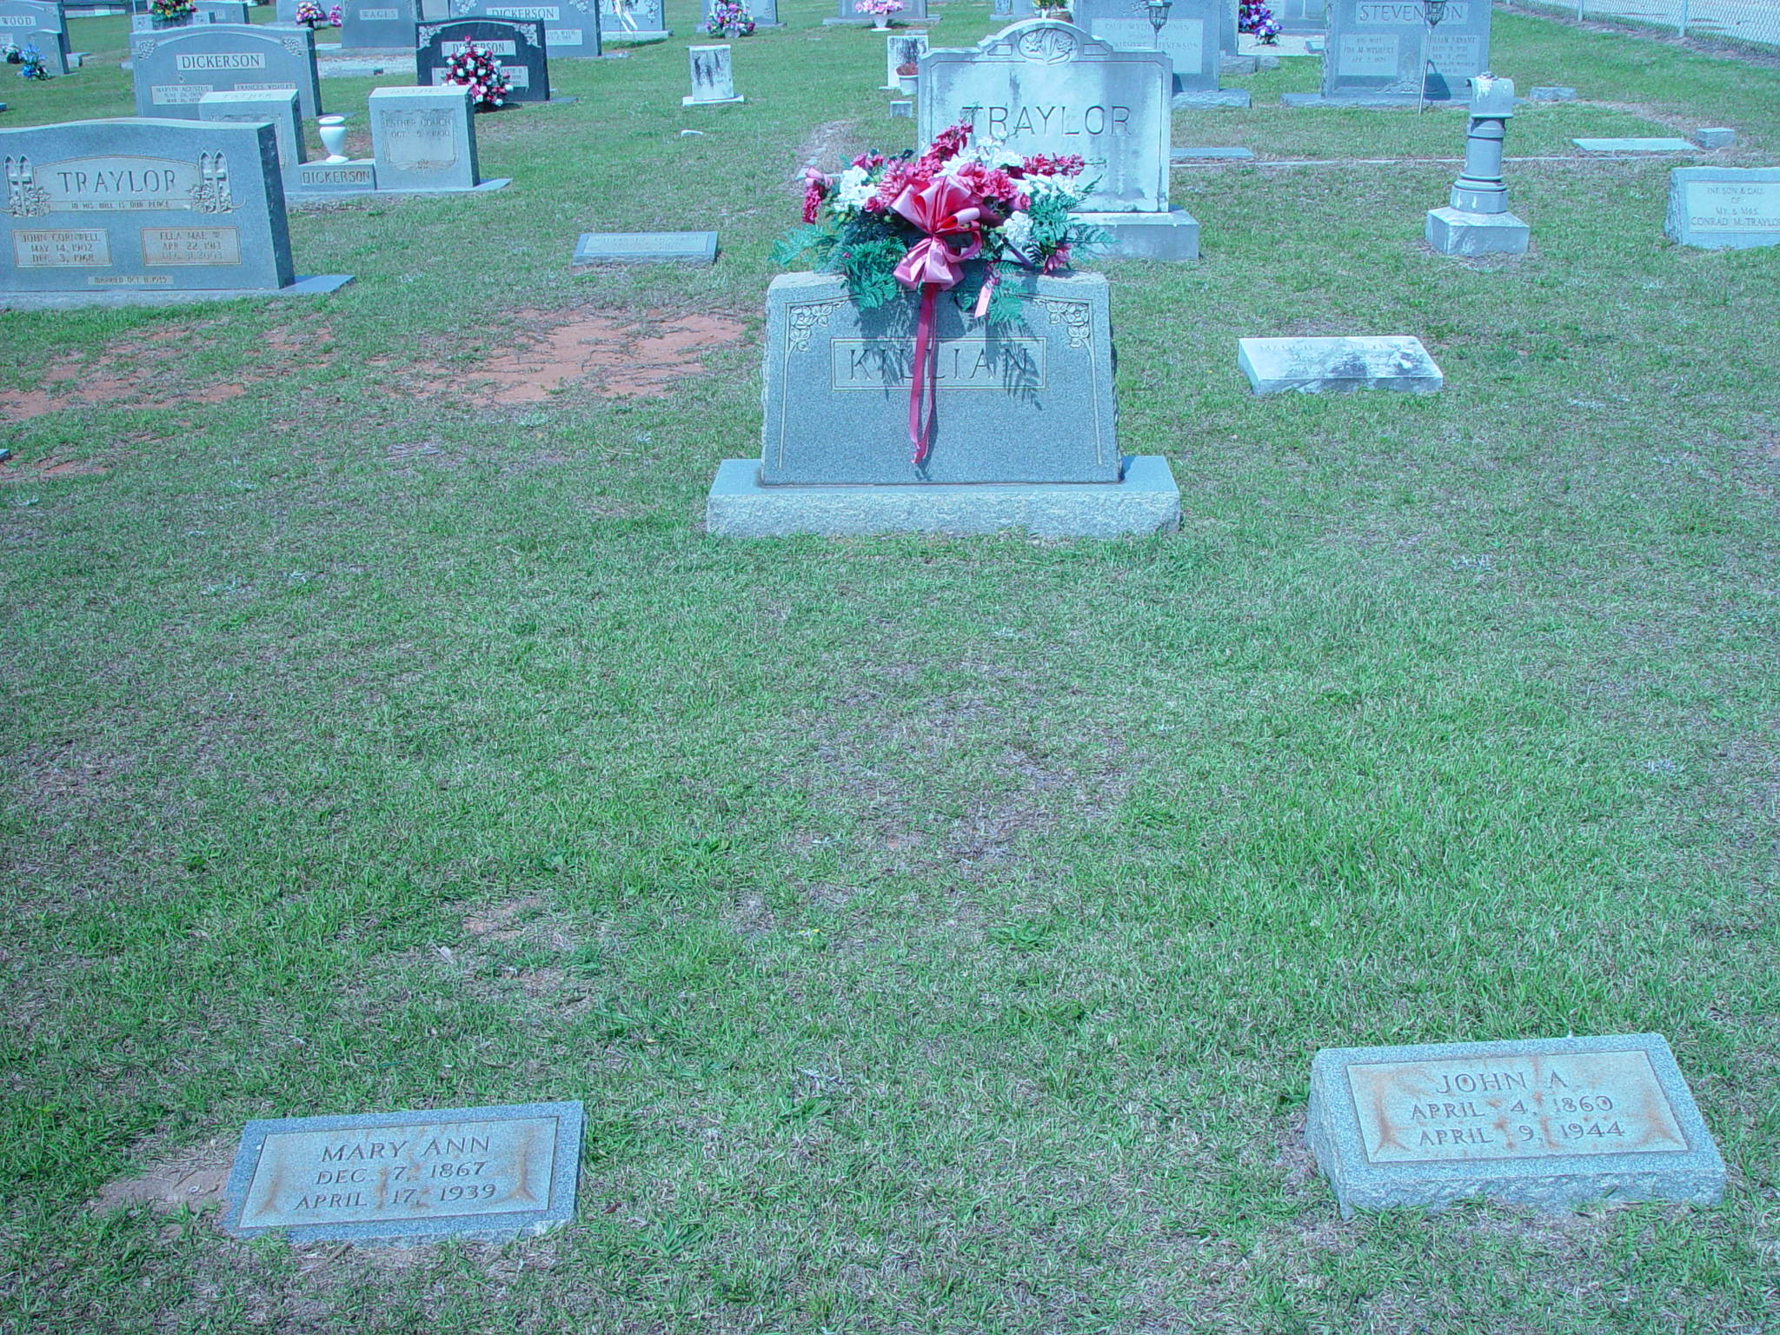
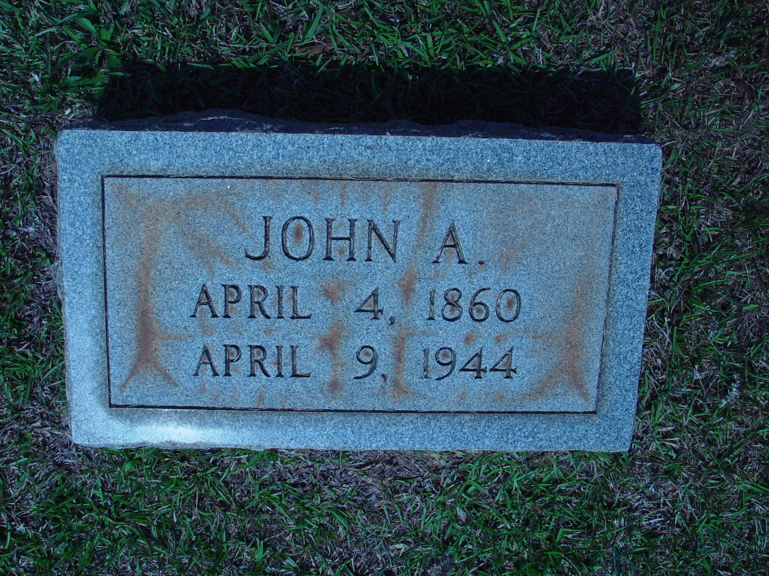
John Alexander Killian
Born 4 April 1859
Chester
Chester County, SC
Died 9 April 1944
Chester
Chester County, SC
Buried Cool Branch Baptist Church
Township #1
Fairfield County, SC
Our John Alexander Killian
Son of Henry Van Killian
Son of John Wesley Killian
Son of Jacob Killian
Son of John Killian
Son of Andreas Killian

Slide 22
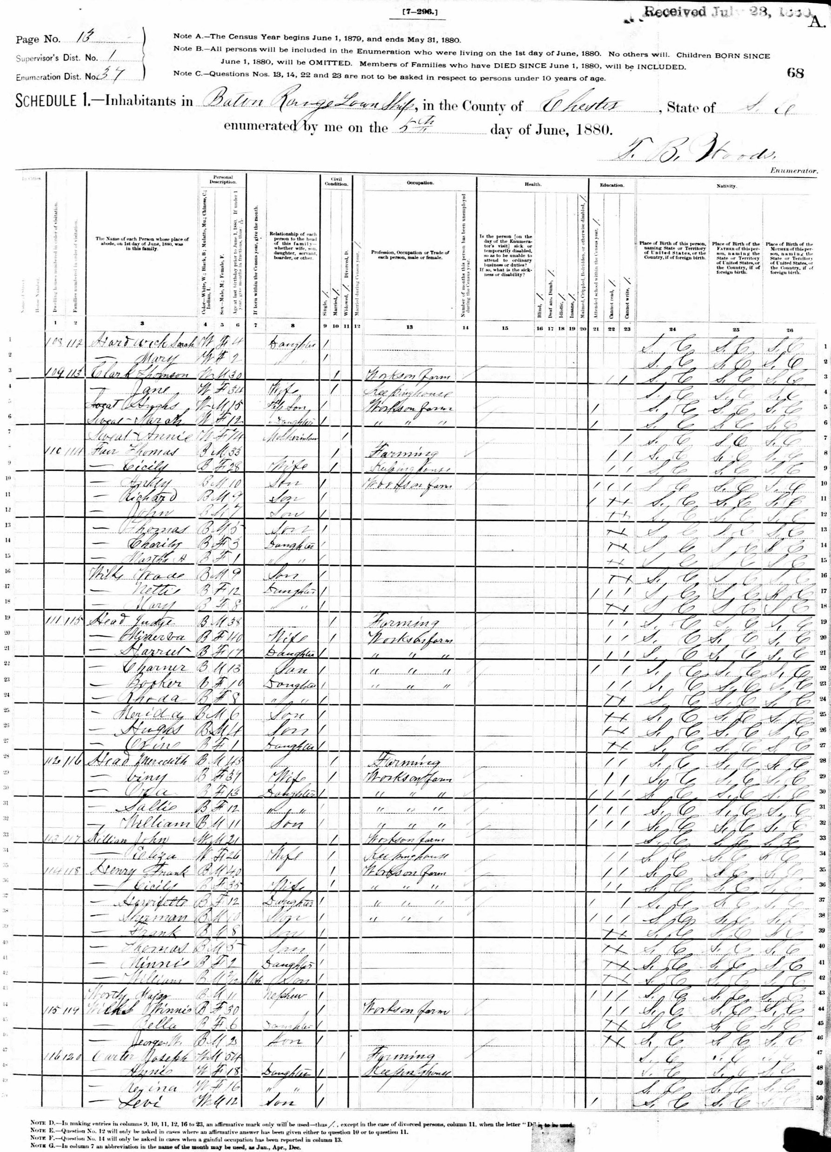
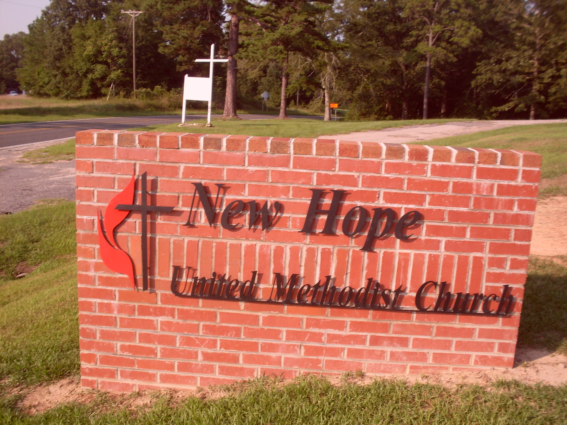
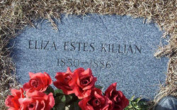
John Alexander Killian
1859 SC – 1944 SC
Married 1st Wife
Between 1870 and 1880
Baton Rouge Township
West Chester County, SC
Eliza
Estes
Born 1850
Baton Rouge Township
West Chester County, SC
Died During Childbirth 1886
Baton Rouge Township
West Chester County, SC
Buried
New Hope United Methodist
Baton Rouge Township
West Chester County, SC
Baby
Killian
1886 SC - 1886 SC
Both Eliza & Baby
Died in Childbirth
Buried
New Hope United Methodist
Baton Rouge Township West Chester County, SC

Slide 23
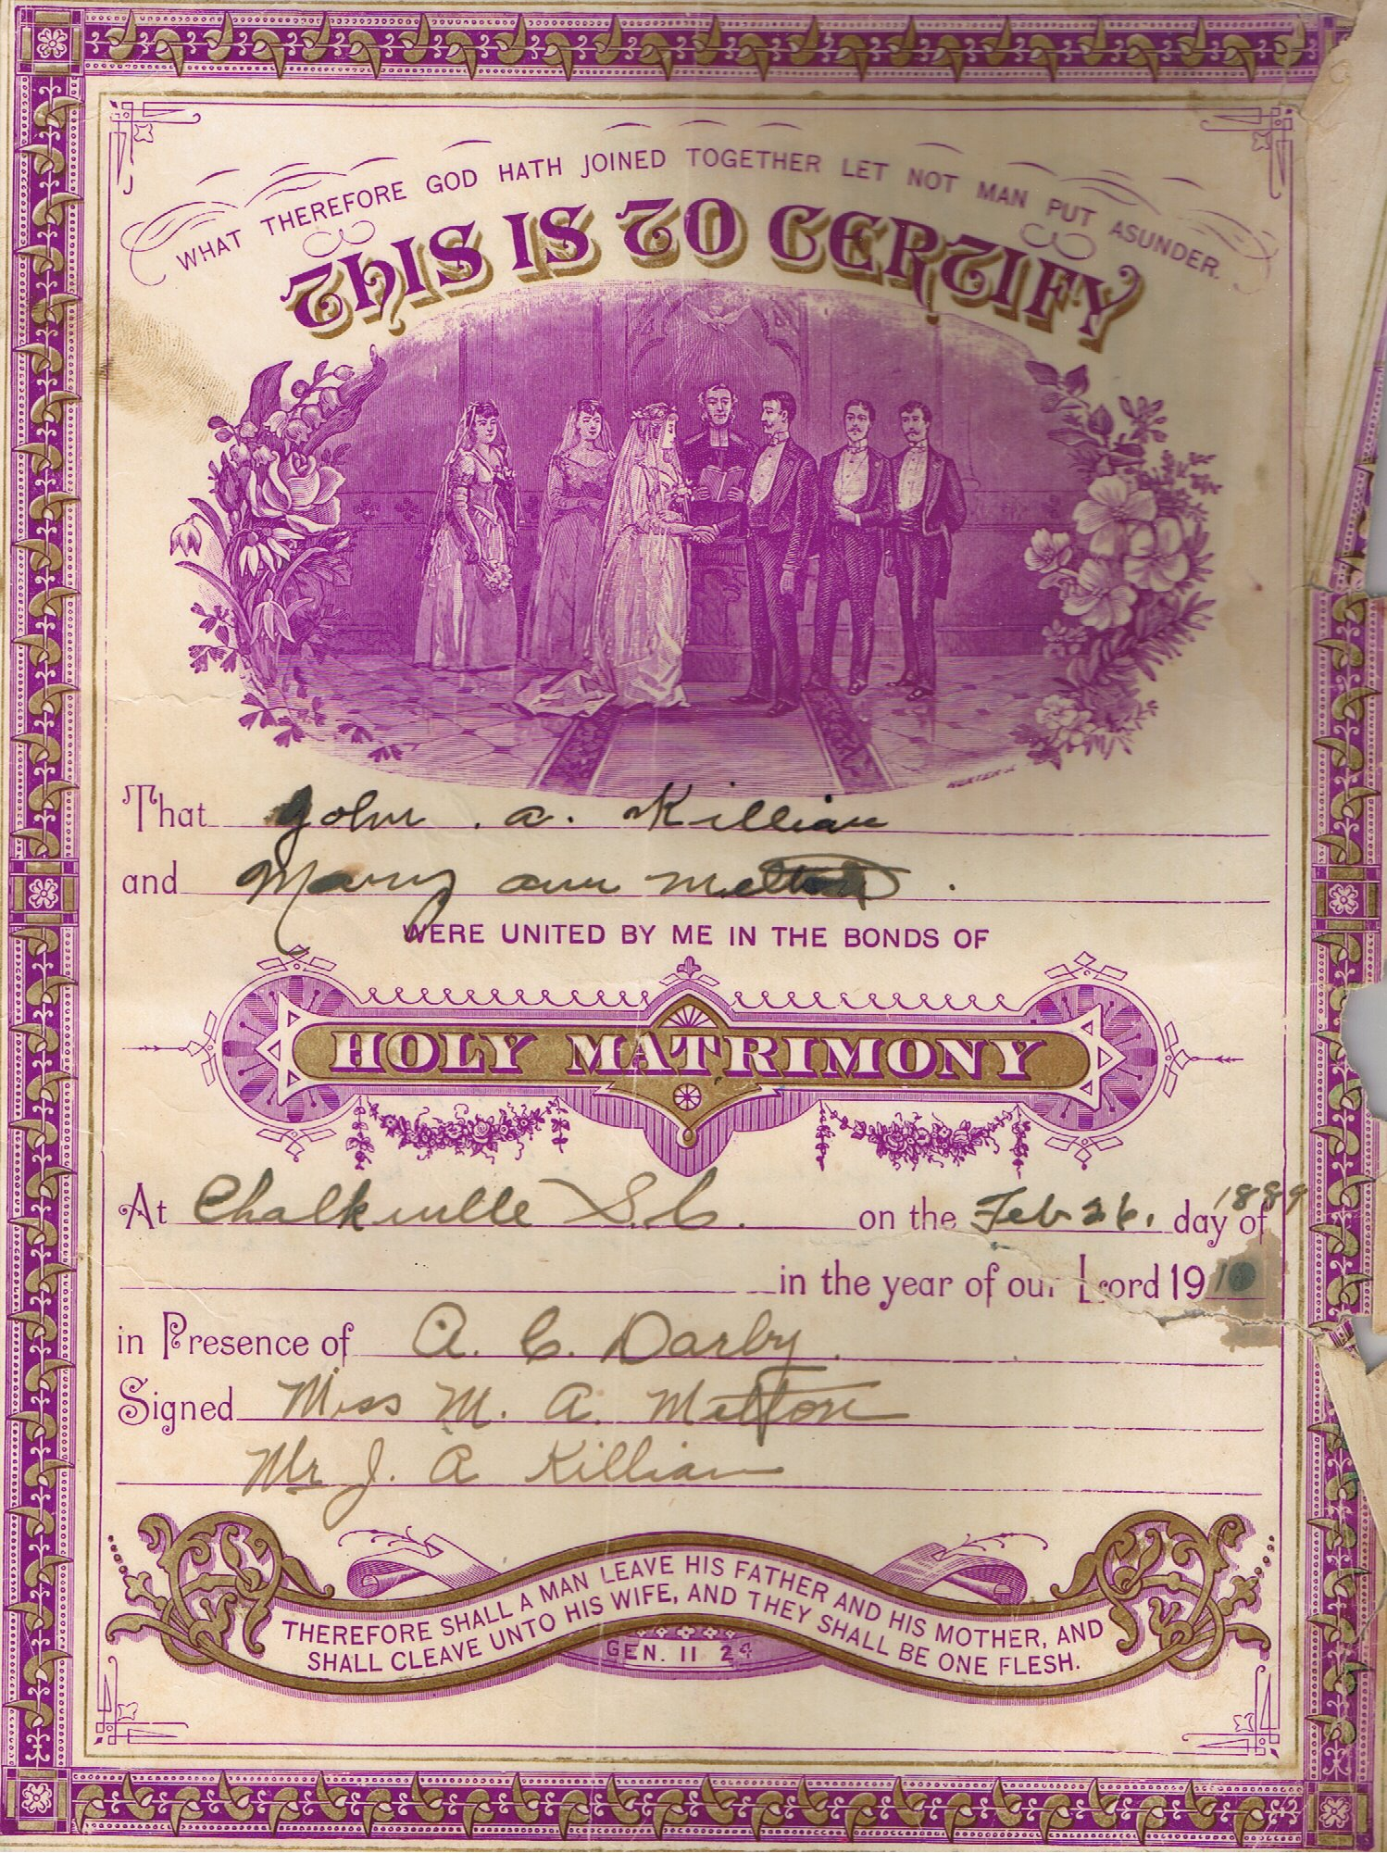
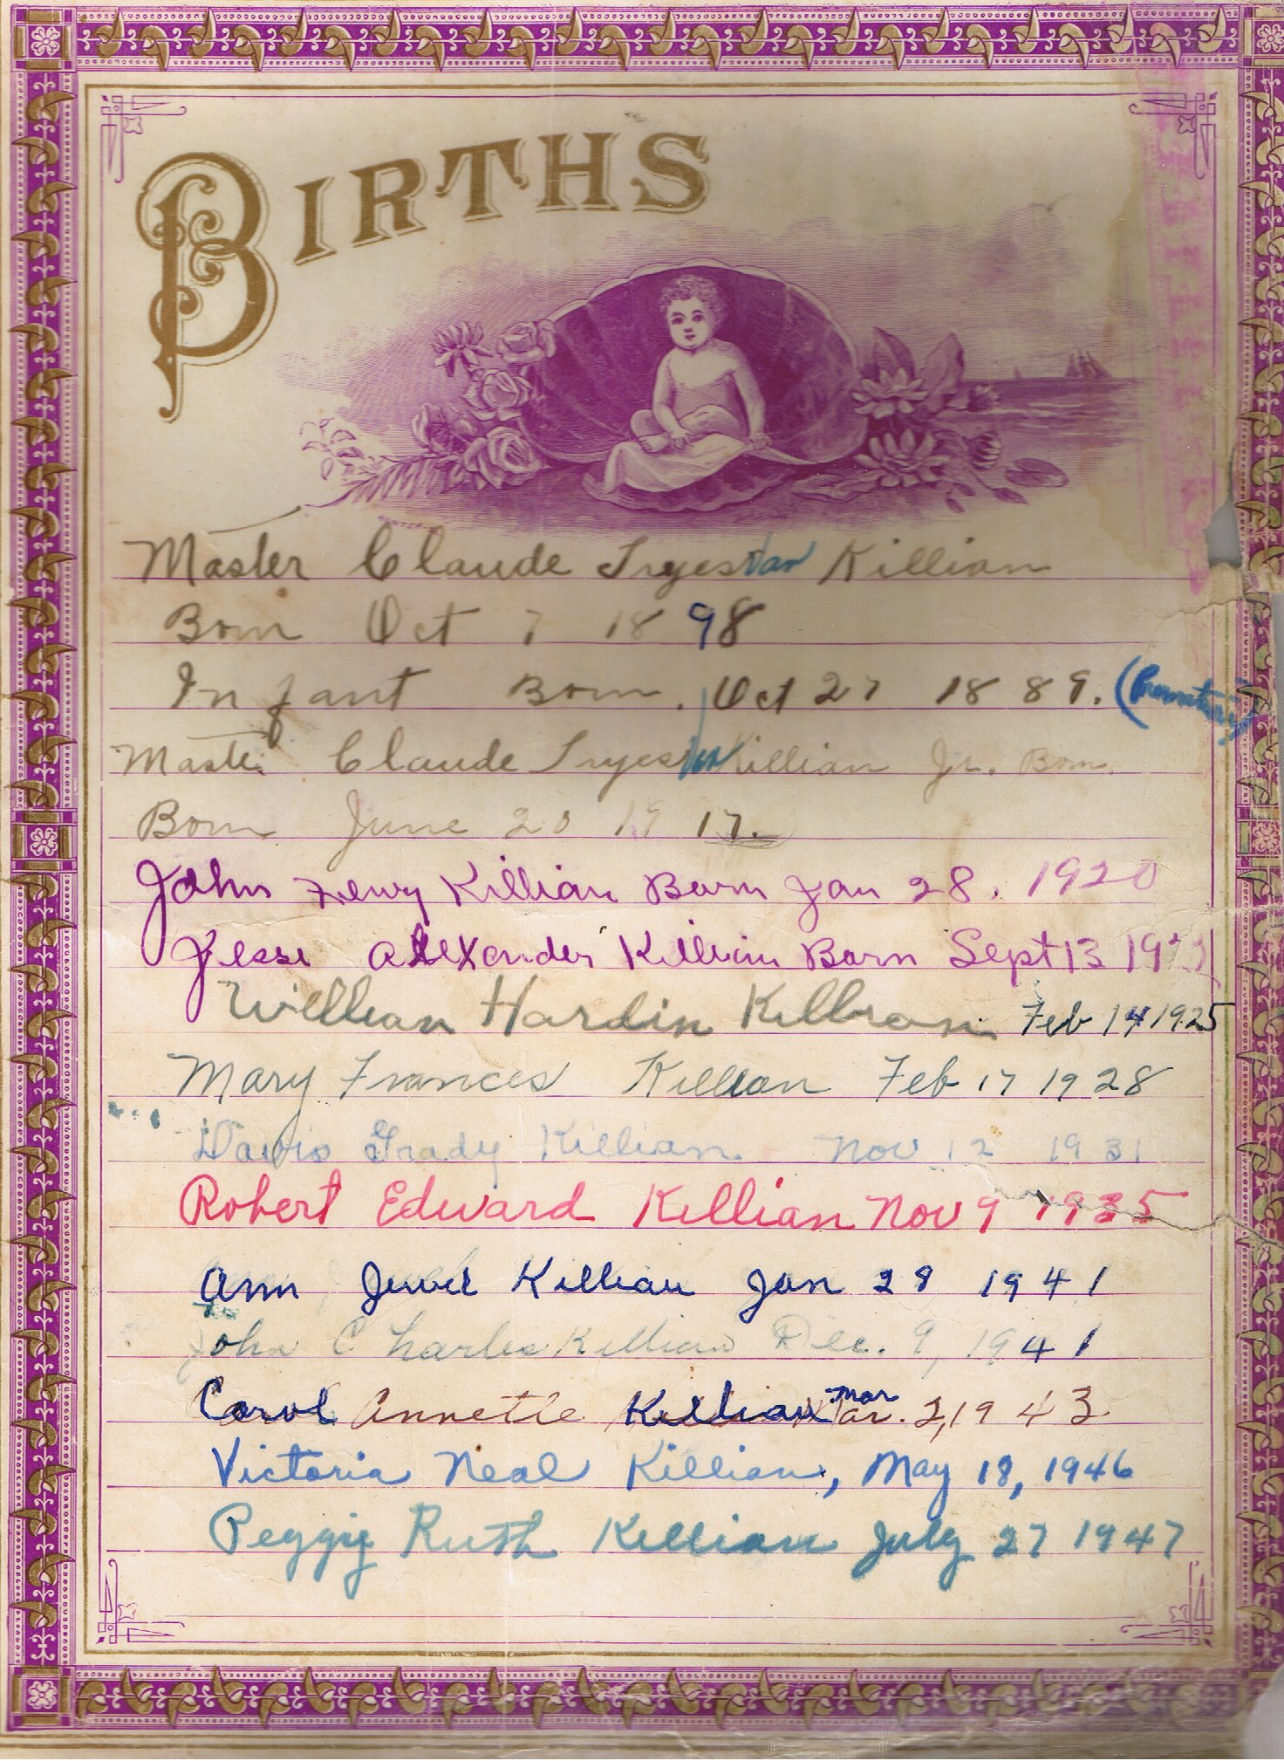
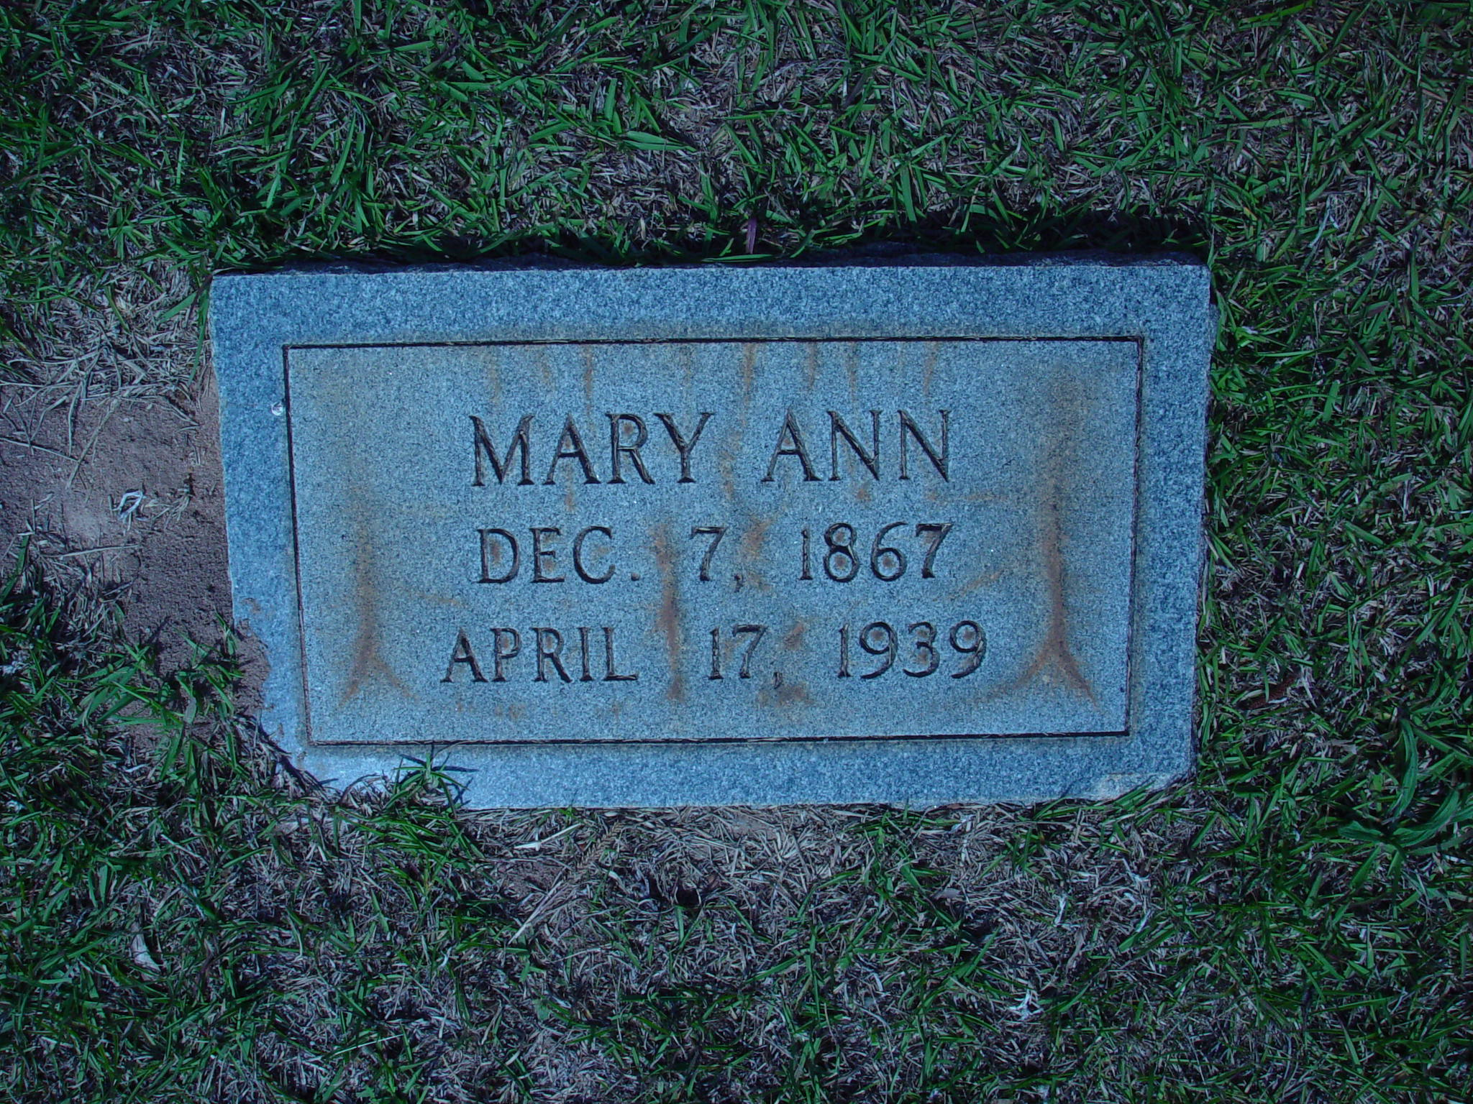
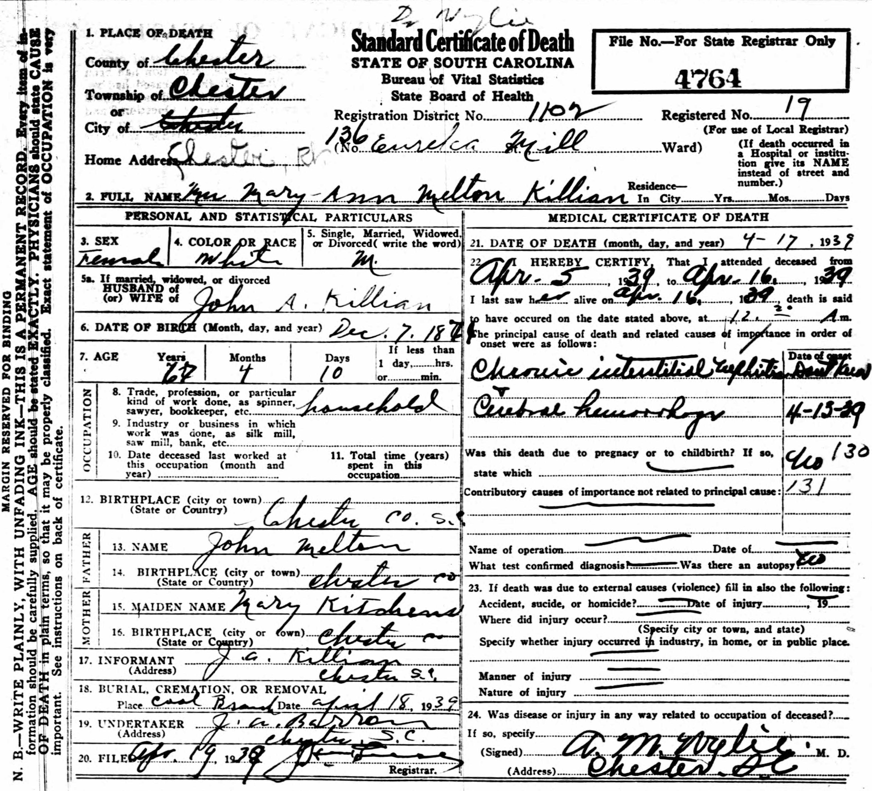
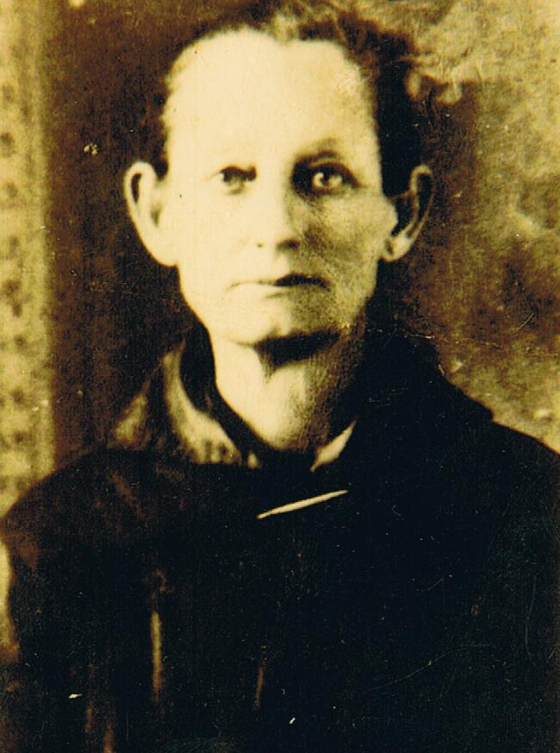
John Alexander and Mary Ann Melton Killian Family Bible Pages
John Alexander Killian
1859 SC – 1944 SC
Married 2nd Wife
26 February 1889
Chaulkville Township
Chester County, SC
Mary Ann Melton
Born 7 December 1867
Baton Rouge Township
Chester County, SC
Died 17 April 1939
Chester
Chester County, SC
Buried Cool Branch Baptist Church, Township #1
Fairfield County, SC
Baby
Killian
1889 SC - 1889 SC
Premature Still Birth
Burial Unknown

Slide 24
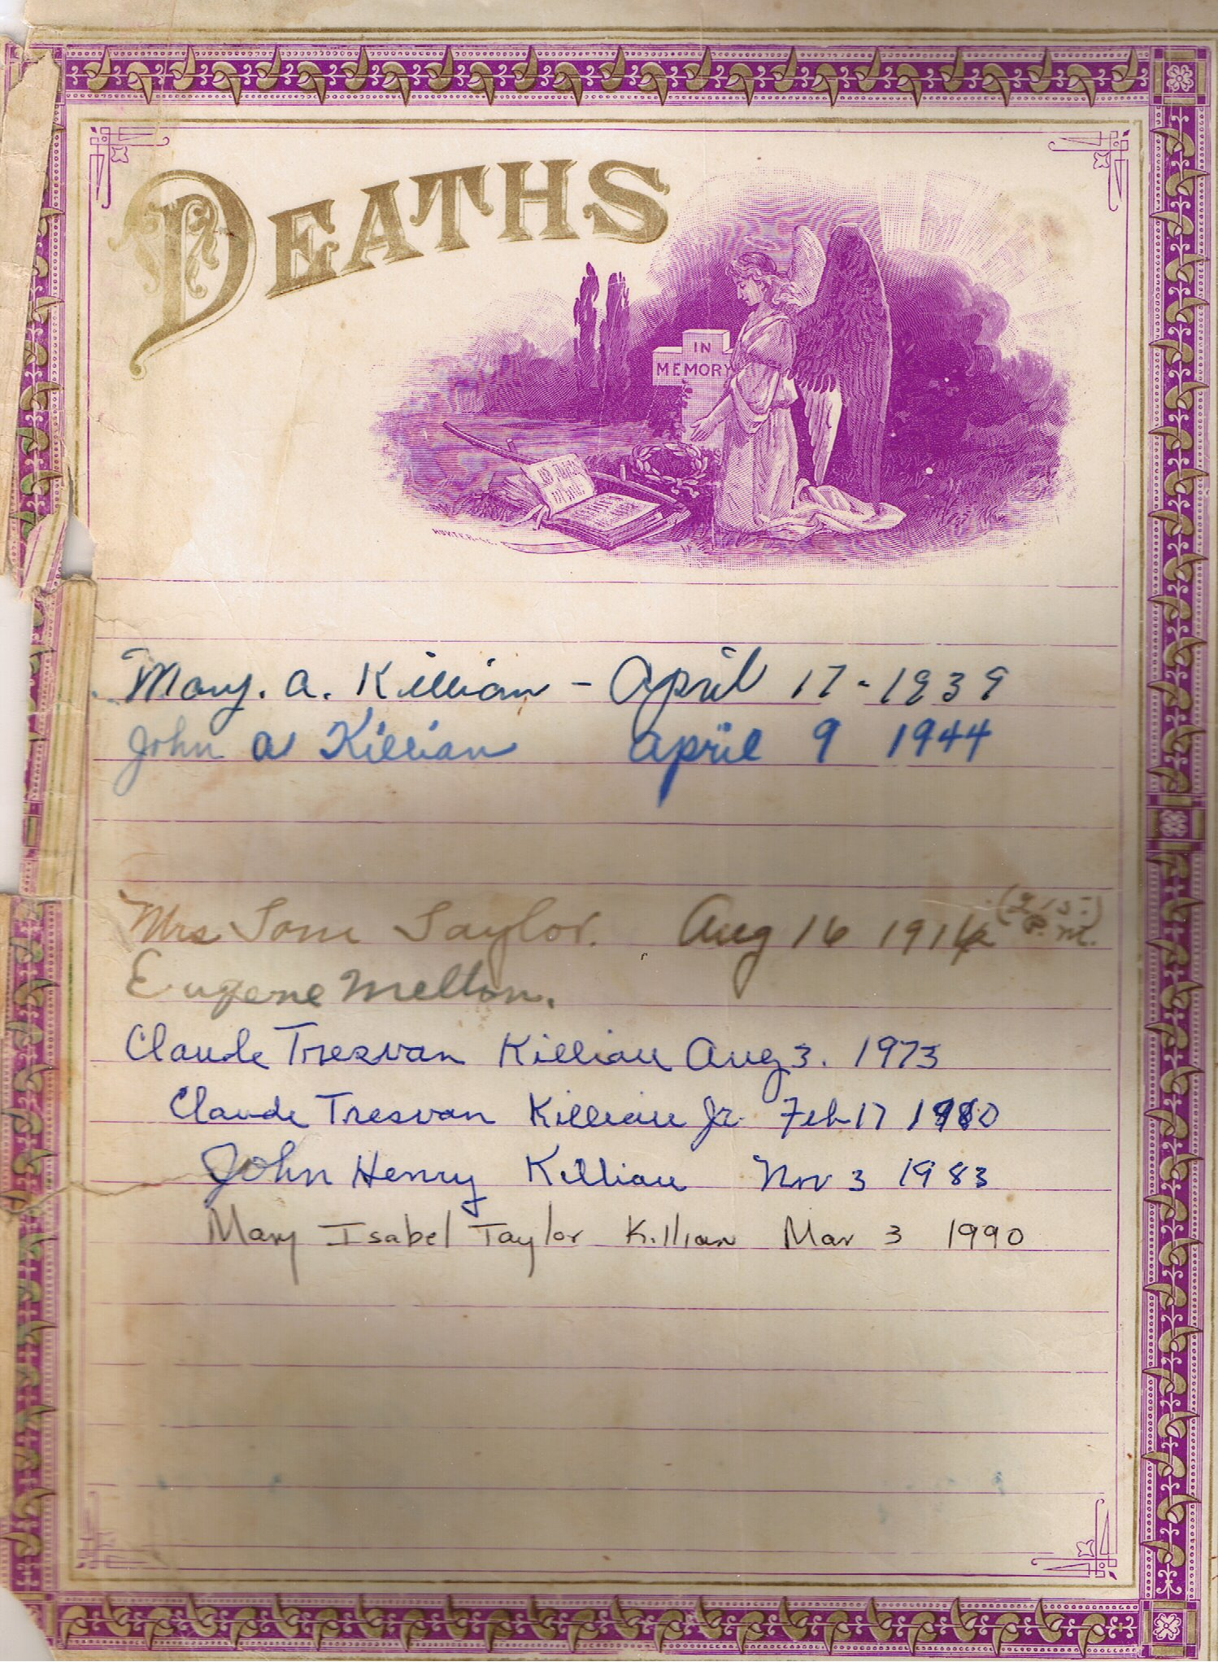
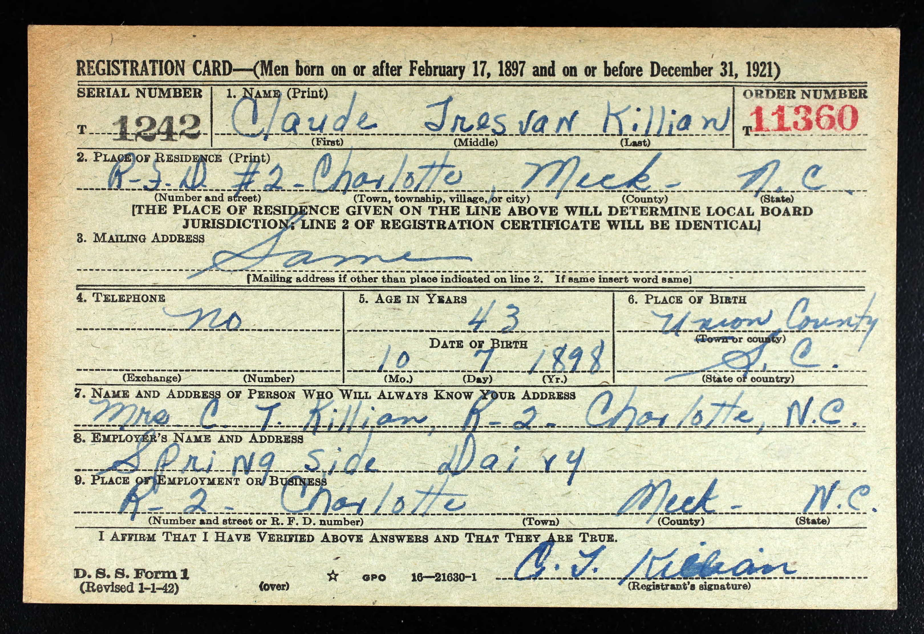
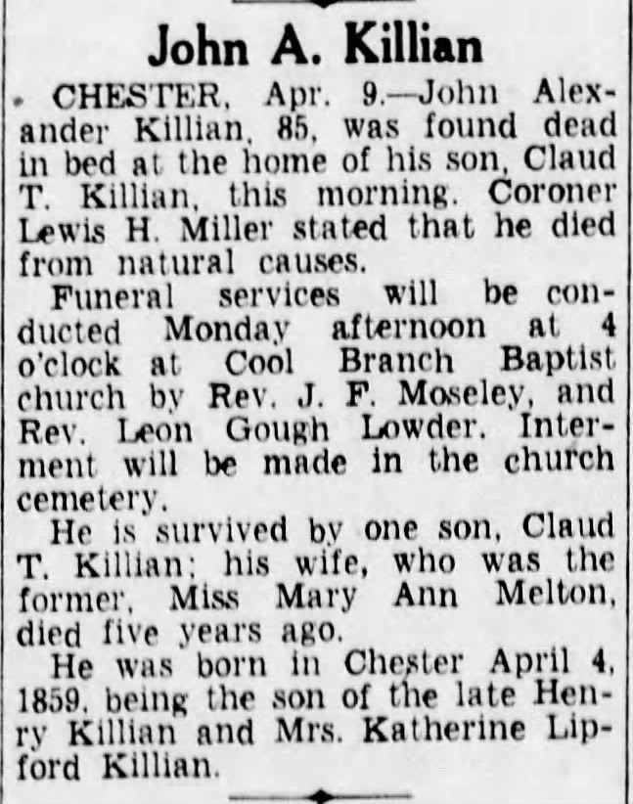
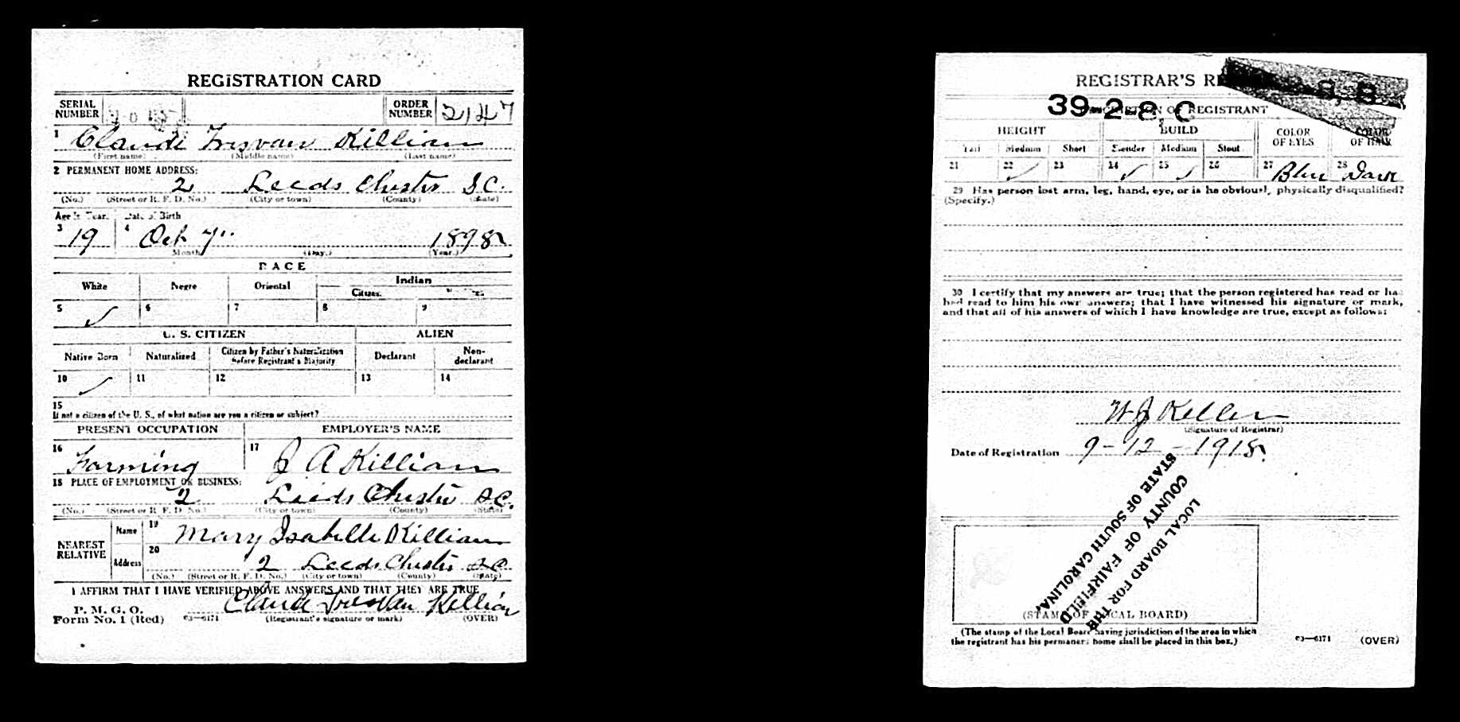
Claude Tresvan Killian
Born 7 October 1898
Fish Dam Township
Union County, SC
Only Surviving Child
Robbed-Killed 3 August 1973
Chester
Chester County, SC
Buried Cool Branch Baptist Church
Township #1
Fairfield County, SC
Our Claude Tresvan “Pop” Killian
Son of John Alexander Killian
Son of Henry Van Killian
Son of John Wesley Killian
Son of Jacob Killian
Son of John Killian
Son of Andreas Killian
John Alexander and Mary Ann Melton Killian Family Bible Pages

Slide 25
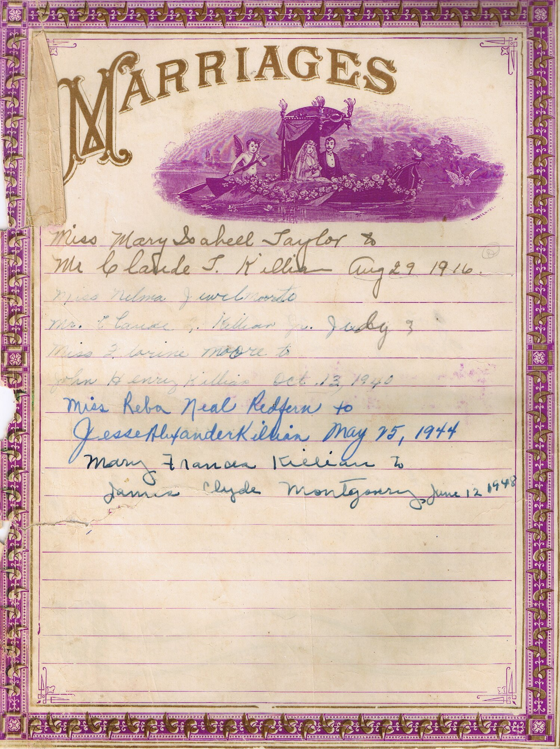
“Pop” Killian Claude Tresvan Killian Sr, 1898 SC – 1973 SC, Married 29 August 1916, Leeds Township, Chester County, SC
Mary Isabell “Grandma” Taylor, Born 22 December 1897, Township #1, Fairfield County, SC, Died 3 March 1990, Presbyterian Hospital, Charlotte, Mecklenburg County, NC
Both Buried Chester Memorial Gardens, West Chester County, SC
John Alexander and Mary Ann Melton Killian Family Bible Pages

Slide 26
(AKDHA) Andreas Killian Descendants Historical Association
AKDHA DNA Committee
Project to Establish a Sons of Andreas Killian DNA Baseline
Any Male Born Descendant of One of Andreas Son’s to Do Y-DNA Test
Andreas Killian
Son John Killian
Son Jacob Killian
Son John Wesley Killian
Son Henry Van Killian
Son John Alexander Killian
Son Claude Tresvan Killian Sr
Son Robert Edward Killian Sr
Son Robert Edward Killian Jr
Submitted a Y-DNA Test for Our Family Line
For the AKDHA DNA Committee Y-DNA Baseline Project

Slide 27
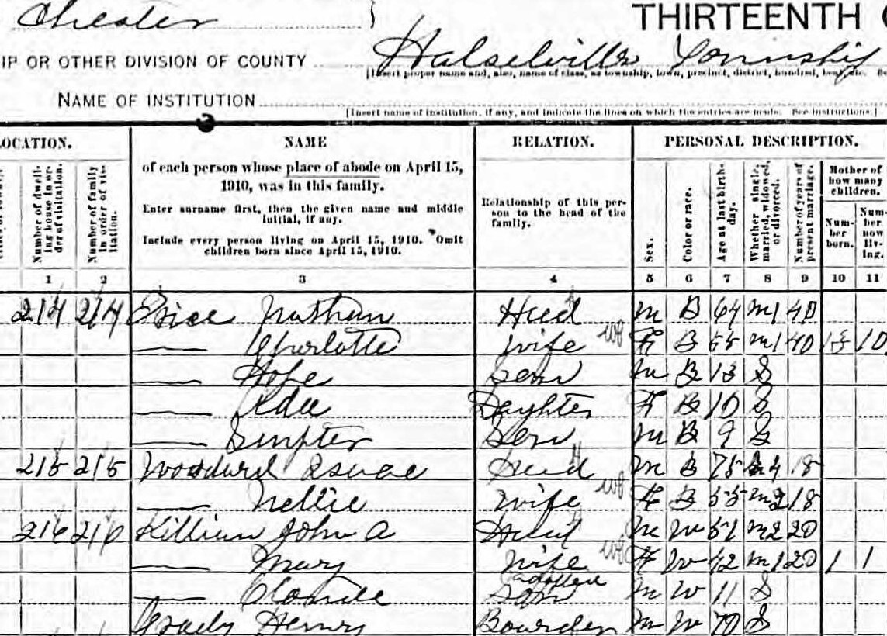
AKDHA DNA Committee Project to Establish a Sons of Andreas Killian DNA Baseline
My Y-DNA Test Did NOT Match the Andreas Killian DNA Baseline
This Means Somewhere Along the Line the Y-DNA Killian Link Was Broken
John Alexander
Killian
1859 SC - 1944 SC
Married
Mary Ann
Melton
1871 SC - 1939 SC
1900 Census Does Not Show Claude Tresvan Killian Living in John Alexander and Mary Ann Melton Killian’s Home
1910 Census (after a much closer look) Says Claude Tresvan Killian Adopted Son
I Asked All of the Living Uncles and Aunts If They Knew That “Pop” Was Adopted, Zero Knew
Grandma Killian Said There Are Some Adoption Papers in the Old Trunk in the Car Shed
Uncle Davis Had Obtained the Old Trunk and Said There Were Only Chewed Up Papers From Where Rats Had Nested
Before the Y-DNA Test, It Was Assumed That the Adoption Papers Were For John Alexander and Dora Killian
Afterall Henry Van Was Killed in the War, John and Dora Were Very Young Still, When Catherine Remarried William Jefferson Davis
Claude Tresvan Killian
1898 SC - 1973 SC
Adopted Son
Killian Y-DNA Not Match

Slide 28
Henry Van
Killian
1836 NC - 1864 GA
Married
Catherine
Lipford
1841 SC - 1906 SC
John Alexander
Killian
1859 SC - 1944 SC
Married
Mary Ann
Melton
1871 SC - 1939 SC

Slide 29
Henry Van
Killian
1836 NC - 1864 GA
Married
Catherine
Lipford
1841 SC - 1906 SC
John Alexander
Killian
1859 SC - 1944 SC
Married
Mary Ann
Melton
1871 SC - 1939 SC
Dora Elizabeth “Etta”
Killian
1862 SC - 1938 SC
Married 1880
Joseph Timothy
Bass
1856 SC - 1924 SC

Slide 30
Henry Van
Killian
1836 NC - 1864 GA
Married
Catherine
Lipford
1841 SC - 1906 SC
John Alexander
Killian
1859 SC - 1944 SC
Married
Mary Ann
Melton
1871 SC - 1939 SC
Dora Elizabeth “Etta”
Killian
1862 SC - 1938 SC
Married 1880
Joseph Timothy
Bass
1856 SC - 1924 SC
Between 1900 & 1910 Adopted
Claude Tresvan Killian
Claude Tresvan Killian
1898 SC - 1973 SC
Killian Y-DNA Not Match

Slide 31
Catherine
Lipford
1841 SC - 1906 SC
Married 1st Husband
Henry Van
Killian
1836 NC - 1864 GA
Y-DNA NOT Match
Catherine
Lipford
1841 SC - 1906 SC
Married 2nd Husband
William Jefferson Nathan
Davis
1838 SC - 1874 SC
John Alexander Killian
1859 SC – 1944 SC
Y-DNA NOT Match
2nd Wife
Mary Ann Melton
1867 SC – 1939 SC
Claude Tresvan Killian
1898 SC - 1973 SC
Adopted Son
Killian Y-DNA Not Match

Slide 32
Catherine
Lipford
1841 SC - 1906 SC
Married 1st Husband
Henry Van
Killian
1836 NC - 1864 GA
Y-DNA NOT Match
Catherine
Lipford
1841 SC - 1906 SC
Married 2nd Husband
William Jefferson Nathan
Davis
1838 SC - 1874 SC
Catherine Lipford’s Son
William Jefferson Nathan Davis Stepson
John Alexander Killian
1859 SC – 1944 SC
Y-DNA NOT Match
2nd Wife
Mary Ann Melton
1867 SC – 1939 SC
Claude Tresvan Killian
1898 SC - 1973 SC
Adopted Son
Killian Y-DNA Not Match

Slide 33
Catherine
Lipford
1841 SC - 1906 SC
Married 1st Husband
Henry Van
Killian
1836 NC - 1864 GA
Y-DNA NOT Match
Catherine
Lipford
1841 SC - 1906 SC
Married 2nd Husband
William Jefferson Nathan
Davis
1838 SC - 1874 SC
Catherine Lipford’s Son
William Jefferson Nathan Davis Stepson
John Alexander Killian
1859 SC – 1944 SC
Y-DNA NOT Match
2nd Wife
Mary Ann Melton
1867 SC – 1939 SC
Claude Tresvan Killian
1898 SC - 1973 SC
Adopted Son
Killian Y-DNA Not Match
Catherine Lipford’s
Adopted Grandson
William Jefferson Nathan Davis Adopted Step Grandson

Slide 34
Phillip Anderson
Davis
1805 SC - 1882 SC
Married
Elizabeth Frances
McJunkin
1820 SC - 1904 SC
Catherine
Lipford
1841 SC - 1906 SC
Married 1st Husband
Henry Van
Killian
1836 NC - 1864 GA
Y-DNA NOT Match
Catherine
Lipford
1841 SC - 1906 SC
Married 2nd Husband
William Jefferson Nathan
Davis
1838 SC - 1874 SC
Catherine Lipford’s Son
William Jefferson Nathan Davis Stepson
John Alexander Killian
1859 SC – 1944 SC
Y-DNA NOT Match
2nd Wife
Mary Ann Melton
1867 SC – 1939 SC
Catherine Lipford’s
Adopted Grandson
William Jefferson Nathan Davis Adopted Step Grandson
Claude Tresvan Killian
1898 SC - 1973 SC
Adopted Son
Killian Y-DNA Not Match

Slide 35
Phillip Anderson
Davis
1805 SC - 1882 SC
Married
Elizabeth Frances
McJunkin
1820 SC - 1904 SC
Catherine
Lipford
1841 SC - 1906 SC
Married 1st Husband
Henry Van
Killian
1836 NC - 1864 GA
Y-DNA NOT Match
Catherine
Lipford
1841 SC - 1906 SC
Married 2nd Husband
William Jefferson Nathan
Davis
1838 SC - 1874 SC
Frances Edwin
Davis
1855 SC - 1940 SC
Married
Mary Elizabeth
Gregory
1858 SC - 1898 SC
Catherine Lipford’s Son
William Jefferson Nathan Davis Stepson
John Alexander Killian
1859 SC – 1944 SC
Y-DNA NOT Match
2nd Wife
Mary Ann Melton
1867 SC – 1939 SC
Catherine Lipford’s
Adopted Grandson
William Jefferson Nathan Davis Adopted Step Grandson
Claude Tresvan Killian
1898 SC - 1973 SC
Adopted Son
Killian Y-DNA Not Match

Slide 36
Phillip Anderson
Davis
1805 SC - 1882 SC
Married
Elizabeth Frances
McJunkin
1820 SC - 1904 SC
Catherine
Lipford
1841 SC - 1906 SC
Married 1st Husband
Henry Van
Killian
1836 NC - 1864 GA
Y-DNA NOT Match
Catherine
Lipford
1841 SC - 1906 SC
Married 2nd Husband
William Jefferson Nathan
Davis
1838 SC - 1874 SC
Frances Edwin
Davis
1855 SC - 1940 SC
Married
Mary Elizabeth
Gregory
1858 SC - 1898 SC
Catherine Lipford’s Son
William Jefferson Nathan Davis Stepson Frances Edwin Davis and
Mary Elizabeth Gregory
Step Nephew
John Alexander Killian
1859 SC – 1944 SC
Y-DNA NOT Match
2nd Wife
Mary Ann Melton
1867 SC – 1939 SC
Claude Tresvan Killian
1898 SC - 1973 SC
Adopted Son
Killian Y-DNA Not Match

Slide 37
Phillip Anderson
Davis
1805 SC - 1882 SC
Married
Elizabeth Frances
McJunkin
1820 SC - 1904 SC
Catherine
Lipford
1841 SC - 1906 SC
Married 1st Husband
Henry Van
Killian
1836 NC - 1864 GA
Y-DNA NOT Match
Catherine Lipford’s
Adopted Grandson
William Jefferson Nathan Davis Adopted Step Grandson
Frances Edwin Davis and Mary Elizabeth Gregory
Adopted Step Great Nephew
Catherine
Lipford
1841 SC - 1906 SC
Married 2nd Husband
William Jefferson Nathan
Davis
1838 SC - 1874 SC
Frances Edwin
Davis
1855 SC - 1940 SC
Married
Mary Elizabeth
Gregory
1858 SC - 1898 SC
John Alexander Killian
1859 SC – 1944 SC
Y-DNA NOT Match
2nd Wife
Mary Ann Melton
1867 SC – 1939 SC
Claude Tresvan Killian
1898 SC - 1973 SC
Adopted Son
Killian Y-DNA Not Match

Slide 38
Phillip Anderson
Davis
1805 SC - 1882 SC
Married
Elizabeth Frances
McJunkin
1820 SC - 1904 SC
Catherine
Lipford
1841 SC - 1906 SC
Married 1st Husband
Henry Van
Killian
1836 NC - 1864 GA
Y-DNA NOT Match
Catherine
Lipford
1841 SC - 1906 SC
Married 2nd Husband
William Jefferson Nathan
Davis
1838 SC - 1874 SC
Frances Edwin
Davis
1855 SC - 1940 SC
Married
Mary Elizabeth
Gregory
1858 SC - 1898 SC
John Alexander Killian
1859 SC – 1944 SC
Y-DNA NOT Match
2nd Wife
Mary Ann Melton
1867 SC – 1939 SC
William
Davis
Henry
Davis
Claude Tresvan Killian
1898 SC - 1973 SC
Adopted Son
Killian Y-DNA Not Match
Samuel
Davis
Frances Elizabeth “Fannie”
Davis

Slide 39
Phillip Anderson
Davis
1805 SC - 1882 SC
Married
Elizabeth Frances
McJunkin
1820 SC - 1904 SC
Catherine
Lipford
1841 SC - 1906 SC
Married 1st Husband
Henry Van
Killian
1836 NC - 1864 GA
Y-DNA NOT Match
Catherine
Lipford
1841 SC - 1906 SC
Married 2nd Husband
William Jefferson Nathan
Davis
1838 SC - 1874 SC
Frances Edwin
Davis
1855 SC - 1940 SC
Married
Mary Elizabeth
Gregory
1858 SC - 1898 SC
John Alexander Killian
1859 SC – 1944 SC
Y-DNA NOT Match
2nd Wife
Mary Ann Melton
1867 SC – 1939 SC
Stepbrothers
Stepsister
William
Davis
Henry
Davis
Claude Tresvan Killian
1898 SC - 1973 SC
Adopted Son
Killian Y-DNA Not Match
Samuel
Davis
Frances Elizabeth “Fannie”
Davis

Slide 40
Phillip Anderson
Davis
1805 SC - 1882 SC
Married
Elizabeth Frances
McJunkin
1820 SC - 1904 SC
Catherine
Lipford
1841 SC - 1906 SC
Married 1st Husband
Henry Van
Killian
1836 NC - 1864 GA
Y-DNA NOT Match
Catherine
Lipford
1841 SC - 1906 SC
Married 2nd Husband
William Jefferson Nathan
Davis
1838 SC - 1874 SC
Frances Edwin
Davis
1855 SC - 1940 SC
Married
Mary Elizabeth
Gregory
1858 SC - 1898 SC
John Alexander Killian
1859 SC – 1944 SC
Y-DNA NOT Match
2nd Wife
Mary Ann Melton
1867 SC – 1939 SC
William
Davis
Henry
Davis
Claude Tresvan Killian
1898 SC - 1973 SC
Killian Y-DNA Not Match
Step Uncles
Step Aunt
Samuel
Davis
Frances Elizabeth “Fannie”
Davis

Slide 41
Phillip Anderson
Davis
1805 SC - 1882 SC
Married
Elizabeth Frances
McJunkin
1820 SC - 1904 SC
Tresvan
Gregory
1822 SC - 1899 SC
Married
Lavinia
Koon
1826 SC - 1889 SC
Catherine
Lipford
1841 SC - 1906 SC
Married 1st Husband
Henry Van
Killian
1836 NC - 1864 GA
Y-DNA NOT Match
Catherine
Lipford
1841 SC - 1906 SC
Married 2nd Husband
William Jefferson Nathan
Davis
1838 SC - 1874 SC
Frances Edwin
Davis
1855 SC - 1940 SC
Married
Mary Elizabeth
Gregory
1858 SC - 1898 SC
John Alexander Killian
1859 SC – 1944 SC
Y-DNA NOT Match
2nd Wife
Mary Ann Melton
1867 SC – 1939 SC
William
Davis
Henry
Davis
Claude Tresvan Killian
1898 SC - 1973 SC
Killian Y-DNA Not Match
Samuel
Davis
Frances Elizabeth “Fannie”
Davis

Slide 42
Phillip Anderson
Davis
1805 SC - 1882 SC
Married
Elizabeth Frances
McJunkin
1820 SC - 1904 SC
Tresvan
Gregory
1822 SC - 1899 SC
Married
Lavinia
Koon
1826 SC - 1889 SC
Catherine
Lipford
1841 SC - 1906 SC
Married 1st Husband
Henry Van
Killian
1836 NC - 1864 GA
Y-DNA NOT Match
Catherine
Lipford
1841 SC - 1906 SC
Married 2nd Husband
William Jefferson Nathan
Davis
1838 SC - 1874 SC
Frances Edwin
Davis
1855 SC - 1940 SC
Married
Mary Elizabeth
Gregory
1858 SC - 1898 SC
John Alexander Killian
1859 SC – 1944 SC
Y-DNA NOT Match
2nd Wife
Mary Ann Melton
1867 SC – 1939 SC
William
Davis
Clara Desdemonia
Davis
Henry
Davis
Claude Tresvan Killian
1898 SC - 1973 SC
Killian Y-DNA Not Match
Samuel
Davis
Frances Elizabeth “Fannie”
Davis

Slide 43
Phillip Anderson
Davis
1805 SC - 1882 SC
Married
Elizabeth Frances
McJunkin
1820 SC - 1904 SC
Tresvan
Gregory
1822 SC - 1899 SC
Married
Lavinia
Koon
1826 SC - 1889 SC
Catherine
Lipford
1841 SC - 1906 SC
Married 1st Husband
Henry Van
Killian
1836 NC - 1864 GA
Y-DNA NOT Match
Catherine
Lipford
1841 SC - 1906 SC
Married 2nd Husband
William Jefferson Nathan
Davis
1838 SC - 1874 SC
Frances Edwin
Davis
1855 SC - 1940 SC
Married
Mary Elizabeth
Gregory
1858 SC - 1898 SC
John Alexander Killian
1859 SC – 1944 SC
Y-DNA NOT Match
2nd Wife
Mary Ann Melton
1867 SC – 1939 SC
William
Davis
Clara Desdemonia
Davis
Henry
Davis
Step 1st Cousin Once Removed
Claude Tresvan Killian
1898 SC - 1973 SC
Killian Y-DNA Not Match
Samuel
Davis
Frances Elizabeth “Fannie”
Davis

Slide 44
Phillip Anderson
Davis
1805 SC - 1882 SC
Married
Elizabeth Frances
McJunkin
1820 SC - 1904 SC
Tresvan
Gregory
1822 SC - 1899 SC
Married
Lavinia
Koon
1826 SC - 1889 SC
Catherine
Lipford
1841 SC - 1906 SC
Married 1st Husband
Henry Van
Killian
1836 NC - 1864 GA
Y-DNA NOT Match
Catherine
Lipford
1841 SC - 1906 SC
Married 2nd Husband
William Jefferson Nathan
Davis
1838 SC - 1874 SC
Frances Edwin
Davis
1855 SC - 1940 SC
Married
Mary Elizabeth
Gregory
1858 SC - 1898 SC
John Alexander Killian
1859 SC – 1944 SC
Y-DNA NOT Match
2nd Wife
Mary Ann Melton
1867 SC – 1939 SC
William
Davis
Clara Desdemonia
Davis
Henry
Davis
Claude Tresvan Killian
1898 SC - 1973 SC
Killian Y-DNA Not Match
Samuel
Davis
1st Cousins
Frances Elizabeth “Fannie”
Davis

Slide 45
Phillip Anderson
Davis
1805 SC - 1882 SC
Married
Elizabeth Frances
McJunkin
1820 SC - 1904 SC
Tresvan
Gregory
1822 SC - 1899 SC
Married
Lavinia
Koon
1826 SC - 1889 SC
General Edward
Taylor
1814 SC - 1896 SC
Married 2nd Wife
Mary
Knight
1839 SC - 1915 SC
Catherine
Lipford
1841 SC - 1906 SC
Married 1st Husband
Henry Van
Killian
1836 NC - 1864 GA
Y-DNA NOT Match
Catherine
Lipford
1841 SC - 1906 SC
Married 2nd Husband
William Jefferson Nathan
Davis
1838 SC - 1874 SC
Frances Edwin
Davis
1855 SC - 1940 SC
Married
Mary Elizabeth
Gregory
1858 SC - 1898 SC
John Alexander Killian
1859 SC – 1944 SC
Y-DNA NOT Match
2nd Wife
Mary Ann Melton
1867 SC – 1939 SC
William
Davis
Clara Desdemonia
Davis
Henry
Davis
Claude Tresvan Killian
1898 SC - 1973 SC
Killian Y-DNA Not Match
Samuel
Davis
Frances Elizabeth “Fannie”
Davis

Slide 46
Phillip Anderson
Davis
1805 SC - 1882 SC
Married
Elizabeth Frances
McJunkin
1820 SC - 1904 SC
Tresvan
Gregory
1822 SC - 1899 SC
Married
Lavinia
Koon
1826 SC - 1889 SC
General Edward
Taylor
1814 SC - 1896 SC
Married 2nd Wife
Mary
Knight
1839 SC - 1915 SC
Catherine
Lipford
1841 SC - 1906 SC
Married 1st Husband
Henry Van
Killian
1836 NC - 1864 GA
Y-DNA NOT Match
Catherine
Lipford
1841 SC - 1906 SC
Married 2nd Husband
William Jefferson Nathan
Davis
1838 SC - 1874 SC
Frances Edwin
Davis
1855 SC - 1940 SC
Married
Mary Elizabeth
Gregory
1858 SC - 1898 SC
Thomas Elijah
Taylor
1868 SC - 1945 SC
Married
Frances Elizabeth “Fannie”
Davis
1868 SC - 1914 SC
John Alexander Killian
1859 SC – 1944 SC
Y-DNA NOT Match
2nd Wife
Mary Ann Melton
1867 SC – 1939 SC
William
Davis
Clara Desdemonia
Davis
Henry
Davis
Claude Tresvan Killian
1898 SC - 1973 SC
Killian Y-DNA Not Match
Samuel
Davis
Frances Elizabeth “Fannie”
Davis

Slide 47
Phillip Anderson
Davis
1805 SC - 1882 SC
Married
Elizabeth Frances
McJunkin
1820 SC - 1904 SC
Tresvan
Gregory
1822 SC - 1899 SC
Married
Lavinia
Koon
1826 SC - 1889 SC
General Edward
Taylor
1814 SC - 1896 SC
Married 2nd Wife
Mary
Knight
1839 SC - 1915 SC
Catherine
Lipford
1841 SC - 1906 SC
Married 1st Husband
Henry Van
Killian
1836 NC - 1864 GA
Y-DNA NOT Match
Frances Edwin
Davis
1855 SC - 1940 SC
Married
Mary Elizabeth
Gregory
1858 SC - 1898 SC
Catherine
Lipford
1841 SC - 1906 SC
Married 2nd Husband
William Jefferson Nathan
Davis
1838 SC - 1874 SC
Thomas Elijah
Taylor
1868 SC - 1945 SC
Married
Frances Elizabeth “Fannie”
Davis
1868 SC - 1914 SC
John Alexander Killian
1859 SC – 1944 SC
Y-DNA NOT Match
2nd Wife
Mary Ann Melton
1867 SC – 1939 SC
Clara Desdemonia
Davis
William
Davis
Henry
Davis
Claude Tresvan Killian
1898 SC - 1973 SC
Killian Y-DNA Not Match
Samuel
Davis
Frances Elizabeth “Fannie”
Davis

Slide 48
Phillip Anderson
Davis
1805 SC - 1882 SC
Married
Elizabeth Frances
McJunkin
1820 SC - 1904 SC
Tresvan
Gregory
1822 SC - 1899 SC
Married
Lavinia
Koon
1826 SC - 1889 SC
General Edward
Taylor
1814 SC - 1896 SC
Married 2nd Wife
Mary
Knight
1839 SC - 1915 SC
Catherine
Lipford
1841 SC - 1906 SC
Married 1st Husband
Henry Van
Killian
1836 NC - 1864 GA
Y-DNA NOT Match
Frances Edwin
Davis
1855 SC - 1940 SC
Married
Mary Elizabeth
Gregory
1858 SC - 1898 SC
Catherine
Lipford
1841 SC - 1906 SC
Married 2nd Husband
William Jefferson Nathan
Davis
1838 SC - 1874 SC
Thomas Elijah
Taylor
1868 SC - 1945 SC
Married
Frances Elizabeth “Fannie”
Davis
1868 SC - 1914 SC
John Alexander Killian
1859 SC – 1944 SC
Y-DNA NOT Match
2nd Wife
Mary Ann Melton
1867 SC – 1939 SC
Clara Desdemonia
Davis
William
Davis
Henry
Davis
Claude Tresvan Killian
1898 SC - 1973 SC
Killian Y-DNA Not Match
Samuel
Davis
Frances Elizabeth “Fannie”
Davis

Slide 49
Phillip Anderson
Davis
1805 SC - 1882 SC
Married
Elizabeth Frances
McJunkin
1820 SC - 1904 SC
Tresvan
Gregory
1822 SC - 1899 SC
Married
Lavinia
Koon
1826 SC - 1889 SC
General Edward
Taylor
1814 SC - 1896 SC
Married 2nd Wife
Mary
Knight
1839 SC - 1915 SC
Catherine
Lipford
1841 SC - 1906 SC
Married 1st Husband
Henry Van
Killian
1836 NC - 1864 GA
Y-DNA NOT Match
Frances Edwin
Davis
1855 SC - 1940 SC
Married
Mary Elizabeth
Gregory
1858 SC - 1898 SC
Catherine
Lipford
1841 SC - 1906 SC
Married 2nd Husband
William Jefferson Nathan
Davis
1838 SC - 1874 SC
Thomas Elijah
Taylor
1868 SC - 1945 SC
Married
Frances Elizabeth “Fannie”
Davis
1868 SC - 1914 SC
John Alexander Killian
1859 SC – 1944 SC
Y-DNA NOT Match
2nd Wife
Mary Ann Melton
1867 SC – 1939 SC
Clara Desdemonia
Davis
William
Davis
Thomas
Taylor
Henry
Davis
Vivian
Taylor
Claude Tresvan Killian
1898 SC - 1973 SC
Killian Y-DNA Not Match
Samuel
Davis
Mamie O.
Taylor
Frances Elizabeth “Fannie”
Davis
Malcom
Taylor

Slide 50
Phillip Anderson
Davis
1805 SC - 1882 SC
Married
Elizabeth Frances
McJunkin
1820 SC - 1904 SC
Tresvan
Gregory
1822 SC - 1899 SC
Married
Lavinia
Koon
1826 SC - 1889 SC
General Edward
Taylor
1814 SC - 1896 SC
Married 2nd Wife
Mary
Knight
1839 SC - 1915 SC
Catherine
Lipford
1841 SC - 1906 SC
Married 1st Husband
Henry Van
Killian
1836 NC - 1864 GA
Y-DNA NOT Match
Frances Edwin
Davis
1855 SC - 1940 SC
Married
Mary Elizabeth
Gregory
1858 SC - 1898 SC
Catherine
Lipford
1841 SC - 1906 SC
Married 2nd Husband
William Jefferson Nathan
Davis
1838 SC - 1874 SC
Thomas Elijah
Taylor
1868 SC - 1945 SC
Married
Frances Elizabeth “Fannie”
Davis
1868 SC - 1914 SC
1st Cousins
Once Removed
John Alexander Killian
1859 SC – 1944 SC
Y-DNA NOT Match
2nd Wife
Mary Ann Melton
1867 SC – 1939 SC
Clara Desdemonia
Davis
William
Davis
Thomas
Taylor
Henry
Davis
Vivian
Taylor
Claude Tresvan Killian
1898 SC - 1973 SC
Killian Y-DNA Not Match
Samuel
Davis
Mamie O.
Taylor
Frances Elizabeth “Fannie”
Davis
Malcom
Taylor

Slide 51
Phillip Anderson
Davis
1805 SC - 1882 SC
Married
Elizabeth Frances
McJunkin
1820 SC - 1904 SC
Tresvan
Gregory
1822 SC - 1899 SC
Married
Lavinia
Koon
1826 SC - 1889 SC
General Edward
Taylor
1814 SC - 1896 SC
Married 2nd Wife
Mary
Knight
1839 SC - 1915 SC
Catherine
Lipford
1841 SC - 1906 SC
Married 1st Husband
Henry Van
Killian
1836 NC - 1864 GA
Y-DNA NOT Match
Frances Edwin
Davis
1855 SC - 1940 SC
Married
Mary Elizabeth
Gregory
1858 SC - 1898 SC
Catherine
Lipford
1841 SC - 1906 SC
Married 2nd Husband
William Jefferson Nathan
Davis
1838 SC - 1874 SC
Thomas Elijah
Taylor
1868 SC - 1945 SC
Married
Frances Elizabeth “Fannie”
Davis
1868 SC - 1914 SC
1st Cousins
Once Removed
John Alexander Killian
1859 SC – 1944 SC
Y-DNA NOT Match
2nd Wife
Mary Ann Melton
1867 SC – 1939 SC
Clara Desdemonia
Davis
William
Davis
Thomas
Taylor
Henry
Davis
Vivian
Taylor
Claude Tresvan Killian
1898 SC - 1973 SC
Killian Y-DNA Not Match
Samuel
Davis
Mamie O.
Taylor
Frances Elizabeth “Fannie”
Davis
Malcom
Taylor

Slide 52
Phillip Anderson
Davis
1805 SC - 1882 SC
Married
Elizabeth Frances
McJunkin
1820 SC - 1904 SC
Tresvan
Gregory
1822 SC - 1899 SC
Married
Lavinia
Koon
1826 SC - 1889 SC
General Edward
Taylor
1814 SC - 1896 SC
Married 2nd Wife
Mary
Knight
1839 SC - 1915 SC
Catherine
Lipford
1841 SC - 1906 SC
Married 1st Husband
Henry Van
Killian
1836 NC - 1864 GA
Y-DNA NOT Match
Frances Edwin
Davis
1855 SC - 1940 SC
Married
Mary Elizabeth
Gregory
1858 SC - 1898 SC
Catherine
Lipford
1841 SC - 1906 SC
Married 2nd Husband
William Jefferson Nathan
Davis
1838 SC - 1874 SC
Thomas Elijah
Taylor
1868 SC - 1945 SC
Married
Frances Elizabeth “Fannie”
Davis
1868 SC - 1914 SC
John Alexander Killian
1859 SC – 1944 SC
Y-DNA NOT Match
2nd Wife
Mary Ann Melton
1867 SC – 1939 SC
Claude Tresvan Killian
1898 SC - 1973 SC
Killian Y-DNA Not Match
Davis Autosomal DNA
Clara Desdemonia
Davis
William
Davis
Thomas
Taylor
Henry
Davis
Vivian
Taylor
Samuel
Davis
Mamie O.
Taylor
Frances Elizabeth “Fannie”
Davis
Malcom
Taylor

Slide 53
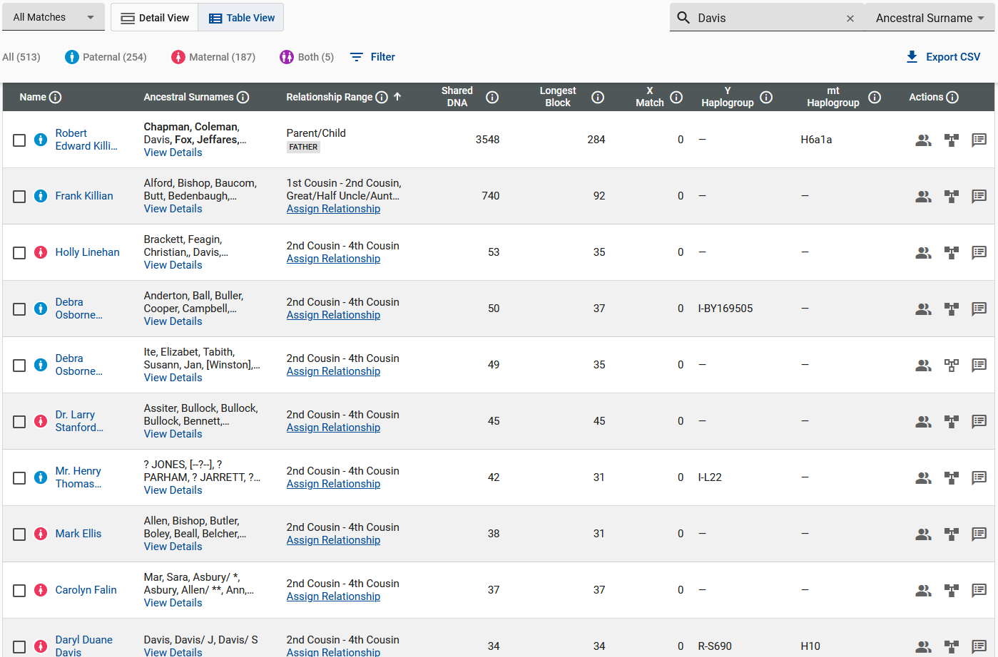

Slide 54
Phillip Anderson
Davis
1805 SC - 1882 SC
Married
Elizabeth Frances
McJunkin
1820 SC - 1904 SC
Tresvan
Gregory
1822 SC - 1899 SC
Married
Lavinia
Koon
1826 SC - 1889 SC
General Edward
Taylor
1814 SC - 1896 SC
Married 2nd Wife
Mary
Knight
1839 SC - 1915 SC
Catherine
Lipford
1841 SC - 1906 SC
Married 1st Husband
Henry Van
Killian
1836 NC - 1864 GA
Y-DNA NOT Match
Frances Edwin
Davis
1855 SC - 1940 SC
Married
Mary Elizabeth
Gregory
1858 SC - 1898 SC
Catherine
Lipford
1841 SC - 1906 SC
Married 2nd Husband
William Jefferson Nathan
Davis
1838 SC - 1874 SC
Thomas Elijah
Taylor
1868 SC - 1945 SC
Married
Frances Elizabeth “Fannie”
Davis
1868 SC - 1914 SC
John Alexander Killian
1859 SC – 1944 SC
Y-DNA NOT Match
2nd Wife
Mary Ann Melton
1867 SC – 1939 SC
Clara Desdemonia
Davis
William
Davis
Thomas
Taylor
Claude Tresvan Killian
1898 SC - 1973 SC
Killian Y-DNA Not Match
Davis Autosomal DNA
Gregory Autosomal DNA
Henry
Davis
Vivian
Taylor
Samuel
Davis
Mamie O.
Taylor
Frances Elizabeth “Fannie”
Davis
Malcom
Taylor

Slide 55
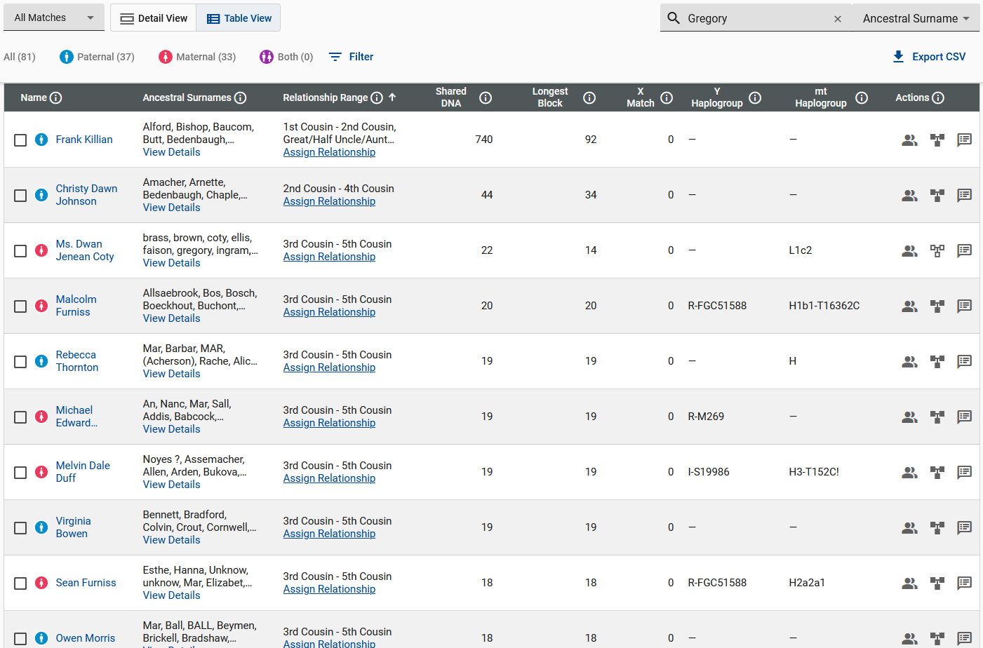

Slide 56
Phillip Anderson
Davis
1805 SC - 1882 SC
Married
Elizabeth Frances
McJunkin
1820 SC - 1904 SC
Tresvan
Gregory
1822 SC - 1899 SC
Married
Lavinia
Koon
1826 SC - 1889 SC
General Edward
Taylor
1814 SC - 1896 SC
Married 2nd Wife
Mary
Knight
1839 SC - 1915 SC
Catherine
Lipford
1841 SC - 1906 SC
Married 1st Husband
Henry Van
Killian
1836 NC - 1864 GA
Y-DNA NOT Match
Frances Edwin
Davis
1855 SC - 1940 SC
Married
Mary Elizabeth
Gregory
1858 SC - 1898 SC
Catherine
Lipford
1841 SC - 1906 SC
Married 2nd Husband
William Jefferson Nathan
Davis
1838 SC - 1874 SC
Thomas Elijah
Taylor
1868 SC - 1945 SC
Married
Frances Elizabeth “Fannie”
Davis
1868 SC - 1914 SC
John Alexander Killian
1859 SC – 1944 SC
Y-DNA NOT Match
2nd Wife
Mary Ann Melton
1867 SC – 1939 SC
Clara Desdemonia
Davis
William
Davis
Thomas
Taylor
Claude Tresvan Killian
1898 SC - 1973 SC
Killian Y-DNA Not Match
Davis Autosomal DNA
Gregory Autosomal DNA
McJunkin Autosomal DNA
Henry
Davis
Vivian
Taylor
Samuel
Davis
Mamie O.
Taylor
Frances Elizabeth “Fannie”
Davis
Malcom
Taylor

Slide 57
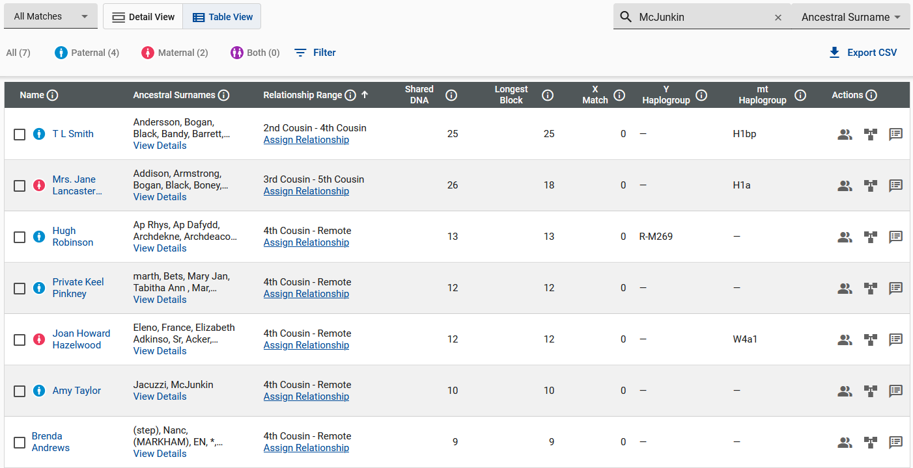

Slide 58
Phillip Anderson
Davis
1805 SC - 1882 SC
Married
Elizabeth Frances
McJunkin
1820 SC - 1904 SC
Tresvan
Gregory
1822 SC - 1899 SC
Married
Lavinia
Koon
1826 SC - 1889 SC
General Edward
Taylor
1814 SC - 1896 SC
Married 2nd Wife
Mary
Knight
1839 SC - 1915 SC
Catherine
Lipford
1841 SC - 1906 SC
Married 1st Husband
Henry Van
Killian
1836 NC - 1864 GA
Y-DNA NOT Match
Frances Edwin
Davis
1855 SC - 1940 SC
Married
Mary Elizabeth
Gregory
1858 SC - 1898 SC
Catherine
Lipford
1841 SC - 1906 SC
Married 2nd Husband
William Jefferson Nathan
Davis
1838 SC - 1874 SC
Thomas Elijah
Taylor
1868 SC - 1945 SC
Married
Frances Elizabeth “Fannie”
Davis
1868 SC - 1914 SC
John Alexander Killian
1859 SC – 1944 SC
Y-DNA NOT Match
2nd Wife
Mary Ann Melton
1867 SC – 1939 SC
Clara Desdemonia
Davis
William
Davis
Thomas
Taylor
Claude Tresvan Killian
1898 SC - 1973 SC
Killian Y-DNA Not Match
Davis Autosomal DNA
Gregory Autosomal DNA
McJunkin Autosomal DNA
Koon Autosomal DNA
Henry
Davis
Vivian
Taylor
Samuel
Davis
Mamie O.
Taylor
Frances Elizabeth “Fannie”
Davis
Malcom
Taylor

Slide 59
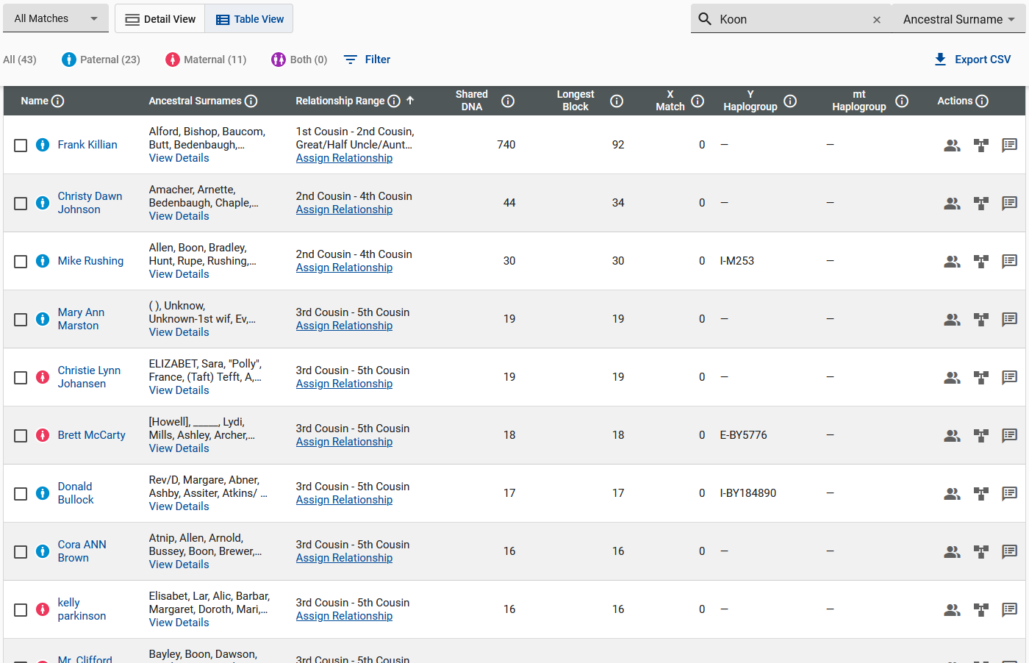

Slide 60
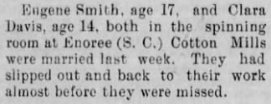
Tresvan
Gregory
1822 SC - 1899 SC
Married
Lavinia
Koon
1826 SC - 1889 SC
Phillip Anderson
Davis
1805 SC - 1882 SC
Married
Elizabeth Frances
McJunkin
1820 SC - 1904 SC
General Edward
Taylor
1814 SC - 1896 SC
Married 2nd Wife
Mary
Knight
1839 SC - 1915 SC
Catherine
Lipford
1841 SC - 1906 SC
Married 1st Husband
Henry Van
Killian
1836 NC - 1864 GA
Y-DNA NOT Match
Frances Edwin
Davis
1855 SC - 1940 SC
Married
Mary Elizabeth
Gregory
1858 SC - 1898 SC
Catherine
Lipford
1841 SC - 1906 SC
Married 2nd Husband
William Jefferson Nathan
Davis
1838 SC - 1874 SC
Thomas Elijah
Taylor
1868 SC - 1945 SC
Married
Frances Elizabeth “Fannie”
Davis
1868 SC - 1914 SC
John Alexander Killian
1859 SC – 1944 SC
Y-DNA NOT Match
2nd Wife
Mary Ann Melton
1867 SC – 1939 SC
Clara Desdemonia
Davis
William
Davis
Henry
Davis
Claude Tresvan Killian
1898 SC - 1973 SC
Killian Y-DNA Not Match
Davis Autosomal DNA
Gregory Autosomal DNA
McJunkin Autosomal DNA
Koon Autosomal DNA
Samuel
Davis
Thomas
Taylor
Frances Elizabeth “Fannie”
Davis
Vivian
Taylor
Mamie O.
Taylor
Malcom
Taylor
29 July 1897 Gaffney, SC

Slide 61
Tresvan
Gregory
1822 SC - 1899 SC
Married
Lavinia
Koon
1826 SC - 1889 SC
Phillip Anderson
Davis
1805 SC - 1882 SC
Married
Elizabeth Frances
McJunkin
1820 SC - 1904 SC
General Edward
Taylor
1814 SC - 1896 SC
Married 2nd Wife
Mary
Knight
1839 SC - 1915 SC
Catherine
Lipford
1841 SC - 1906 SC
Married 1st Husband
Henry Van
Killian
1836 NC - 1864 GA
Y-DNA NOT Match
Frances Edwin
Davis
1855 SC - 1940 SC
Married
Mary Elizabeth
Gregory
1858 SC - 1898 SC
Catherine
Lipford
1841 SC - 1906 SC
Married 2nd Husband
William Jefferson Nathan
Davis
1838 SC - 1874 SC
Thomas Elijah
Taylor
1868 SC - 1945 SC
Married
Frances Elizabeth “Fannie”
Davis
1868 SC - 1914 SC
John Alexander Killian
1859 SC – 1944 SC
Y-DNA NOT Match
2nd Wife
Mary Ann Melton
1867 SC – 1939 SC
Eugene Tamlin
Smith
1881 NC - 1973 KS
Brother Claude Smith
Clara Desdemonia
Davis
William
Davis
Henry
Davis
Claude Tresvan Killian
1898 SC - 1973 SC
Killian Y-DNA Not Match
Davis Autosomal DNA
Gregory Autosomal DNA
McJunkin Autosomal DNA
Koon Autosomal DNA
Samuel
Davis
Thomas
Taylor
Frances Elizabeth “Fannie”
Davis
Vivian
Taylor
Mamie O.
Taylor
Malcom
Taylor
29 July 1897 Gaffney, SC

Slide 62
Tresvan
Gregory
1822 SC - 1899 SC
Married
Lavinia
Koon
1826 SC - 1889 SC
Phillip Anderson
Davis
1805 SC - 1882 SC
Married
Elizabeth Frances
McJunkin
1820 SC - 1904 SC
General Edward
Taylor
1814 SC - 1896 SC
Married 2nd Wife
Mary
Knight
1839 SC - 1915 SC
Catherine
Lipford
1841 SC - 1906 SC
Married 1st Husband
Henry Van
Killian
1836 NC - 1864 GA
Y-DNA NOT Match
Frances Edwin
Davis
1855 SC - 1940 SC
Married
Mary Elizabeth
Gregory
1858 SC - 1898 SC
Catherine
Lipford
1841 SC - 1906 SC
Married 2nd Husband
William Jefferson Nathan
Davis
1838 SC - 1874 SC
Thomas Elijah
Taylor
1868 SC - 1945 SC
Married
Frances Elizabeth “Fannie”
Davis
1868 SC - 1914 SC
John Alexander Killian
1859 SC – 1944 SC
Y-DNA NOT Match
2nd Wife
Mary Ann Melton
1867 SC – 1939 SC
Eugene Tamlin
Smith (Bartee-Terry)
1881 NC - 1973 KS
Y-DNA 111 Match
Autosomal DNA Match
Brother Claude Smith
Clara Desdemonia
Davis
William
Davis
Henry
Davis
Claude Tresvan Killian
1898 SC - 1973 SC
Killian Y-DNA Not Match
Davis Autosomal DNA
Gregory Autosomal DNA
McJunkin Autosomal DNA
Koon Autosomal DNA
Bartee Y-DNA 111 Match
Bartee Autosomal DNA
Samuel
Davis
Thomas
Taylor
Frances Elizabeth “Fannie”
Davis
Vivian
Taylor
Mamie O.
Taylor
Malcom
Taylor
29 July 1897 Gaffney, SC

Slide 63
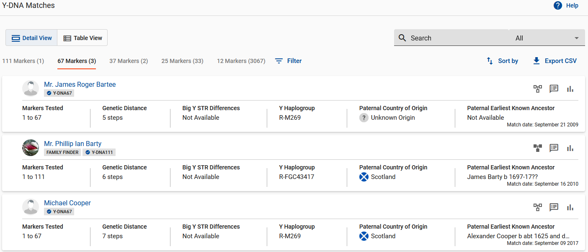

Slide 64
Tresvan
Gregory
1822 SC - 1899 SC
Married
Lavinia
Koon
1826 SC - 1889 SC
Phillip Anderson
Davis
1805 SC - 1882 SC
Married
Elizabeth Frances
McJunkin
1820 SC - 1904 SC
General Edward
Taylor
1814 SC - 1896 SC
Married 2nd Wife
Mary
Knight
1839 SC - 1915 SC
Catherine
Lipford
1841 SC - 1906 SC
Married 1st Husband
Henry Van
Killian
1836 NC - 1864 GA
Y-DNA NOT Match
Frances Edwin
Davis
1855 SC - 1940 SC
Married
Mary Elizabeth
Gregory
1858 SC - 1898 SC
Catherine
Lipford
1841 SC - 1906 SC
Married 2nd Husband
William Jefferson Nathan
Davis
1838 SC - 1874 SC
Thomas Elijah
Taylor
1868 SC - 1945 SC
Married
Frances Elizabeth “Fannie”
Davis
1868 SC - 1914 SC
John Alexander Killian
1859 SC – 1944 SC
Y-DNA NOT Match
2nd Wife
Mary Ann Melton
1867 SC – 1939 SC
Eugene Tamlin
Smith (Bartee-Terry)
1881 NC - 1973 KS
Y-DNA 111 Match
Autosomal DNA Match
Brother Claude Smith
Clara Desdemonia
Davis
William
Davis
Henry
Davis
Claude Tresvan Killian
1898 SC - 1973 SC
Killian Y-DNA Not Match
Davis Autosomal DNA
Gregory Autosomal DNA
McJunkin Autosomal DNA
Koon Autosomal DNA
Bartee Y-DNA 111 Match
Bartee Autosomal DNA
Samuel
Davis
Thomas
Taylor
Frances Elizabeth “Fannie”
Davis
Vivian
Taylor
Mamie O.
Taylor
Malcom
Taylor
29 July 1897 Gaffney, SC

Slide 65
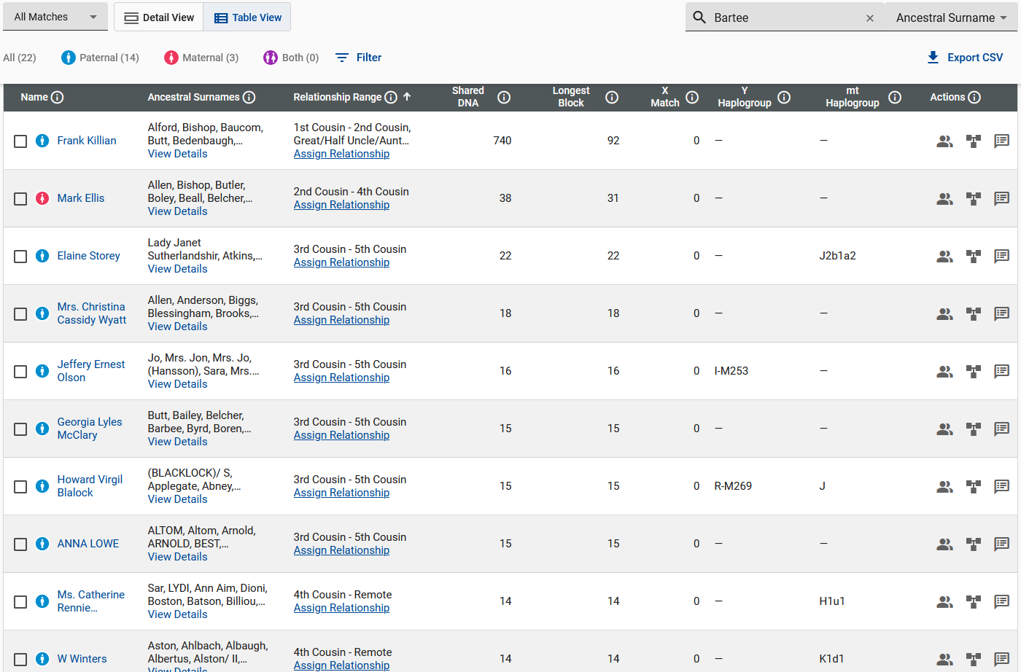

Slide 66
Tresvan
Gregory
1822 SC - 1899 SC
Married
Lavinia
Koon
1826 SC - 1889 SC
Phillip Anderson
Davis
1805 SC - 1882 SC
Married
Elizabeth Frances
McJunkin
1820 SC - 1904 SC
General Edward
Taylor
1814 SC - 1896 SC
Married 2nd Wife
Mary
Knight
1839 SC - 1915 SC
Frances Edwin
Davis
1855 SC - 1940 SC
Married
Mary Elizabeth
Gregory
1858 SC - 1898 SC
Catherine
Lipford
1841 SC - 1906 SC
Married 2nd Husband
William Jefferson Nathan
Davis
1838 SC - 1874 SC
Thomas Elijah
Taylor
1868 SC - 1945 SC
Married
Frances Elizabeth “Fannie”
Davis
1868 SC - 1914 SC
Eugene Tamlin
Smith
1881 NC - 1973 KS
Y-DNA 111 Match
Autosomal DNA Match
Brother Claude Smith
Married
Autosomal DNA Match
Clara Desdemonia
Davis
1880 SC - 1970 GA
William
Davis
Henry
Davis
Samuel
Davis
Frances Elizabeth “Fannie”
Davis
Thomas
Taylor
Claude Tresvan Killian
1898 SC - 1973 SC
Killian Y-DNA Not Match, Bartee Y-DNA 111 Match
Davis, Gregory, McJunkin, Koon, Bartee Autosomal DNA
Vivian
Taylor
Mamie O.
Taylor
Malcom
Taylor

Slide 67
Tresvan
Gregory
1822 SC - 1899 SC
Married
Lavinia
Koon
1826 SC - 1889 SC
Phillip Anderson
Davis
1805 SC - 1882 SC
Married
Elizabeth Frances
McJunkin
1820 SC - 1904 SC
General Edward
Taylor
1814 SC - 1896 SC
Married 2nd Wife
Mary
Knight
1839 SC - 1915 SC
Richard Maryland
Bartee
1861 NC - 1938 NC
Married
Sarah Sahara Virginia Terry
1856 NC - 1921 SC
Frances Edwin
Davis
1855 SC - 1940 SC
Married
Mary Elizabeth
Gregory
1858 SC - 1898 SC
Catherine
Lipford
1841 SC - 1906 SC
Married 2nd Husband
William Jefferson Nathan
Davis
1838 SC - 1874 SC
Thomas Elijah
Taylor
1868 SC - 1945 SC
Married
Frances Elizabeth “Fannie”
Davis
1868 SC - 1914 SC
Eugene Tamlin
Smith (Bartee-Terry)
1881 NC - 1973 KS
Y-DNA 111 Match
Autosomal DNA Match
Brother Claude Smith
Married
Autosomal DNA Match
Clara Desdemonia
Davis
1880 SC - 1970 GA
William
Davis
Henry
Davis
Samuel
Davis
Frances Elizabeth “Fannie”
Davis
Thomas
Taylor
Claude Tresvan Killian
1898 SC - 1973 SC
Killian Y-DNA Not Match, Bartee Y-DNA 111 Match
Davis, Gregory, McJunkin, Koon, Bartee, Terry Autosomal DNA
Vivian
Taylor
Mamie O.
Taylor
Malcom
Taylor

Slide 68
Tresvan
Gregory
1822 SC - 1899 SC
Married
Lavinia
Koon
1826 SC - 1889 SC
Phillip Anderson
Davis
1805 SC - 1882 SC
Married
Elizabeth Frances
McJunkin
1820 SC - 1904 SC
General Edward
Taylor
1814 SC - 1896 SC
Married 2nd Wife
Mary
Knight
1839 SC - 1915 SC
Richard Maryland
Bartee
1861 NC - 1938 NC
Married
Sarah Sahara Virginia Terry
1856 NC - 1921 SC
Frances Edwin
Davis
1855 SC - 1940 SC
Married
Mary Elizabeth
Gregory
1858 SC - 1898 SC
Catherine
Lipford
1841 SC - 1906 SC
Married 2nd Husband
William Jefferson Nathan
Davis
1838 SC - 1874 SC
Thomas Elijah
Taylor
1868 SC - 1945 SC
Married
Frances Elizabeth “Fannie”
Davis
1868 SC - 1914 SC
Eugene Tamlin
Smith (Bartee-Terry)
1881 NC - 1973 KS
Y-DNA 111 Match
Autosomal DNA Match
Brother Claude Smith
Married
Autosomal DNA Match
Clara Desdemonia
Davis
1880 SC - 1970 GA
William
Davis
Henry
Davis
Samuel
Davis
Frances Elizabeth “Fannie”
Davis
Thomas
Taylor
Claude Tresvan Killian
1898 SC - 1973 SC
Killian Y-DNA Not Match, Bartee Y-DNA 111 Match
Davis, Gregory, McJunkin, Koon, Bartee, Terry Autosomal DNA
Vivian
Taylor
Mamie O.
Taylor
Malcom
Taylor

Slide 69
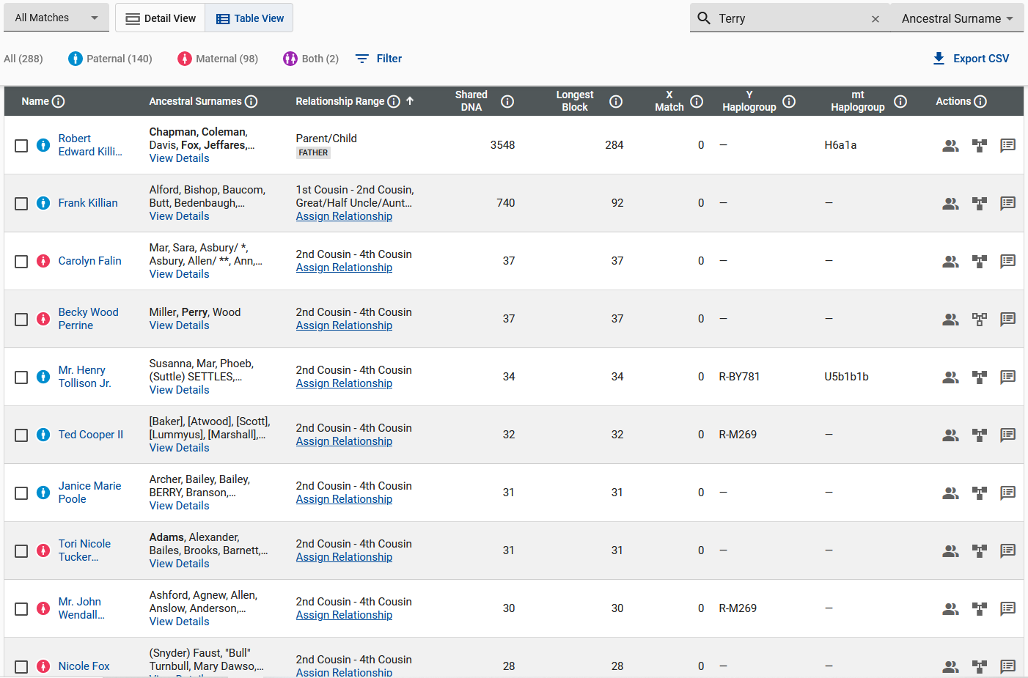

Slide 70
Tresvan
Gregory
1822 SC - 1899 SC
Married
Lavinia
Koon
1826 SC - 1889 SC
Phillip Anderson
Davis
1805 SC - 1882 SC
Married
Elizabeth Frances
McJunkin
1820 SC - 1904 SC
General Edward
Taylor
1814 SC - 1896 SC
Married 2nd Wife
Mary
Knight
1839 SC - 1915 SC
Richard Maryland
Bartee
1861 NC - 1938 NC
Married
Sarah Sahara Virginia Terry
1856 NC - 1921 SC
Frances Edwin
Davis
1855 SC - 1940 SC
Married
Mary Elizabeth
Gregory
1858 SC - 1898 SC
Catherine
Lipford
1841 SC - 1906 SC
Married 2nd Husband
William Jefferson Nathan
Davis
1838 SC - 1874 SC
Thomas Elijah
Taylor
1868 SC - 1945 SC
Married
Frances Elizabeth “Fannie”
Davis
1868 SC - 1914 SC
“Pop’s” Biological
Father
According to
DNA Results
Eugene Tamlin
Smith (Bartee-Terry)
1881 NC - 1973 KS
Y-DNA 111 Match
Autosomal DNA Match
Brother Claude Smith
Married
Autosomal DNA Match
Clara Desdemonia
Davis
1880 SC - 1970 GA
William
Davis
“Pop’s” Biological
Mother
According to
DNA Results
Henry
Davis
Samuel
Davis
Frances Elizabeth “Fannie”
Davis
Thomas
Taylor
Claude Tresvan Killian
1898 SC - 1973 SC
Killian Y-DNA Not Match, Bartee Y-DNA 111 Match
Davis, Gregory, McJunkin, Koon, Bartee, Terry Autosomal DNA
Vivian
Taylor
Mamie O.
Taylor
Malcom
Taylor

Slide 71
Jefferson Jeffery T Bartee
1832 VA - 1901 NC
Married
Emily
Hopkins
1828 NC - 1900 NC
Tresvan
Gregory
1822 SC - 1899 SC
Married
Lavinia
Koon
1826 SC - 1889 SC
Phillip Anderson
Davis
1805 SC - 1882 SC
Married
Elizabeth Frances
McJunkin
1820 SC - 1904 SC
General Edward
Taylor
1814 SC - 1896 SC
Married 2nd Wife
Mary
Knight
1839 SC - 1915 SC
Richard Maryland
Bartee
1861 NC - 1938 NC
Married
Sarah Sahara Virginia Terry
1856 NC - 1921 SC
Frances Edwin
Davis
1855 SC - 1940 SC
Married
Mary Elizabeth
Gregory
1858 SC - 1898 SC
Catherine
Lipford
1841 SC - 1906 SC
Married 2nd Husband
William Jefferson Nathan
Davis
1838 SC - 1874 SC
Thomas Elijah
Taylor
1868 SC - 1945 SC
Married
Frances Elizabeth “Fannie”
Davis
1868 SC - 1914 SC
Eugene Tamlin
Smith (Bartee-Terry)
1881 NC - 1973 KS
Y-DNA 111 Match
Autosomal DNA Match
Brother Claude Smith
Married
Autosomal DNA Match
Clara Desdemonia
Davis
1880 SC - 1970 GA
William
Davis
Henry
Davis
Samuel
Davis
Frances Elizabeth “Fannie”
Davis
Thomas
Taylor
Claude Tresvan Killian
1898 SC - 1973 SC
Killian Y-DNA Not Match, Bartee Y-DNA 111 Match
Davis, Gregory, McJunkin, Koon, Bartee, Terry, Hopkins Autosomal DNA
Vivian
Taylor
Mamie O.
Taylor
Malcom
Taylor

Slide 72
Jefferson Jeffery T Bartee
1832 VA - 1901 NC
Married
Emily
Hopkins
1828 NC - 1900 NC
Tresvan
Gregory
1822 SC - 1899 SC
Married
Lavinia
Koon
1826 SC - 1889 SC
Phillip Anderson
Davis
1805 SC - 1882 SC
Married
Elizabeth Frances
McJunkin
1820 SC - 1904 SC
General Edward
Taylor
1814 SC - 1896 SC
Married 2nd Wife
Mary
Knight
1839 SC - 1915 SC
Richard Maryland
Bartee
1861 NC - 1938 NC
Married
Sarah Sahara Virginia Terry
1856 NC - 1921 SC
Frances Edwin
Davis
1855 SC - 1940 SC
Married
Mary Elizabeth
Gregory
1858 SC - 1898 SC
Catherine
Lipford
1841 SC - 1906 SC
Married 2nd Husband
William Jefferson Nathan
Davis
1838 SC - 1874 SC
Thomas Elijah
Taylor
1868 SC - 1945 SC
Married
Frances Elizabeth “Fannie”
Davis
1868 SC - 1914 SC
Eugene Tamlin
Smith (Bartee-Terry)
1881 NC - 1973 KS
Y-DNA 111 Match
Autosomal DNA Match
Brother Claude Smith
Married
Autosomal DNA Match
Clara Desdemonia
Davis
1880 SC - 1970 GA
William
Davis
Henry
Davis
Samuel
Davis
Frances Elizabeth “Fannie”
Davis
Thomas
Taylor
Claude Tresvan Killian
1898 SC - 1973 SC
Killian Y-DNA Not Match, Bartee Y-DNA 111 Match
Davis, Gregory, McJunkin, Koon, Bartee, Terry, Hopkins Autosomal DNA
Vivian
Taylor
Mamie O.
Taylor
Malcom
Taylor

Slide 73
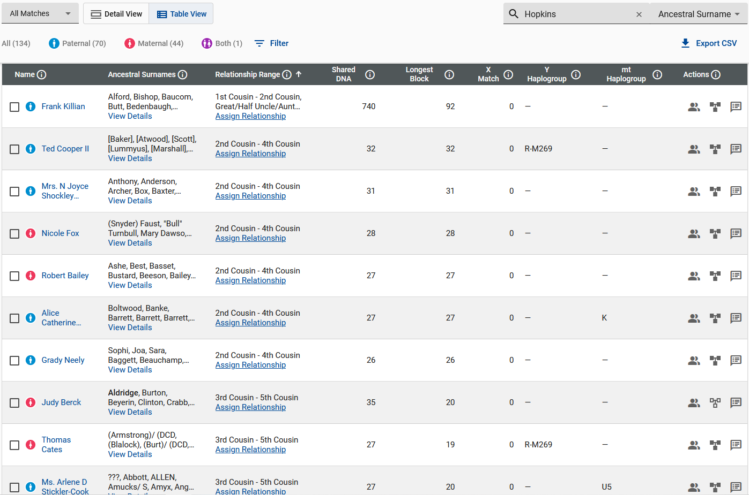

Slide 74
Jefferson Jeffery T Bartee
1832 VA - 1901 NC
Married
Emily
Hopkins
1828 NC - 1900 NC
Enoch
Terry
1810 VA - 1880 NC
Married
Edna
Wilkerson
1815 VA - 1880 NC
Tresvan
Gregory
1822 SC - 1899 SC
Married
Lavinia
Koon
1826 SC - 1889 SC
Phillip Anderson
Davis
1805 SC - 1882 SC
Married
Elizabeth Frances
McJunkin
1820 SC - 1904 SC
General Edward
Taylor
1814 SC - 1896 SC
Married 2nd Wife
Mary
Knight
1839 SC - 1915 SC
Richard Maryland
Bartee
1861 NC - 1938 NC
Married
Sarah Sahara Virginia Terry
1856 NC - 1921 SC
Frances Edwin
Davis
1855 SC - 1940 SC
Married
Mary Elizabeth
Gregory
1858 SC - 1898 SC
Catherine
Lipford
1841 SC - 1906 SC
Married 2nd Husband
William Jefferson Nathan
Davis
1838 SC - 1874 SC
Thomas Elijah
Taylor
1868 SC - 1945 SC
Married
Frances Elizabeth “Fannie”
Davis
1868 SC - 1914 SC
Eugene Tamlin
Smith (Bartee-Terry)
1881 NC - 1973 KS
Y-DNA 111 Match
Autosomal DNA Match
Brother Claude Smith
Married
Autosomal DNA Match
Clara Desdemonia
Davis
1880 SC - 1970 GA
William
Davis
Henry
Davis
Samuel
Davis
Frances Elizabeth “Fannie”
Davis
Thomas
Taylor
Claude Tresvan Killian
1898 SC - 1973 SC
Killian Y-DNA Not Match, Bartee Y-DNA 111 Match
Davis, Gregory, McJunkin, Koon, Bartee, Terry, Hopkins, Wilkerson Autosomal DNA
Vivian
Taylor
Mamie O.
Taylor
Malcom
Taylor

Slide 75
Jefferson Jeffery T Bartee
1832 VA - 1901 NC
Married
Emily
Hopkins
1828 NC - 1900 NC
Enoch
Terry
1810 VA - 1880 NC
Married
Edna
Wilkerson
1815 VA - 1880 NC
Tresvan
Gregory
1822 SC - 1899 SC
Married
Lavinia
Koon
1826 SC - 1889 SC
Phillip Anderson
Davis
1805 SC - 1882 SC
Married
Elizabeth Frances
McJunkin
1820 SC - 1904 SC
General Edward
Taylor
1814 SC - 1896 SC
Married 2nd Wife
Mary
Knight
1839 SC - 1915 SC
Richard Maryland
Bartee
1861 NC - 1938 NC
Married
Sarah Sahara Virginia Terry
1856 NC - 1921 SC
Frances Edwin
Davis
1855 SC - 1940 SC
Married
Mary Elizabeth
Gregory
1858 SC - 1898 SC
Catherine
Lipford
1841 SC - 1906 SC
Married 2nd Husband
William Jefferson Nathan
Davis
1838 SC - 1874 SC
Thomas Elijah
Taylor
1868 SC - 1945 SC
Married
Frances Elizabeth “Fannie”
Davis
1868 SC - 1914 SC
Eugene Tamlin
Smith (Bartee-Terry)
1881 NC - 1973 KS
Y-DNA 111 Match
Autosomal DNA Match
Brother Claude Smith
Married
Autosomal DNA Match
Clara Desdemonia
Davis
1880 SC - 1970 GA
William
Davis
Henry
Davis
Samuel
Davis
Frances Elizabeth “Fannie”
Davis
Thomas
Taylor
Claude Tresvan Killian
1898 SC - 1973 SC
Killian Y-DNA Not Match, Bartee Y-DNA 111 Match
Davis, Gregory, McJunkin, Koon, Bartee, Terry, Hopkins, Wilkerson Autosomal DNA
Vivian
Taylor
Mamie O.
Taylor
Malcom
Taylor

Slide 76
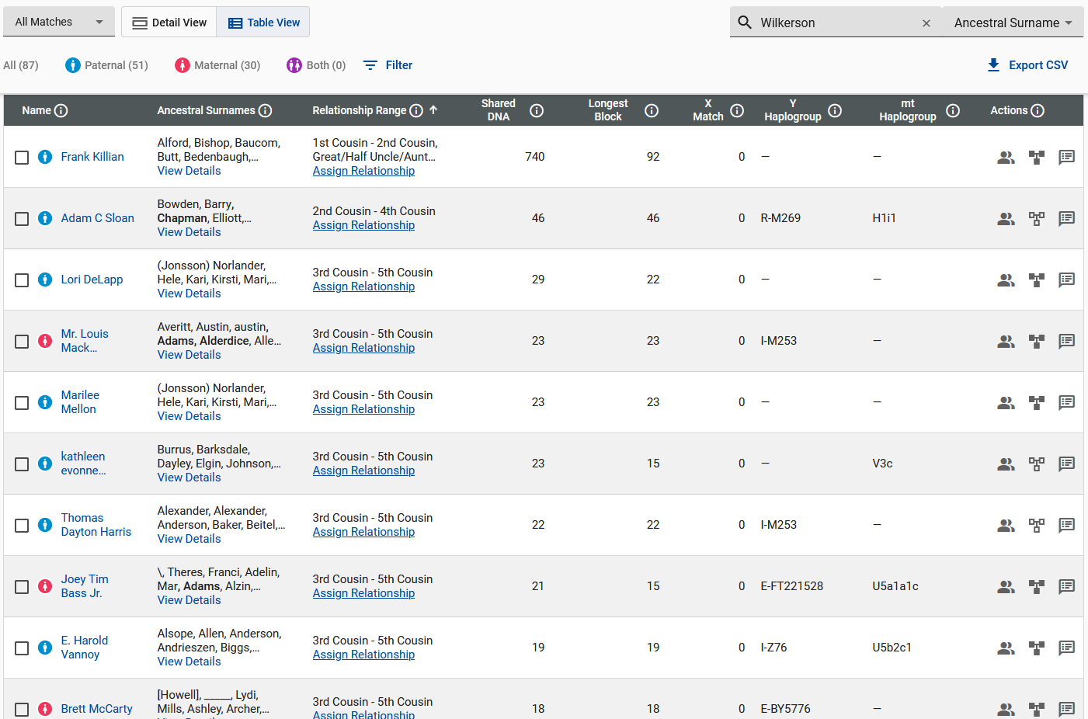

Slide 77
Jefferson Jeffery T Bartee
1832 VA - 1901 NC
Married
Emily
Hopkins
1828 NC - 1900 NC
Enoch
Terry
1810 VA - 1880 NC
Married
Edna
Wilkerson
1815 VA - 1880 NC
Tresvan
Gregory
1822 SC - 1899 SC
Married
Lavinia
Koon
1826 SC - 1889 SC
Phillip Anderson
Davis
1805 SC - 1882 SC
Married
Elizabeth Frances
McJunkin
1820 SC - 1904 SC
General Edward
Taylor
1814 SC - 1896 SC
Married 1st Wife
Nancy
Chapman
1824 SC - 1866 SC
General Edward
Taylor
1814 SC - 1896 SC
Married 2nd Wife
Mary
Knight
1839 SC - 1915 SC
Richard Maryland
Bartee
1861 NC - 1938 NC
Married
Sarah Sahara Virginia Terry
1856 NC - 1921 SC
Frances Edwin
Davis
1855 SC - 1940 SC
Married
Mary Elizabeth
Gregory
1858 SC - 1898 SC
Catherine
Lipford
1841 SC - 1906 SC
Married 2nd Husband
William Jefferson Nathan
Davis
1838 SC - 1874 SC
Thomas Elijah
Taylor
1868 SC - 1945 SC
Married
Frances Elizabeth “Fannie”
Davis
1868 SC - 1914 SC
Eugene Tamlin
Smith (Bartee-Terry)
1881 NC - 1973 KS
Y-DNA 111 Match
Autosomal DNA Match
Brother Claude Smith
Married
Autosomal DNA Match
Clara Desdemonia
Davis
1880 SC - 1970 GA
William
Davis
Henry
Davis
Samuel
Davis
Frances Elizabeth “Fannie”
Davis
Thomas
Taylor
Claude Tresvan Killian
1898 SC - 1973 SC
Killian Y-DNA Not Match, Bartee Y-DNA 111 Match
Davis, Gregory, McJunkin, Koon, Bartee, Terry, Hopkins, Wilkerson Autosomal DNA
Vivian
Taylor
Mamie O.
Taylor
Malcom
Taylor

Slide 78
Jefferson Jeffery T Bartee
1832 VA - 1901 NC
Married
Emily
Hopkins
1828 NC - 1900 NC
Enoch
Terry
1810 VA - 1880 NC
Married
Edna
Wilkerson
1815 VA - 1880 NC
Tresvan
Gregory
1822 SC - 1899 SC
Married
Lavinia
Koon
1826 SC - 1889 SC
Phillip Anderson
Davis
1805 SC - 1882 SC
Married
Elizabeth Frances
McJunkin
1820 SC - 1904 SC
General Edward
Taylor
1814 SC - 1896 SC
Married 1st Wife
Nancy
Chapman
1824 SC - 1866 SC
General Edward
Taylor
1814 SC - 1896 SC
Married 2nd Wife
Mary
Knight
1839 SC - 1915 SC
Richard Maryland
Bartee
1861 NC - 1938 NC
Married
Sarah Sahara Virginia Terry
1856 NC - 1921 SC
Frances Edwin
Davis
1855 SC - 1940 SC
Married
Mary Elizabeth
Gregory
1858 SC - 1898 SC
Catherine
Lipford
1841 SC - 1906 SC
Married 2nd Husband
William Jefferson Nathan
Davis
1838 SC - 1874 SC
Edward Miles
Taylor
1850 SC - 1923 SC
Married
Charlotte Caroline
Poole
1841-1913
Thomas Elijah
Taylor
1868 SC - 1945 SC
Married
Frances Elizabeth “Fannie”
Davis
1868 SC - 1914 SC
Eugene Tamlin
Smith (Bartee-Terry)
1881 NC - 1973 KS
Y-DNA 111 Match
Autosomal DNA Match
Brother Claude Smith
Married
Autosomal DNA Match
Clara Desdemonia
Davis
1880 SC - 1970 GA
William
Davis
Henry
Davis
Samuel
Davis
Frances Elizabeth “Fannie”
Davis
Thomas
Taylor
Claude Tresvan Killian
1898 SC - 1973 SC
Killian Y-DNA Not Match, Bartee Y-DNA 111 Match
Davis, Gregory, McJunkin, Koon, Bartee, Terry, Hopkins, Wilkerson Autosomal DNA
Vivian
Taylor
Mamie O.
Taylor
Malcom
Taylor

Slide 79
Jefferson Jeffery T Bartee
1832 VA - 1901 NC
Married
Emily
Hopkins
1828 NC - 1900 NC
Enoch
Terry
1810 VA - 1880 NC
Married
Edna
Wilkerson
1815 VA - 1880 NC
Tresvan
Gregory
1822 SC - 1899 SC
Married
Lavinia
Koon
1826 SC - 1889 SC
Phillip Anderson
Davis
1805 SC - 1882 SC
Married
Elizabeth Frances
McJunkin
1820 SC - 1904 SC
General Edward
Taylor
1814 SC - 1896 SC
Married 1st Wife
Nancy
Chapman
1824 SC - 1866 SC
General Edward
Taylor
1814 SC - 1896 SC
Married 2nd Wife
Mary
Knight
1839 SC - 1915 SC
Richard Maryland
Bartee
1861 NC - 1938 NC
Married
Sarah Sahara Virginia Terry
1856 NC - 1921 SC
Frances Edwin
Davis
1855 SC - 1940 SC
Married
Mary Elizabeth
Gregory
1858 SC - 1898 SC
Catherine
Lipford
1841 SC - 1906 SC
Married 2nd Husband
William Jefferson Nathan
Davis
1838 SC - 1874 SC
Edward Miles
Taylor
1850 SC - 1923 SC
Married
Charlotte Caroline
Poole
1841-1913
Thomas Elijah
Taylor
1868 SC - 1945 SC
Married
Frances Elizabeth “Fannie”
Davis
1868 SC - 1914 SC
Eugene Tamlin
Smith (Bartee-Terry)
1881 NC - 1973 KS
Y-DNA 111 Match
Autosomal DNA Match
Brother Claude Smith
Married
Autosomal DNA Match
Clara Desdemonia
Davis
1880 SC - 1970 GA
William
Davis
Edward Tapley
Taylor
1870 SC - 1935 SC
Married
Martha Savilla “Mattie” Jeffares
1869 SC – 1908 SC
Henry
Davis
Samuel
Davis
Frances Elizabeth “Fannie”
Davis
Thomas
Taylor
Claude Tresvan Killian
1898 SC - 1973 SC
Killian Y-DNA Not Match, Bartee Y-DNA 111 Match
Davis, Gregory, McJunkin, Koon, Bartee, Terry, Hopkins, Wilkerson Autosomal DNA
Vivian
Taylor
Mamie O.
Taylor
Malcom
Taylor

Slide 80
Jefferson Jeffery T Bartee
1832 VA - 1901 NC
Married
Emily
Hopkins
1828 NC - 1900 NC
Enoch
Terry
1810 VA - 1880 NC
Married
Edna
Wilkerson
1815 VA - 1880 NC
Tresvan
Gregory
1822 SC - 1899 SC
Married
Lavinia
Koon
1826 SC - 1889 SC
Phillip Anderson
Davis
1805 SC - 1882 SC
Married
Elizabeth Frances
McJunkin
1820 SC - 1904 SC
General Edward
Taylor
1814 SC - 1896 SC
Married 1st Wife
Nancy
Chapman
1824 SC - 1866 SC
General Edward
Taylor
1814 SC - 1896 SC
Married 2nd Wife
Mary
Knight
1839 SC - 1915 SC
Richard Maryland
Bartee
1861 NC - 1938 NC
Married
Sarah Sahara Virginia Terry
1856 NC - 1921 SC
Frances Edwin
Davis
1855 SC - 1940 SC
Married
Mary Elizabeth
Gregory
1858 SC - 1898 SC
Catherine
Lipford
1841 SC - 1906 SC
Married 2nd Husband
William Jefferson Nathan
Davis
1838 SC - 1874 SC
Edward Miles
Taylor
1850 SC - 1923 SC
Married
Charlotte Caroline
Poole
1841-1913
Thomas Elijah
Taylor
1868 SC - 1945 SC
Married
Frances Elizabeth “Fannie”
Davis
1868 SC - 1914 SC
Eugene Tamlin
Smith (Bartee-Terry)
1881 NC - 1973 KS
Y-DNA 111 Match
Autosomal DNA Match
Brother Claude Smith
Married
Autosomal DNA Match
Clara Desdemonia
Davis
1880 SC - 1970 GA
William
Davis
Edward Tapley
Taylor
1870 SC - 1935 SC
Married
Martha Savilla “Mattie” Jeffares
1869 SC – 1908 SC
Henry
Davis
Samuel
Davis
Frances Elizabeth “Fannie”
Davis
Mary Isabel
Taylor
1897 SC - 1990 NC
Thomas
Taylor
Claude Tresvan Killian
1898 SC - 1973 SC
Killian Y-DNA Not Match, Bartee Y-DNA 111 Match
Davis, Gregory, McJunkin, Koon, Bartee, Terry, Hopkins, Wilkerson Autosomal DNA
Vivian
Taylor
Mamie O.
Taylor
Malcom
Taylor

Slide 81
Jefferson Jeffery T Bartee
1832 VA - 1901 NC
Married
Emily
Hopkins
1828 NC - 1900 NC
Enoch
Terry
1810 VA - 1880 NC
Married
Edna
Wilkerson
1815 VA - 1880 NC
Tresvan
Gregory
1822 SC - 1899 SC
Married
Lavinia
Koon
1826 SC - 1889 SC
Phillip Anderson
Davis
1805 SC - 1882 SC
Married
Elizabeth Frances
McJunkin
1820 SC - 1904 SC
General Edward
Taylor
1814 SC - 1896 SC
Married 1st Wife
Nancy
Chapman
1824 SC - 1866 SC
General Edward
Taylor
1814 SC - 1896 SC
Married 2nd Wife
Mary
Knight
1839 SC - 1915 SC
Richard Maryland
Bartee
1861 NC - 1938 NC
Married
Sarah Sahara Virginia Terry
1856 NC - 1921 SC
Frances Edwin
Davis
1855 SC - 1940 SC
Married
Mary Elizabeth
Gregory
1858 SC - 1898 SC
Catherine
Lipford
1841 SC - 1906 SC
Married 2nd Husband
William Jefferson Nathan
Davis
1838 SC - 1874 SC
Edward Miles
Taylor
1850 SC - 1923 SC
Married
Charlotte Caroline
Poole
1841-1913
Eugene Tamlin
Smith (Bartee-Terry)
1881 NC - 1973 KS
Y-DNA 111 Match
Autosomal DNA Match
Brother Claude Smith
Married
Autosomal DNA Match
Clara Desdemonia
Davis
1880 SC - 1970 GA
William
Davis
Edward Tapley
Taylor
1870 SC - 1935 SC
Married
Martha Savilla “Mattie” Jeffares
1869 SC – 1908 SC
Thomas Elijah
Taylor
1868 SC - 1945 SC
Married
Frances Elizabeth “Fannie”
Davis
1868 SC - 1914 SC
Henry
Davis
Samuel
Davis
Frances Elizabeth “Fannie”
Davis
Mary Isabel
Taylor
1897 SC - 1990 NC
Thomas
Taylor
Vivian
Taylor
Claude Tresvan Killian
1898 SC - 1973 SC
Killian Y-DNA Not Match, Bartee Y-DNA 111 Match
Davis, Gregory, McJunkin, Koon, Bartee, Terry, Hopkins, Wilkerson Autosomal DNA
Mamie O.
Taylor
Malcom
Taylor

Slide 82
Jefferson Jeffery T Bartee
1832 VA - 1901 NC
Married
Emily
Hopkins
1828 NC - 1900 NC
Enoch
Terry
1810 VA - 1880 NC
Married
Edna
Wilkerson
1815 VA - 1880 NC
Tresvan
Gregory
1822 SC - 1899 SC
Married
Lavinia
Koon
1826 SC - 1889 SC
Phillip Anderson
Davis
1805 SC - 1882 SC
Married
Elizabeth Frances
McJunkin
1820 SC - 1904 SC
General Edward
Taylor
1814 SC - 1896 SC
Married 1st Wife
Nancy
Chapman
1824 SC - 1866 SC
General Edward
Taylor
1814 SC - 1896 SC
Married 2nd Wife
Mary
Knight
1839 SC - 1915 SC
Richard Maryland
Bartee
1861 NC - 1938 NC
Married
Sarah Sahara Virginia Terry
1856 NC - 1921 SC
Frances Edwin
Davis
1855 SC - 1940 SC
Married
Mary Elizabeth
Gregory
1858 SC - 1898 SC
Catherine
Lipford
1841 SC - 1906 SC
Married 2nd Husband
William Jefferson Nathan
Davis
1838 SC - 1874 SC
Edward Miles
Taylor
1850 SC - 1923 SC
Married
Charlotte Caroline
Poole
1841-1913
Eugene Tamlin
Smith (Bartee-Terry)
1881 NC - 1973 KS
Y-DNA 111 Match
Autosomal DNA Match
Brother Claude Smith
Married
Autosomal DNA Match
Clara Desdemonia
Davis
1880 SC - 1970 GA
William
Davis
Edward Tapley
Taylor
1870 SC - 1935 SC
Married
Martha Savilla “Mattie” Jeffares
1869 SC – 1908 SC
Thomas Elijah
Taylor
1868 SC - 1945 SC
Married
Frances Elizabeth “Fannie”
Davis
1868 SC - 1914 SC
Henry
Davis
Samuel
Davis
Frances Elizabeth “Fannie”
Davis
Mary Isabel
Taylor
1897 SC - 1990 NC
Thomas
Taylor
Vivian
Taylor
Claude Tresvan Killian
1898 SC - 1973 SC
Killian Y-DNA Not Match, Bartee Y-DNA 111 Match
Davis, Gregory, McJunkin, Koon, Bartee, Terry, Hopkins, Wilkerson Autosomal DNA
Mamie O.
Taylor
Malcom
Taylor
Mary Isabell Taylor
1897 SC – 1990 NC
Taylor Autosomal DNA

Slide 83
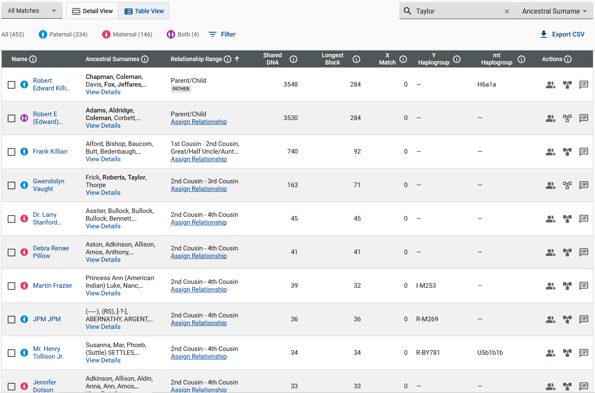

Slide 84
Jefferson Jeffery T Bartee
1832 VA - 1901 NC
Married
Emily
Hopkins
1828 NC - 1900 NC
Enoch
Terry
1810 VA - 1880 NC
Married
Edna
Wilkerson
1815 VA - 1880 NC
Tresvan
Gregory
1822 SC - 1899 SC
Married
Lavinia
Koon
1826 SC - 1889 SC
Phillip Anderson
Davis
1805 SC - 1882 SC
Married
Elizabeth Frances
McJunkin
1820 SC - 1904 SC
General Edward
Taylor
1814 SC - 1896 SC
Married 1st Wife
Nancy
Chapman
1824 SC - 1866 SC
General Edward
Taylor
1814 SC - 1896 SC
Married 2nd Wife
Mary
Knight
1839 SC - 1915 SC
Richard Maryland
Bartee
1861 NC - 1938 NC
Married
Sarah Sahara Virginia Terry
1856 NC - 1921 SC
Frances Edwin
Davis
1855 SC - 1940 SC
Married
Mary Elizabeth
Gregory
1858 SC - 1898 SC
Catherine
Lipford
1841 SC - 1906 SC
Married 2nd Husband
William Jefferson Nathan
Davis
1838 SC - 1874 SC
Edward Miles
Taylor
1850 SC - 1923 SC
Married
Charlotte Caroline
Poole
1841-1913
Eugene Tamlin
Smith (Bartee-Terry)
1881 NC - 1973 KS
Y-DNA 111 Match
Autosomal DNA Match
Brother Claude Smith
Married
Autosomal DNA Match
Clara Desdemonia
Davis
1880 SC - 1970 GA
William
Davis
Edward Tapley
Taylor
1870 SC - 1935 SC
Married
Martha Savilla “Mattie” Jeffares
1869 SC – 1908 SC
Thomas Elijah
Taylor
1868 SC - 1945 SC
Married
Frances Elizabeth “Fannie”
Davis
1868 SC - 1914 SC
Henry
Davis
Samuel
Davis
Frances Elizabeth “Fannie”
Davis
Mary Isabel
Taylor
1897 SC - 1990 NC
Thomas
Taylor
Vivian
Taylor
Claude Tresvan Killian
1898 SC - 1973 SC
Killian Y-DNA Not Match, Bartee Y-DNA 111 Match
Davis, Gregory, McJunkin, Koon, Bartee, Terry, Hopkins, Wilkerson Autosomal DNA
Mamie O.
Taylor
Malcom
Taylor
Mary Isabell Taylor
1897 SC – 1990 NC
Taylor, Chapman Autosomal DNA

Slide 85
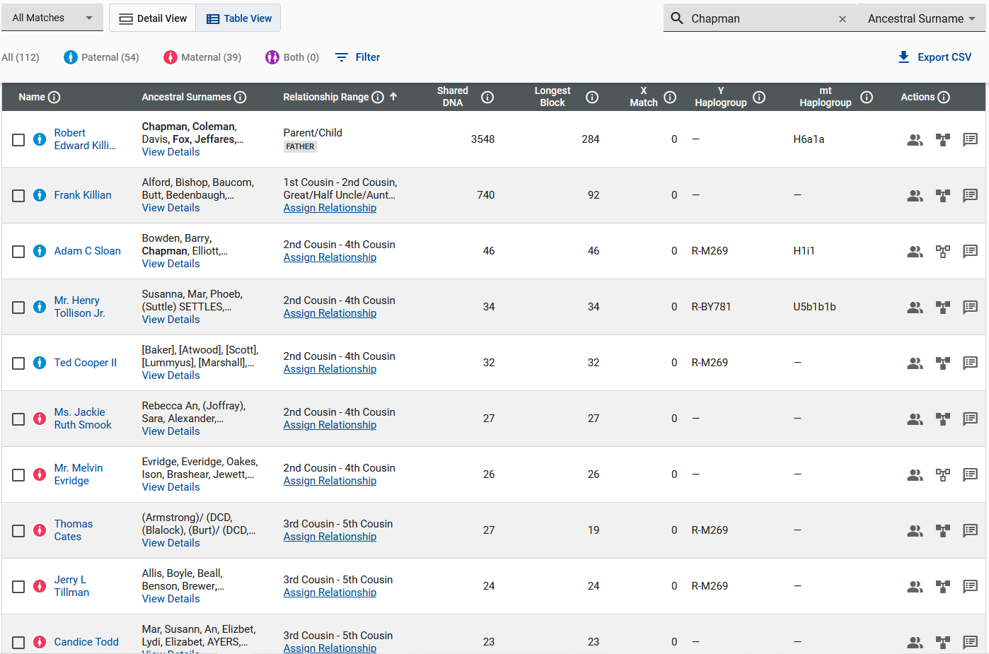

Slide 86
Jefferson Jeffery T Bartee
1832 VA - 1901 NC
Married
Emily
Hopkins
1828 NC - 1900 NC
Enoch
Terry
1810 VA - 1880 NC
Married
Edna
Wilkerson
1815 VA - 1880 NC
Tresvan
Gregory
1822 SC - 1899 SC
Married
Lavinia
Koon
1826 SC - 1889 SC
Phillip Anderson
Davis
1805 SC - 1882 SC
Married
Elizabeth Frances
McJunkin
1820 SC - 1904 SC
General Edward
Taylor
1814 SC - 1896 SC
Married 1st Wife
Nancy
Chapman
1824 SC - 1866 SC
General Edward
Taylor
1814 SC - 1896 SC
Married 2nd Wife
Mary
Knight
1839 SC - 1915 SC
Richard Maryland
Bartee
1861 NC - 1938 NC
Married
Sarah Sahara Virginia Terry
1856 NC - 1921 SC
Frances Edwin
Davis
1855 SC - 1940 SC
Married
Mary Elizabeth
Gregory
1858 SC - 1898 SC
Catherine
Lipford
1841 SC - 1906 SC
Married 2nd Husband
William Jefferson Nathan
Davis
1838 SC - 1874 SC
Edward Miles
Taylor
1850 SC - 1923 SC
Married
Charlotte Caroline
Poole
1841-1913
Eugene Tamlin
Smith (Bartee-Terry)
1881 NC - 1973 KS
Y-DNA 111 Match
Autosomal DNA Match
Brother Claude Smith
Married
Autosomal DNA Match
Clara Desdemonia
Davis
1880 SC - 1970 GA
William
Davis
Edward Tapley
Taylor
1870 SC - 1935 SC
Married
Martha Savilla “Mattie” Jeffares
1869 SC – 1908 SC
Thomas Elijah
Taylor
1868 SC - 1945 SC
Married
Frances Elizabeth “Fannie”
Davis
1868 SC - 1914 SC
Henry
Davis
Samuel
Davis
Frances Elizabeth “Fannie”
Davis
Mary Isabel
Taylor
1897 SC - 1990 NC
Thomas
Taylor
Vivian
Taylor
Claude Tresvan Killian
1898 SC - 1973 SC
Killian Y-DNA Not Match, Bartee Y-DNA 111 Match
Davis, Gregory, McJunkin, Koon, Bartee, Terry, Hopkins, Wilkerson Autosomal DNA
Mamie O.
Taylor
Malcom
Taylor
Mary Isabell Taylor
1897 SC – 1990 NC
Taylor, Chapman, Poole Autosomal DNA

Slide 87
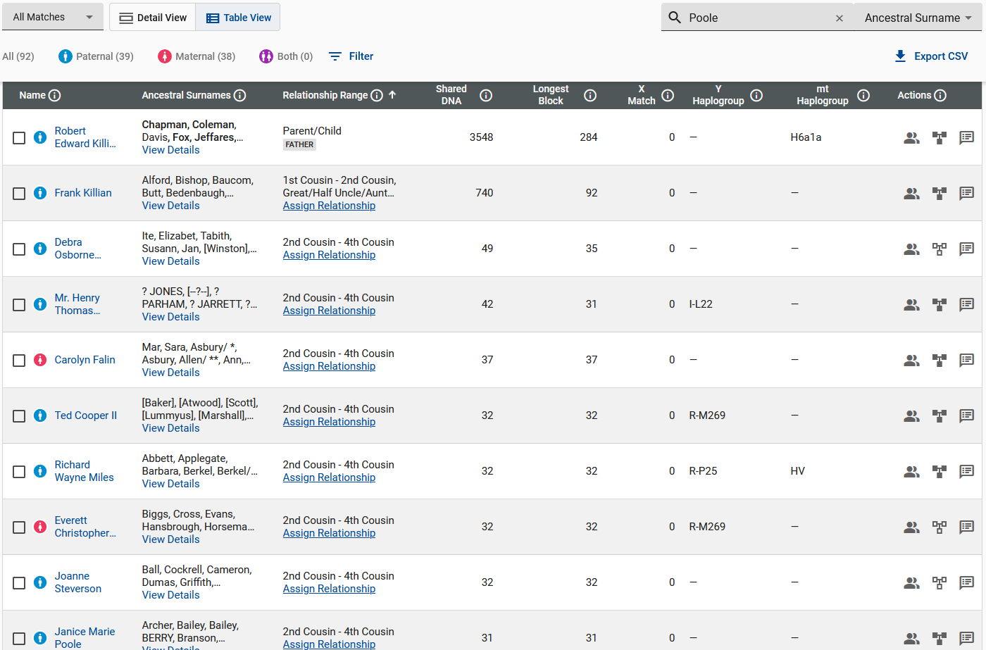

Slide 88
Jefferson Jeffery T Bartee
1832 VA - 1901 NC
Married
Emily
Hopkins
1828 NC - 1900 NC
Enoch
Terry
1810 VA - 1880 NC
Married
Edna
Wilkerson
1815 VA - 1880 NC
Tresvan
Gregory
1822 SC - 1899 SC
Married
Lavinia
Koon
1826 SC - 1889 SC
Phillip Anderson
Davis
1805 SC - 1882 SC
Married
Elizabeth Frances
McJunkin
1820 SC - 1904 SC
General Edward
Taylor
1814 SC - 1896 SC
Married 1st Wife
Nancy
Chapman
1824 SC - 1866 SC
General Edward
Taylor
1814 SC - 1896 SC
Married 2nd Wife
Mary
Knight
1839 SC - 1915 SC
Richard Maryland
Bartee
1861 NC - 1938 NC
Married
Sarah Sahara Virginia Terry
1856 NC - 1921 SC
Frances Edwin
Davis
1855 SC - 1940 SC
Married
Mary Elizabeth
Gregory
1858 SC - 1898 SC
Catherine
Lipford
1841 SC - 1906 SC
Married 2nd Husband
William Jefferson Nathan
Davis
1838 SC - 1874 SC
Edward Miles
Taylor
1850 SC - 1923 SC
Married
Charlotte Caroline
Poole
1841-1913
Eugene Tamlin
Smith (Bartee-Terry)
1881 NC - 1973 KS
Y-DNA 111 Match
Autosomal DNA Match
Brother Claude Smith
Married
Autosomal DNA Match
Clara Desdemonia
Davis
1880 SC - 1970 GA
William
Davis
Edward Tapley
Taylor
1870 SC - 1935 SC
Married
Martha Savilla “Mattie” Jeffares
1869 SC – 1908 SC
Thomas Elijah
Taylor
1868 SC - 1945 SC
Married
Frances Elizabeth “Fannie”
Davis
1868 SC - 1914 SC
Henry
Davis
Samuel
Davis
Frances Elizabeth “Fannie”
Davis
Mary Isabel
Taylor
1897 SC - 1990 NC
Thomas
Taylor
Vivian
Taylor
Claude Tresvan Killian
1898 SC - 1973 SC
Killian Y-DNA Not Match, Bartee Y-DNA 111 Match
Davis, Gregory, McJunkin, Koon, Bartee, Terry, Hopkins, Wilkerson Autosomal DNA
Mamie O.
Taylor
Malcom
Taylor
Mary Isabell Taylor
1897 SC – 1990 NC
Taylor, Chapman, Poole, Jeffares Autosomal DNA

Slide 90
Jefferson Jeffery T Bartee
1832 VA - 1901 NC
Married
Emily
Hopkins
1828 NC - 1900 NC
Enoch
Terry
1810 VA - 1880 NC
Married
Edna
Wilkerson
1815 VA - 1880 NC
Tresvan
Gregory
1822 SC - 1899 SC
Married
Lavinia
Koon
1826 SC - 1889 SC
Phillip Anderson
Davis
1805 SC - 1882 SC
Married
Elizabeth Frances
McJunkin
1820 SC - 1904 SC
General Edward
Taylor
1814 SC - 1896 SC
Married 1st Wife
Nancy
Chapman
1824 SC - 1866 SC
General Edward
Taylor
1814 SC - 1896 SC
Married 2nd Wife
Mary
Knight
1839 SC - 1915 SC
Richard Maryland
Bartee
1861 NC - 1938 NC
Married
Sarah Sahara Virginia Terry
1856 NC - 1921 SC
Frances Edwin
Davis
1855 SC - 1940 SC
Married
Mary Elizabeth
Gregory
1858 SC - 1898 SC
Catherine
Lipford
1841 SC - 1906 SC
Married 2nd Husband
William Jefferson Nathan
Davis
1838 SC - 1874 SC
Edward Miles
Taylor
1850 SC - 1923 SC
Married
Charlotte Caroline
Poole
1841-1913
Eugene Tamlin
Smith (Bartee-Terry)
1881 NC - 1973 KS
Y-DNA 111 Match
Autosomal DNA Match
Brother Claude Smith
Married
Autosomal DNA Match
Clara Desdemonia
Davis
1880 SC - 1970 GA
William
Davis
Edward Tapley
Taylor
1870 SC - 1935 SC
Married
Martha Savilla “Mattie” Jeffares
1869 SC – 1908 SC
Thomas Elijah
Taylor
1868 SC - 1945 SC
Married
Frances Elizabeth “Fannie”
Davis
1868 SC - 1914 SC
Henry
Davis
Samuel
Davis
Frances Elizabeth “Fannie”
Davis
Mary Isabel
Taylor
1897 SC - 1990 NC
Thomas
Taylor
Vivian
Taylor
Claude Tresvan Killian
1898 SC - 1973 SC
Killian Y-DNA Not Match, Bartee Y-DNA 111 Match
Davis, Gregory, McJunkin, Koon, Bartee, Terry, Hopkins, Wilkerson Autosomal DNA
1st Cousin’s
One Generation Removed
Mamie O.
Taylor
Malcom
Taylor

Slide 91
Jefferson Jeffery T Bartee
1832 VA - 1901 NC
Married
Emily
Hopkins
1828 NC - 1900 NC
Enoch
Terry
1810 VA - 1880 NC
Married
Edna
Wilkerson
1815 VA - 1880 NC
Tresvan
Gregory
1822 SC - 1899 SC
Married
Lavinia
Koon
1826 SC - 1889 SC
Phillip Anderson
Davis
1805 SC - 1882 SC
Married
Elizabeth Frances
McJunkin
1820 SC - 1904 SC
General Edward
Taylor
1814 SC - 1896 SC
Married 1st Wife
Nancy
Chapman
1824 SC - 1866 SC
General Edward
Taylor
1814 SC - 1896 SC
Married 2nd Wife
Mary
Knight
1839 SC - 1915 SC
Richard Maryland
Bartee
1861 NC - 1938 NC
Married
Sarah Sahara Virginia Terry
1856 NC - 1921 SC
Frances Edwin
Davis
1855 SC - 1940 SC
Married
Mary Elizabeth
Gregory
1858 SC - 1898 SC
Catherine
Lipford
1841 SC - 1906 SC
Married 2nd Husband
William Jefferson Nathan
Davis
1838 SC - 1874 SC
Edward Miles
Taylor
1850 SC - 1923 SC
Married
Charlotte Caroline
Poole
1841-1913
Eugene Tamlin
Smith (Bartee-Terry)
1881 NC - 1973 KS
Y-DNA 111 Match
Autosomal DNA Match
Brother Claude Smith
Married
Autosomal DNA Match
Clara Desdemonia
Davis
1880 SC - 1970 GA
William
Davis
Edward Tapley
Taylor
1870 SC - 1935 SC
Married
Martha Savilla “Mattie” Jeffares
1869 SC – 1908 SC
Thomas Elijah
Taylor
1868 SC - 1945 SC
Married
Frances Elizabeth “Fannie”
Davis
1868 SC - 1914 SC
Henry
Davis
Samuel
Davis
Frances Elizabeth “Fannie”
Davis
Mary Isabel
Taylor
1897 SC - 1990 NC
Thomas
Taylor
Vivian
Taylor
Claude Tresvan Killian
1898 SC - 1973 SC
Killian Y-DNA Not Match, Bartee Y-DNA 111 Match
Davis, Gregory, McJunkin, Koon, Bartee, Terry, Hopkins, Wilkerson Autosomal DNA
Mamie O.
Taylor
Malcom
Taylor

Slide 92
Jefferson Jeffery T Bartee
1832 VA - 1901 NC
Married
Emily
Hopkins
1828 NC - 1900 NC
Enoch
Terry
1810 VA - 1880 NC
Married
Edna
Wilkerson
1815 VA - 1880 NC
Tresvan
Gregory
1822 SC - 1899 SC
Married
Lavinia
Koon
1826 SC - 1889 SC
Phillip Anderson
Davis
1805 SC - 1882 SC
Married
Elizabeth Frances
McJunkin
1820 SC - 1904 SC
General Edward
Taylor
1814 SC - 1896 SC
Married 1st Wife
Nancy
Chapman
1824 SC - 1866 SC
General Edward
Taylor
1814 SC - 1896 SC
Married 2nd Wife
Mary
Knight
1839 SC - 1915 SC
Richard Maryland
Bartee
1861 NC - 1938 NC
Married
Sarah Sahara Virginia Terry
1856 NC - 1921 SC
Frances Edwin
Davis
1855 SC - 1940 SC
Married
Mary Elizabeth
Gregory
1858 SC - 1898 SC
Catherine
Lipford
1841 SC - 1906 SC
Married 2nd Husband
William Jefferson Nathan
Davis
1838 SC - 1874 SC
Edward Miles
Taylor
1850 SC - 1923 SC
Married
Charlotte Caroline
Poole
1841-1913
Eugene Tamlin
Smith (Bartee-Terry)
1881 NC - 1973 KS
Y-DNA 111 Match
Autosomal DNA Match
Brother Claude Smith
Married
Autosomal DNA Match
Clara Desdemonia
Davis
1880 SC - 1970 GA
William
Davis
Edward Tapley
Taylor
1870 SC - 1935 SC
Married
Martha Savilla “Mattie” Jeffares
1869 SC – 1908 SC
Thomas Elijah
Taylor
1868 SC - 1945 SC
Married
Frances Elizabeth “Fannie”
Davis
1868 SC - 1914 SC
Henry
Davis
Samuel
Davis
Frances Elizabeth “Fannie”
Davis
Mary Isabell
Taylor
1897 SC - 1990 NC
Thomas
Taylor
Claude Tresvan Killian
Married 29 August 1916
Mary Isabell Taylor
Vivian
Taylor
Claude Tresvan Killian
1898 SC - 1973 SC
Mamie O.
Taylor
Malcom
Taylor

Slide 93
Jefferson Jeffery T Bartee
1832 VA - 1901 NC
Married
Emily
Hopkins
1828 NC - 1900 NC
Enoch
Terry
1810 VA - 1880 NC
Married
Edna
Wilkerson
1815 VA - 1880 NC
Tresvan
Gregory
1822 SC - 1899 SC
Married
Lavinia
Koon
1826 SC - 1889 SC
Phillip Anderson
Davis
1805 SC - 1882 SC
Married
Elizabeth Frances
McJunkin
1820 SC - 1904 SC
General Edward
Taylor
1814 SC - 1896 SC
Married 1st Wife
Nancy
Chapman
1824 SC - 1866 SC
General Edward
Taylor
1814 SC - 1896 SC
Married 2nd Wife
Mary
Knight
1839 SC - 1915 SC
Richard Maryland
Bartee
1861 NC - 1938 NC
Married
Sarah Sahara Virginia Terry
1856 NC - 1921 SC
Frances Edwin
Davis
1855 SC - 1940 SC
Married
Mary Elizabeth
Gregory
1858 SC - 1898 SC
Catherine
Lipford
1841 SC - 1906 SC
Married 2nd Husband
William Jefferson Nathan
Davis
1838 SC - 1874 SC
Edward Miles
Taylor
1850 SC - 1923 SC
Married
Charlotte Caroline
Poole
1841-1913
Eugene Tamlin
Smith (Bartee-Terry)
1881 NC - 1973 KS
Brother Claude Smith
Married
Clara Desdemonia
Davis
1880 SC - 1970 GA
William
Davis
Edward Tapley
Taylor
1870 SC - 1935 SC
Married
Martha Savilla “Mattie” Jeffares
1869 SC – 1908 SC
Thomas Elijah
Taylor
1868 SC - 1945 SC
Married
Frances Elizabeth “Fannie”
Davis
1868 SC - 1914 SC
Henry
Davis
Samuel
Davis
Frances Elizabeth “Fannie”
Davis
Mary Isabell
Taylor
1897 SC - 1990 NC
Thomas
Taylor
Claude Tresvan
Bartee-Davis (Killian)
1898 SC - 1973 SC
Married
Mary Isabel
Taylor
1897 SC - 1990 SC
Vivian
Taylor
Mamie O.
Taylor
“Bob” Robert Edward Killian Sr 1935 SC – 2017 SC
Killian Y-DNA Not Match, Bartee Y-DNA 111 Match
Pop’s: Davis, Gregory, McJunkin, Koon, Bartee, Terry, Hopkins, Wilkerson, Gma’s: Taylor, Jeffares, Coleman, Poole, Lyles, Chapman Autosomal DNA
Malcom
Taylor

Slide 94
Claude Tresvan Killian
1898 SC - 1973 SC
Bartee Y-DNA 111 Match
Davis Autosomal DNA
Bartee Autosomal DNA
Terry Autosomal DNA
Gregory Autosomal DNA
Hopkins Autosomal DNA
McJunkin Autosomal DNA
Koon Autosomal DNA
Wilkerson Autosomal DNA
Married
29 August 1916
Mary Isabel Taylor
1897 SC - 1990 SC
Taylor Autosomal DNA
Jeffares Autosomal DNA
Poole Autosomal DNA
Lyles Autosomal DNA
Coleman Autosomal DNA
Mobley Autosomal DNA
Chapman Autosomal DNA
1912
Attended/Stayed
Feasterville Academy
Called It Finishing School
Coleman, Feaster, Mobley
Association
CFM Association
Family and Friends
Annual Reunion (now 81st)

Slide 98
Henry Van
Killian
1836 NC - 1864 GA
Married
Catherine
Lipford
1841 SC - 1906 SC
John Alexander
Killian
1859 SC - 1944 SC
Married
Mary Ann
Melton
1871 SC - 1939 SC
Dora Elizabeth “Etta”
Killian
1862 SC - 1938 SC
Married 1880
Joseph Timothy
Bass
1856 SC - 1924 SC
Bass-Killian
Y-DNA Bass Match
Autosomal DNA Match
Davis, Gregory, Killian, Koon, Lipford, Mobley & Probably Others
Claude Tresvan Killian
1898 SC - 1973 SC
Bartee Y-DNA 111 Match
Davis Autosomal DNA
Bartee Autosomal DNA
Terry Autosomal DNA
Gregory Autosomal DNA
Hopkins Autosomal DNA
McJunkin Autosomal DNA
Koon Autosomal DNA
Wilkerson Autosomal DNA
Married
Mary Isabel Taylor
1897 SC - 1990 SC
Taylor Autosomal DNA
Jeffares Autosomal DNA
Poole Autosomal DNA
Lyles Autosomal DNA
Coleman Autosomal DNA
Mobley Autosomal DNA
Chapman Autosomal DNA

Slide 100
Parents of
Seven Children
Claude Tresvan “Pop”
Killian Sr
Born
7 October 1898
Fish Dam Township
Union County, SC
Died
5 May 1973
Chester
Chester County, SC
Buried
Chester Memorial Gardens
West Chester County, SC
Claude Tresvan “Pop” Killian 1898 SC - 1973 SC
Mary Isabel “Grandma” Taylor 1897 SC - 1990 SC

Slide 101
Parents of
Seven Children
Claude Tresvan “Pop”
Killian Sr
Born
7 October 1898
Fish Dam Township
Union County, SC
Died
5 May 1973
Chester
Chester County, SC
Buried
Chester Memorial Gardens
West Chester County, SC
Married
29 August 1916
Chester
Chester County, SC
Mary Isabell Taylor
Born
22 December 1897
Township 1
Fairfield County, SC
Died
3 March 1990
Presbyterian Hospital
Charlotte
Mecklenburg County, NC
Buried
Chester Memorial Gardens
West Chester County, SC
Claude Tresvan “Pop” Killian 1898 SC - 1973 SC
Mary Isabel “Grandma” Taylor 1897 SC - 1990 SC

Slide 102
Parents of
Seven Children
“C.T.” Claude Tresvan Killian Jr
“Johnny” John Alexander Killian
“Jake” Jesse Alexander Killian
“Bill” William Hardin Killian
Mary “Frances” Killian Montgomery
“Davis” Grady Killian
“Bob” Robert Edward Killian Sr
Claude Tresvan “Pop” Killian 1898 SC - 1973 SC
Mary Isabel “Grandma” Taylor 1897 SC - 1990 SC

Slide 103
Parents of
Seven Children
Claude Tresvan “C.T.”
Killian Jr
Born
20 June 1917
Township 1
Fairfield County, SC
Died
17 February 1980
Raleigh General Hospital
Raleigh
Wake County, NC
Buried
Forestville Baptist Church
Forestville
Wake County, NC
Married
3 July 1939
Baton Rouge Township
Chester County, SC
Nelma Jewel “Nell”
Moore
Born
17 January 1922
Charlotte
Mecklenburg County, NC
Died
4 April 2011
Piedmont Medical Center
Rock Hill
York County, SC
Burial Unknown
Claude Tresvan “Pop” Killian 1898 SC - 1973 SC
Mary Isabel “Grandma” Taylor 1897 SC - 1990 SC

Slide 104
Parents of
Seven Children
John Henry “Johnny”
Killian
Born
28 January 1920
Township 1
Fairfield County, SC
Died
3 November 1983
Fort Lawn
Chester County, SC
Buried
Chester Memorial Gardens
West Chester County, SC
Married
13 October 1940
Lowry’s Township
Chester County, SC
“Florine” Jessie Mae
Moore
Born
3 January 1920
Charlotte
Mecklenburg County, NC
Died
17 November 1990
Chester County Hospital
Chester
Chester County, SC
Buried
Chester Memorial Gardens
West Chester County, SC
Claude Tresvan “Pop” Killian 1898 SC - 1973 SC
Mary Isabel “Grandma” Taylor 1897 SC - 1990 SC

Slide 105
Parents of
Seven Children
Jessie Alexander “Jake”
Killian
Born
13 September 1922
Leeds Township
Chester County, SC
Died
15 October 2011
Peachland
Anson County, NC
Buried
Peachland City Cemetery
Anson County, NC
Married
25 May 1944
Chesterfield
Chesterfield County, SC
“Reba” Cornelia
Redfern
Born
21 June 1925
Anson County, NC
Died
18 April 2008
Autumn Care
Marshville
Union County, NC
Buried
Peachland City Cemetery
Anson County, NC
Claude Tresvan “Pop” Killian 1898 SC - 1973 SC
Mary Isabel “Grandma” Taylor 1897 SC - 1990 SC

Slide 106
Parents of
Seven Children
William Hardin “Bill”
Killian
Born
14 February 1925
Chester
Chester County, SC
Died
7 December 2006
Lexington County Hospital
Lexington County, SC
Buried
Chester Memorial Gardens
West Chester County, SC
Married
23 December 1949
Marshville
Union County, NC
“Betty” Arrilla
Baucom
Born
1 May 1930
Marshville
Union County, NC
Died
28 November 2014
Chester Memorial Hospital
Chester County, SC
Buried
Chester Memorial Gardens
West Chester County, SC
Claude Tresvan “Pop” Killian 1898 SC - 1973 SC
Mary Isabel “Grandma” Taylor 1897 SC - 1990 SC

Slide 107
Parents of
Seven Children
Mary “Frances”
Killian
Born
17 February 1928
Chester
Chester County, SC
Died
2 May 2008
Presbyterian Hospital
Charlotte
Mecklenburg County, NC
Buried
Lakeview Memory Gardens
York County, SC
Married
12 June 1948
Chester
Chester County, SC
James “Clyde”
Montgomery
Born
17 November 1920
Beersheba Township
York County, SC
Died
2 January 1994
Presbyterian Hospital
Charlotte
Mecklenburg County, NC
Buried
Lakeview Memory Gardens
York County, SC
Claude Tresvan “Pop” Killian 1898 SC - 1973 SC
Mary Isabel “Grandma” Taylor 1897 SC - 1990 SC

Slide 108
Parents of
Seven Children
“Davis” Grady
Killian
Born
12 November 1931
Chester
Chester County, SC
Died
19 March 2012
Fort Mill
York County, SC
Buried
Chester Memorial Gardens
West Chester County, SC
Married
26 July 1953
Chester
Chester County, SC
“Mary” Julia
Clowney
Born
6 May 1930
Blair Township
Fairfield County, SC
Died
8 January 2013
Fort Mill
York County, SC
Buried
Chester Memorial Gardens
West Chester County, SC
Claude Tresvan “Pop” Killian 1898 SC - 1973 SC
Mary Isabel “Grandma” Taylor 1897 SC - 1990 SC

Slide 109
Parents of
Seven Children
Robert “Bob” Edward
Killian Sr
Born
17 November 1935
Baton Rouge Township
Chester County, SC
Died
23 December 2017
West Columbia
Lexington County, SC
Buried
Fort Jackson National
Fort Jackson
Richland County, SC
Married
5 June 1955
Chester
Chester County, SC
Patricia “Pat” Ann
Hunter
Born
12 May 1937
Lancaster
Lancaster County, SC
--- Living ---
Claude Tresvan “Pop” Killian 1898 SC - 1973 SC
Mary Isabel “Grandma” Taylor 1897 SC - 1990 SC

